Slide 2
AAFP National Conference Family Medicine in Motion
Medical students, YOU are the future of family medicine.
Join the movement.
Immerse yourself in topics ranging from clinical skills and career planning, to the factors influencing the health care system. Leave with important connections and a plan to form your future in family medicine.
July 28-July 30, 2016
Kansas City, MO
www.aafp.org/nc
Notes:
More than 1,200 students and 1,100 residents attended last year’s National Conference of Family Medicine Residents and Medical Students.

Slide 3

See how your fellow medical students have formed their future at National Conference.
www.aafp.org/nc
Notes:
Link for video: http://www.aafp.org/aafp/medical-school-residency/choosing-fm/choose-knowledge.html

Slide 4
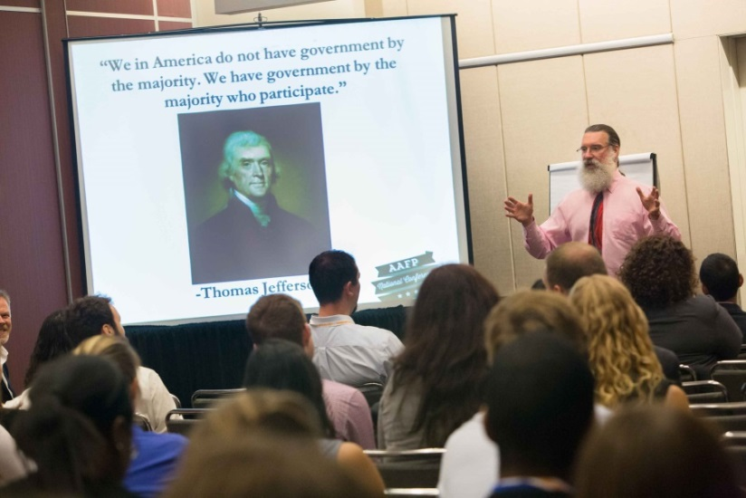
Educational Programming
Choose from main stage sessions, workshops, musculoskeletal clinics, procedural skills courses, and poster presentations covering more than 35 topics, including:
Applying to residency
Do’s and don’ts of residency interviewing
Procedures in family medicine
Global health
Wilderness medicine
Sessions are offered in six key focus areas:
Career planning
Clinical skills
Health policy and advocacy
Leadership development
Practice management
Research
www.aafp.org/nc
Notes:
A complete schedule will be available online in early April.

Slide 5
Nationally Recognized Speakers
Hear from family medicine leaders, prominent educators, public health officials, practice consultants, and health care researchers including:
Family Medicine for America’s Health
Members of the Family Medicine for America’s Health leadership team and physicians involved with the Health is Primary campaign will share information and innovations regarding primary care and the role students can have in shaping the future.
Wanda Filer, MD, FAAFP
2016 AAFP President
Maureen Murphy, MD, FAAFP
2015 AAFP Family Physician of the Year (FPOY)
www.aafp.org/nc
Notes:
-Full speaker bios, dates, and times for these presentations and more will be announced online later this spring.

Slide 6

Connect
Network with nationally recognized family medicine leaders and interact with hundreds of your peers from around the country who are passionate about family medicine.
Expo Hall Grand Opening: Join us at this Expo Hall kick-off event for networking and fun, and help us celebrate family medicine. A FREE 2016 National Conference t-shirt will be available for paid attendees.
Celebration: Enjoy a night of celebrating you and your fellow attendees with music, beverages, and food at the historic Midland Theatre in downtown Kansas City.
www.aafp.org/nc
Notes:
For more information on the My So Called Band and Kansas City, visit the website.

Slide 7
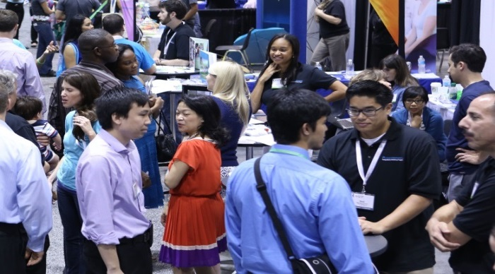

Expo Hall
More than 400 exhibitors, including 300-plus residency programs, fellowship programs, medical mission opportunities, and government agencies will be in the Expo Hall.
Last year 68% of all U.S. family medicine residencies exhibited at National Conference.
www.aafp.org/nc
Notes:
Visit the website for a current list of exhibitors.

Slide 8
AAFP Student Congress
Join the discussion. Expand your leadership skills through Student Congress. Actively participate in the AAFP governance process to share your voice on medical education, improving the health care system, and more.
Available student leadership opportunities include:
AAFP Board of Directors
National Conference Student Chair
Delegates to AAFP Congress of Delegates
FMIG National Coordinator
AAFP liaison to the AAFP Foundation and the Society of Teachers of Family Medicine
www.aafp.org/nc
Notes:
Activities include participating in discussion groups, writing resolutions, and testifying at reference committee hearings. New student leaders will be elected on the congress floor.
Ask your chapter about serving as its delegate. Your vote counts!
For a full schedule of events, past resolutions, and complete details of elected and appointed positions available visit the website.

Slide 9
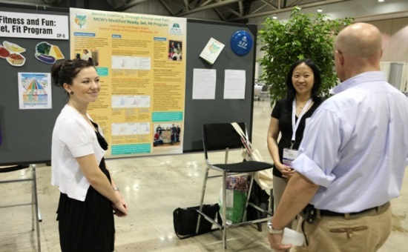
Poster Presentations
If you have research you would like to present, applications for poster presentations are now being accepted.
Posters are selected based on their originality, relevance to family medicine, and clarity of communication. Presentations must be of value to, and within the scope of, family medicine.
Poster categories:
Clinical Inquiry
Community Project
Educational Program
Research
Submission deadline: April 1
www.aafp.org/nc
Notes:
Visit the website to view winners from 2014. Submission forms and IRB FAQs are also available.

Slide 10
Scholarships
Be recognized for your passion and talent as a future family physician.
Apply for one of 220 available Family Medicine Leads scholarships.
The $600 scholarships are made possible by the American Academy of Family Physicians Foundation, as well as individual and corporate sponsors.
Submission deadline: May 1
You must be an AAFP student member to apply. Not a member? Student membership is FREE.
Join today at www.aafp.org/join.
www.aafp.org/nc
Notes:
Categories: First-time Student Attendee Award, Minority Scholarships Program for Residents and Medical Students, Community Outreach Award, Tomorrow's Leader Award, and Family Medicine Interest Group (FMIG) Leadership Scholarship Program.
Scholarship descriptions, eligibility requirements, and applications are available online at www.aafp.org/nc.
Some state chapters offer additional scholarships.

Slide 11

Student Registration Fees
AAFP Member:
Before June 30: $165
After June 30: $215
One-day rate: $140
Non-Member:
Before June 30: $240
After June 30: $290
One-day rate: $215
Non-members must call the AAFP Contact Center to register at (800) 274-2237.
What’s included in my fee?
Access to a wide range of educational sessions including main stage sessions, featured speakers, and more than 35 workshops and clinics
Admission to the Expo Hall with more than 300-plus residency programs
Participation in an official leadership forum (AAFP Student Congress)
A celebration for you and your student peers
Procedural skills courses require a separate registration and fee.
www.aafp.org/nc

Slide 12
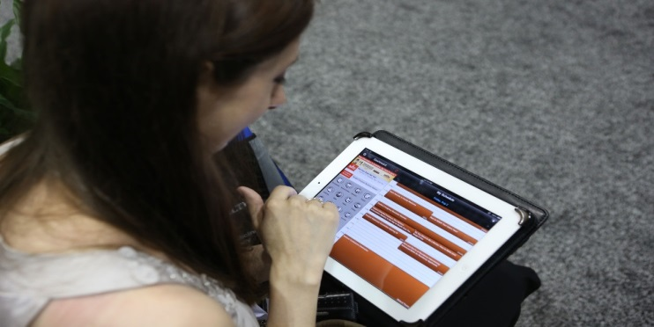
Mobile App: Available June 2016
Enjoy 24-hour access to
interactive conference information.
Customize your conference schedule.
Plan your Expo Hall visits.
Opt-in to connect with fellow attendees
and exhibitors.
www.aafp.org/nc

Slide 13
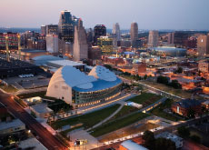
About Kansas City
Discover everything Kansas City–recently coined “THE place to be” by The Huffington Post—has to offer, including mouth-watering BBQ, a lively jazz history, electrifying professional sports teams, and so much more.
www.visitkc.com
www.aafp.org/nc

Slide 14
Important Dates
NOW: Registration open
April 1: Poster presentation deadline
May 1 : Scholarship application deadline
June 30: Advance registration deadline*
*Save $50 by registering before this date.
www.aafp.org/nc

Slide 15
Keep up with National Conference
Visit www.aafp.org/nc for frequent updates on 2016 National Conference.
Follow us on:
Facebook: www.facebook.com/fmignetwork
Twitter: @aafp_fmig (use hashtag #aafpnc)
Instagram: @the_aafp (use hashtag #aafpnc)
www.aafp.org/nc

Slide 16
Additional Comments
www.aafp.org/nc
Notes:
Use this slide to share any personal National Conference highlights or stories. Delete this slide if you prefer not to add any additional information.

Slide 17
AAFP National Conference of Family Medicine Residents and Medical Students July 28-July 30, 2016
Kansas City, MO
Register today at www.aafp.org/nc or call the
AAFP Contact Center at (800) 274-2237.
www.aafp.org/nc
Notes:
AAFP members can register online. Non-AAFP members must call the Contact Center to register.

