Slide 2
You + Family Medicine be part of the National Conference equation
July 27-July 29, 2017
Kansas City, MO
aafp.org/nc

Slide 3
National Conference exists to support future physicians in their family medicine journey.
Notes:
https://aafp-1.wistia.com/medias/10tlso11r3

Slide 4
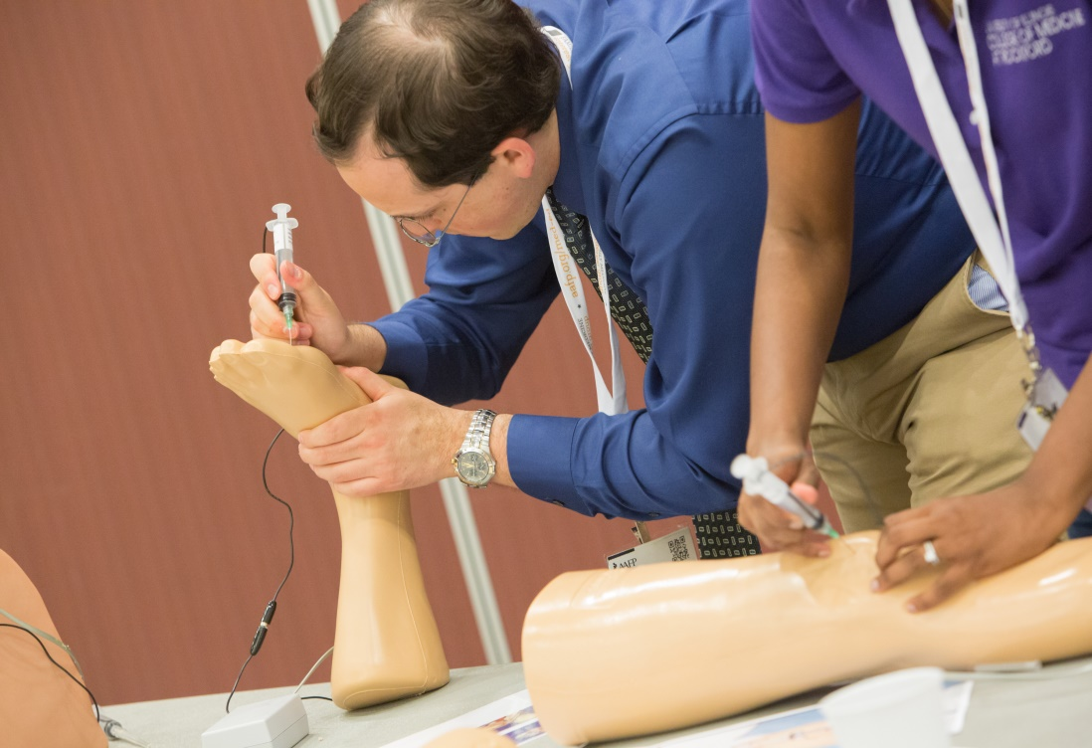
Educational Programming
Attend main stage sessions, workshops, musculoskeletal clinics, procedural skills courses, and poster presentations.
Pick from more than 35 topics:
Applying to residency
Do’s and don’ts of residency interviewing
Procedures in family medicine
Global health
Wilderness medicine
Ultrasound
Wellness in Medical Education
Sessions offered in key focus areas:
Career planning
Clinical skills
Health policy and advocacy
Leadership development
Practice management
Research

Slide 5
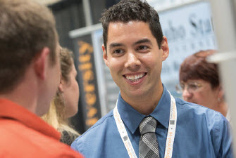
Expo Hall
450 exhibitors, including 350+ residency programs, fellowship programs, medical mission opportunities, and government agencies, will be at National Conference.
Last year 68% of all U.S. family medicine residencies exhibited at National Conference.

Slide 6
Connect
Expo Hall Grand Opening: Join us at this Expo Hall kick-off for networking, fun, and to celebrate family medicine.
Celebration: Enjoy a night of celebrating you and your fellow attendees with music, beverages, and food at the historic Midland Theatre in downtown Kansas City.

Slide 7
AAFP Student Congress
Join the discussion.
Expand your leadership skills through Student Congress. Actively participate in the AAFP governance process to share your view on medical education, improving the health care system, and more.
Available student leadership opportunities include:
AAFP Board of Directors
National Conference Student Chair
Delegates to AAFP Congress of Delegates
FMIG National Coordinator
AAFP liaison to the AAFP Foundation and the Society of Teachers of Family Medicine

Slide 8
Poster Presentations
Present your research.
Applications for poster presentations are open.
Posters are selected based on their originality, relevance to family medicine, and clarity of communication. Presentations must be of value to, and within the scope of, family medicine.
Poster categories:
Clinical Inquiry
Community Project
Educational Program
Research
Submission deadline: April 1

Slide 9
Scholarships
Be recognized for your passion and talent as a future family physician.
Apply for one of 220 available Family Medicine Leads scholarships.
The $600 scholarships are made possible by the American Academy of Family Physicians Foundation, as well as individual and corporate sponsors.
Submission deadline: May 1
You must be an AAFP student member to apply. Not a member?
Student membership is FREE.
Join today at www.aafp.org/join.

Slide 10
Student Registration Fees
AAFP Member:
Before June 30: $165
After June 30: $215
One-day rate: $140
Non-Member:
Before June 29: $240
After June 29: $290
One-day rate: $215
*Non-members must call the AAFP Contact Center to register at (800) 274-2237.
What’s included in my fee?
Educational sessions including main stage sessions, featured speakers, and more than 35 workshops and clinics
Admission to the Expo Hall with more than 350+ residency programs
Participation in an official leadership forum (AAFP Student Congress)
A celebration for you and your student peers

Slide 11
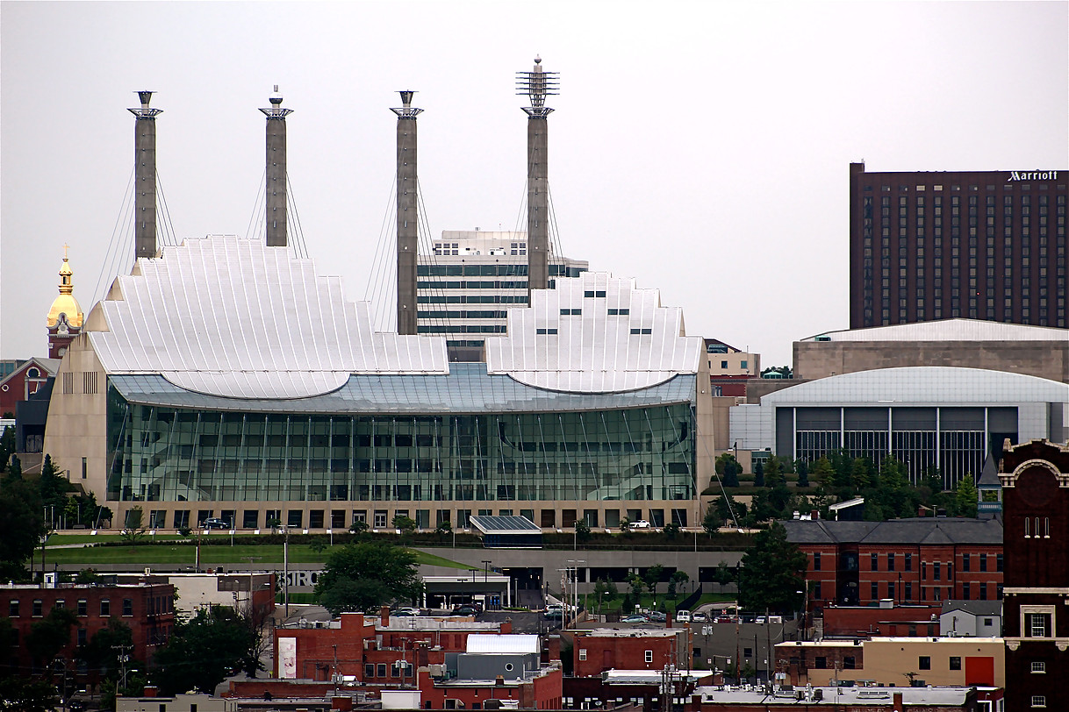
About Kansas City
Discover everything Kansas City. “THE place to be” coined by The Huffington Post. Kansas City offers mouth-watering BBQ, a lively jazz history, electrifying professional sports teams, world-class museums, and so much more.
www.visitkc.com

Slide 12
Important Dates
NOW: Registration open
April 1: Poster presentation deadline
May 1 : Scholarship application deadline
June 29: Advance registration deadline* *Save $50 by registering before this date.

Slide 13
Keep up with
National Conference
Visit www.aafp.org/nc for frequent updates
fmignetwork
@aafp_fmig (hashtag #aafpnc)
@the_aafp (hashtag #aafpnc)

Slide 14
AAFP National Conference of Family Medicine Residents and Medical Students July 27-July 29, 2017
Kansas City, MO
Register today at www.aafp.org/nc AAFP Contact Center at (800) 274-2237

