Slide 1
Treating Tobacco Dependence
Ask your patients about tobacco use
Act to help them quit
Notes:
1

Slide 2
Synopsis
Tobacco use remains the leading preventable cause of disease, disability, and death.
Emerging tobacco and nicotine products (e.g., e-cigarettes) are an increasing health concern.
Family physicians have influence in the fight against tobacco and nicotine use.

Slide 3
Objectives
Make system changes that increase intervention and tobacco cessation rates.
Conduct productive counseling sessions.
Use the most recent evidence on pharmacotherapy to treat nicotine dependence.
Maximize payment for tobacco cessation treatment and counseling.
Notes:
3

Slide 4
ASK AND ACT
Helping Patients Quit Tobacco Use
Notes:
4

Slide 5
Reasons Physicians Do Not Ask About Patient’s Smoking Status
Too busy
Lack of expertise
No financial incentive
Think tobacco users cannot or will not quit
Do not want to appear judgmental
Respect for patient’s privacy
Notes:
5

Slide 6
Physicians Have the Opportunity to Ask and Act
70% of tobacco users want to quit.
Without assistance, only 5% are able to quit.
Most tobacco users try to quit on their own; more than 95% relapse.
Physicians using evidence-based programs can more than double the quit rates.
Ending the Tobacco Problem: A Blueprint for the Nation
U.S. Public Health Service (USPHS) Clinical Practice Guideline: Treating Tobacco Use and Dependence: 2008 Update
Notes:
6

Slide 7
Ask and Act
Ask every patient about tobacco use
Act to help them quit
For resources, visit AAFP Tobacco Control Toolkit
Notes:
7

Slide 8
SYSTEM CHANGES
Identifying and Documenting Tobacco Use
Notes:
8

Slide 9
System Changes
Use posters, brochures, and lapel pins to signal to patients that you can help them quit tobacco use
Develop templates for your EHR
Ask about tobacco use as part of taking vital signs
Document status in patient records (current user, former user, or never used tobacco)
Notes:
9

Slide 10
System Changes
Offer tobacco cessation group visits
Maintain tobacco cessation patient registry
Follow up with patients after their tobacco quit date
Notes:
10

Slide 11
COUNSELING
Motivating Patients to Quit Tobacco Use
Notes:
11

Slide 12
Reasons Patients Are Unwilling to Quit Tobacco Use
  Lack information about harmful effects of tobacco use or benefits of quitting
  Lack financial resources
  Have fears or concerns about quitting
  Think they cannot quit
USPHS Clinical Practice Guideline: Treating Tobacco Use and Dependence: 2008 Update
Notes:
12

Slide 13
Brief Interventions
Do not have to be delivered by physician
Electronic patient databases, tobacco user registries, and real-time clinical care prompts provide opportunities to fit brief interventions into a busy practice.
USPHS Clinical Practice Guideline: Treating Tobacco Use and Dependence: 2008 Update
Notes:
13

Slide 14
Brief Interventions
Minimal interventions lasting less than 3 minutes increase overall tobacco abstinence rates.
Every tobacco user should be offered minimal intervention, whether or not the patient is referred to an intensive intervention.
USPHS Clinical Practice Guideline: Treating Tobacco Use and Dependence: 2008 Update
Notes:
14

Slide 15
Brief Interventions
Even when patients are not willing to make a quit attempt, physician-delivered brief interventions enhance motivation and increase the likelihood of future quit attempts.
USPHS Clinical Practice Guideline: Treating Tobacco Use and Dependence: 2008 Update
Notes:
15

Slide 16
Principles for Motivational Interviewing
Express empathy
Develop discrepancy
Roll with resistance
Support self-efficacy
Motivational interviewing is effective in
increasing future quit attempts.
USPHS Clinical Practice Guideline: Treating Tobacco Use and Dependence: 2008 Update
Notes:
16

Slide 17
5 R’s of Motivational Interviewing
Relevance
Risks
Rewards
Roadblocks
Repetition
The 5 R’s enhance future quit attempts.
USPHS Clinical Practice Guideline: Treating Tobacco Use and Dependence: 2008 Update
Notes:
Relevance: Talk about why quitting is personally relevant (e.g., improve health, save money, benefit others in the household).
Risks: Help patient identify risks associated with continued tobacco use. If the patient is not ready to quit now or does not want to quit, you may want to ask what the patient has heard about the risks of tobacco use.
Rewards: Discuss the benefits of quitting (e.g., food tastes better, more energy, more money, hair and clothes will not smell like smoke).
Roadblocks: Identify barriers to quitting (e.g., triggers and cravings, withdrawal, being around others who smoke, concerns about weight gain, possibility of relapse).
Repetition: Discuss quitting smoking more than once. Ambivalence is normal.
Ask open-ended questions.
How important do you think it is for you to quit?
What may happen if you quit?
Would you like to hear about some strategies that can help address your concerns when you quit?
17

Slide 18
Practical Counseling
Teach problem-solving skills
Identify danger situations for tobacco user
Suggest coping skills to use for danger situations and strategies to avoid temptation
Provide basic information about tobacco use dangers, withdrawal symptoms, and addiction
USPHS Clinical Practice Guideline: Treating Tobacco Use and Dependence: 2008 Update
Notes:
Some trigger situations in which a patient may be tempted to smoke include using alcohol, feeling stressed, and being around other smokers. Advise your patient to try the following strategies:
Change your environment, and stay away from places where people are likely to be smoking.
Let others know you are trying to quit and ask them to not smoke around you.
Instead of reaching for a cigarette when tempted, drink a glass of water, chew gum, or go for a walk.
Distract yourself from the urge to smoke by talking to someone or working on a task.
18

Slide 19
Counseling Adolescents
Tobacco cessation counseling is recommended for adolescents.
Use motivational interviewing
Respect privacy
USPHS Clinical Practice Guideline: Treating Tobacco Use and Dependence: 2008 Update
Notes:
19

Slide 20
Counseling Patients Who Have a Mental Health Disorder
Counseling is critical to success.
More and longer sessions are often necessary.
Patients may need more time to prepare for quitting.
Quit dates should be flexible.
Include problem-solving skills training.
Notes:
20

Slide 21
QUIT PLANS AND QUITLINES
Helping Patients Who Are Ready to Quit
Notes:
21

Slide 22
Quitting Nicotine
Be aware of newer popular nicotine products.
  E-cigarettes and vape pens
    Unregulated, not approved by FDA
    No empirical evidence for use in tobacco cessation
  Flavored smokeless tobacco (e.g., orbs, sticks, snus, strips)
Dual use with traditional cigarettes is common.
  May contribute to nicotine dependence
Notes:
22

Slide 23
Develop a Quit Plan
Help patient set a quit date
Have patient tell family and friends and get rid of tobacco/nicotine products
Identify social support
Prescribe medication
Notes:
23

Slide 24
Patient is Ready to Quit
Intensive tobacco dependence treatment is more effective than brief treatment.
Intensive treatment = more comprehensive treatment over multiple visits for a longer period of time
May be provided by more than one health care professional, including quitline specialist
USPHS Clinical Practice Guideline: Treating Tobacco Use and Dependence: 2008 Update
Notes:
24

Slide 25
Intensive Treatment
Especially effective
  Practical counseling (e.g., problem-solving skills training)
  Social support
  Individual, group, and telephone counseling
USPHS Clinical Practice Guideline: Treating Tobacco Use and Dependence: 2008 Update
Notes:
25

Slide 26
Quitlines
It only takes 30 seconds to refer a patient to a toll-free tobacco cessation quitline.
Quitlines are staffed by trained specialists who tailor a plan and advice for each caller.
Calling a quitline can increase a tobacco user’s chance of successfully quitting.
Notes:
26

Slide 27
Advantages of Quitlines
Accessible
Appeal to patients who are uncomfortable in a group setting
More likely to be used by patients than a face-to-face program
No cost to patient
Easy intervention for health care professionals
Notes:
Accessibility: don’t have to wait for classes to form or worry about transportation. Good for people in remote areas.
27

Slide 28
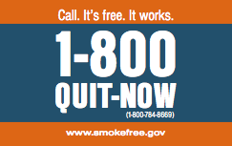
Quitlines
1-800-QUIT-NOW
callers are routed
to state-run quitlines or the National
Cancer Institute quitline.
Quitline referral cards are available through the AAFP Tobacco Prevention & Cessation catalog
Notes:
28

Slide 29
PHARMACOTHERAPY
Products, Precautions, and Patient Concerns
Notes:
29

Slide 30
Pharmacotherapy
Q: Who should receive medication?
  A: All tobacco users trying to quit, except where contraindicated or for specific populations in which there is insufficient evidence of effectiveness (e.g., pregnant women, smokeless tobacco users, light smokers, adolescents)
USPHS Clinical Practice Guideline: Treating Tobacco Use and Dependence: 2008 Update
Notes:
30

Slide 31
Factors to Consider When Prescribing
Physician’s familiarity with medications
Contraindications
Patient preference
Previous patient experience
Patient characteristics (e.g., history of depression, weight gain concerns)
USPHS Clinical Practice Guideline: Treating Tobacco Use and Dependence: 2008 Update
Notes:
31

Slide 32
Bupropion Sustained Release (SR)
$2.72 to $6.22 for 2 tablets per day
Plan quit date 1 to 2 weeks after start of treatment.
Start with 150 mg once daily for 3 days, then increase to 150 mg twice per day for 7 to 12 weeks.
Common side effects include insomnia and dry mouth.
Rx for Change Pharmacologic Product Guide
Notes:
32

Slide 33
Bupropion SR
Monitor for neuropsychiatric symptoms
Contraindicated in patients who have a history of seizure disorders
Contraindicated in patients who have a history of anorexia or bulimia
Selectively inhibits neuronal reuptake of dopamine
Notes:
33

Slide 34
Varenicline
$8.24 for 2 tablets per day
Plan quit date 1 week after start of treatment.
Start with 0.5 mg daily for 3 days, then increase to 0.5 mg twice daily for 4 days.
On quit date, increase to 1 mg twice daily for 12 weeks.
Rx for Change Pharmacologic Product Guide
Notes:
34

Slide 35
Varenicline
Most common side effects are nausea, insomnia, and vivid dreams.
Monitor for neuropsychiatric symptoms.
Take with food to avoid nausea.
Partial agonist at alpha4-beta2 neuronal nicotinic acetylcholine receptors.
Notes:
35

Slide 36
Nicotine Gum
$1.90 to $3.70 per day (9 pieces)
Available in 2 mg or 4 mg.
4 mg is recommended for patients who have first cigarette within 30 minutes of waking.
Weeks 1-6: 1 piece every 1 to 2 hours
Weeks 7-9: 1 piece every 2 to 4 hours
Weeks 10-12: 1 piece every 4 to 8 hours
Maximum = 24 pieces per day
Rx for Change Pharmacologic Product Guide
Notes:
36

Slide 37
Nicotine Gum
Common side effects are jaw pain and mouth soreness.
OTC medication
Binds to central nervous system and peripheral nicotinic-cholinergic receptors
Rx for Change Pharmacologic Product Guide
Notes:
37

Slide 38
Nicotine Inhaler
$8.51 per day (6 cartridges)
6 to 16 cartridges per day, initially 1 every 1 to 2 hours, for up to 12 weeks.
Do not inhale into lungs. Puff as if lighting a pipe.
Common side effects are mouth and throat irritation, and cough.
Prescription medication
Rx for Change Pharmacologic Product Guide
Notes:
38

Slide 39
Nicotine Nasal Spray
$5.00 per day (8 doses)
1 to 2 doses per hour (1 dose = 1 spray in each nostril)
Maximum = 5 doses per hour or 40 doses per day
Use for 3 to 6 months.
Common side effects are nose and throat irritation, sneezing, and cough.
Prescription medication
Rx for Change Pharmacologic Product Guide
Notes:
39

Slide 40
Nicotine Patch
$1.52 to $3.48 per day (1 patch)
Patient who smokes >10 cigarettes per day: 21 mg patch once daily for 4 to 6 weeks, then 14 mg patch once daily for 2 weeks, then 7 mg patch once daily for 2 weeks
Patient who smokes ≤10 cigarettes per day: start with 14 mg patch once daily for 4 to 6 weeks, then 7 mg patch once daily for 2 weeks
Rx for Change Pharmacologic Product Guide
Notes:
40

Slide 41
Nicotine Patch
Common side effects are skin irritation and sleep issues (if patch is worn at night).
OTC and prescription medication
Rx for Change Pharmacologic Product Guide
Notes:
41

Slide 42
Nicotine Lozenge
$2.66 to $4.10 per day (9 pieces)
Available in 2 mg or 4 mg
4 mg is recommended for patients who have first cigarette within 30 minutes of waking.
Weeks 1-6: 1 lozenge every 1 to 2 hours
Weeks 7-9: 1 lozenge every 2 to 4 hours
Weeks 10-12: 1 lozenge every 4 to 8 hours
Maximum = 20 lozenges per day
Rx for Change Pharmacologic Product Guide
Notes:
42

Slide 43
Nicotine Lozenge
Common side effects are mouth soreness, dyspepsia, and nausea.
OTC medication
Rx for Change Pharmacologic Product Guide
Notes:
43

Slide 44
Nicotine Patch and Lozenge
Starting patch 2 weeks prior to quit date increases success.
Patient is instructed to get rid of tobacco products and other smoking cues on the quit date and begin the lozenge or other short-acting nicotine replacement therapy (NRT) while continuing the patch.
Notes:
44

Slide 45
Weight Gain
Bupropion SR and nicotine replacement therapies (especially gum and 4-mg lozenge) may delay, but not prevent, weight gain.
The average weight gain from tobacco cessation is less than 10 pounds.
Weight gain is more common in women.
USPHS Clinical Practice Guideline: Treating Tobacco Use and Dependence: 2008 Update
Notes:
45

Slide 46
For Patients Who Have a History of Depression
Bupropion SR
Nicotine replacement therapy
USPHS Clinical Practice Guideline: Treating Tobacco Use and Dependence: 2008 Update
Notes:
46

Slide 47
Patients Who Have a Mental Health Disorder
Most will need medication
May need higher doses, longer duration of treatment, and combination of medications.
Bupropion SR is contraindicated in patients with history of an eating disorder.
Bupropion SR is not recommended for patients who have a bipolar disorder; nicotine patch is suggested.
Nicotine patch is effective for patients who have schizophrenia.
USPHS Clinical Practice Guideline: Treating Tobacco Use and Dependence: 2008 Update
Signal Behavioral Health Network and the Colorado State Tobacco Education & Prevention Partnership (STEPP). Smoking Cessation for Persons with Mental Illness: A Toolkit for Health Providers. 2009
Notes:
47

Slide 48
Patients Who Have a Mental Health Disorder
Quitting can increase the effect of some psychiatric medications; dose adjustments may be needed.
Check for relapse of mental health disorder with changes in smoking status.
USPHS Clinical Practice Guideline: Treating Tobacco Use and Dependence: 2008 Update
Notes:
48

Slide 49
Patients Who Have a History of Cardiovascular Disease
No evidence of association between the nicotine patch and acute cardiovascular events, even in patients who continue to smoke while using the patch.
NRT packaging recommends caution in patients who have acute cardiovascular disease.
USPHS Clinical Practice Guideline: Treating Tobacco Use and Dependence: 2008 Update
Notes:
49

Slide 50
Pregnant Women Who Smoke
Counseling is the best choice
Risk of premature birth or stillbirth caused by smoking may be higher than the potential risk of birth defects caused by NRT use.
Bupropion SR and varenicline are both category C.
Prescription NRT is category D.
USPHS Clinical Practice Guideline: Treating Tobacco Use and Dependence: 2008 Update
Rx for Change Pharmacologic Product Guide
Notes:
50

Slide 51
Adolescents
NRT shown to be safe
Very little evidence to support the effectiveness of medications in this population; not a recommended intervention
USPHS Clinical Practice Guideline: Treating Tobacco Use and Dependence: 2008 Update
Notes:
51

Slide 52
Long-Term Pharmacotherapy
Helpful for tobacco users who have persistent withdrawal symptoms
Long-term use of NRT does not present a known health risk.
Bupropion SR approved for up to 6 months
Varenicline recommended for 12 weeks; may repeat for 12 more weeks
Notes:
52

Slide 53
Combining Medications
Patch + gum or nasal spray increases long-term abstinence
Patch + inhaler is effective
Patch + bupropion SR is more effective than patch alone
Patch + short-acting NRT showed equal efficacy with varenicline (Cochrane Review)
Treating smokers in the health care setting. New England Journal of Medicine.
USPHS Clinical Practice Guideline: Treating Tobacco Use and Dependence: 2008 Update
Notes:
53

Slide 54
PAYMENT FOR TOBACCO CESSATION
Medicaid, Medicare, and Private Insurers
Notes:
54

Slide 55
Medicaid
Only 2 states offer comprehensive coverage:
  Indiana and Massachusetts cover all 7 medications and all forms of counseling.
27 states cover all 7 medications.
22 states (including Washington, DC) cover fewer than 7 medications.
American Lung Association, State Tobacco Cessation Coverage Database: 2014 www.lung.org/cessationcoverage
Medicaid information current as of April 2015
Notes:
55

Slide 56
Medicare
Pays for tobacco cessation counseling for all patients who smoke.
Prescription drug benefit covers smoking cessation treatments prescribed by a physician.
  OTC treatments are not covered.
Notes:
56

Slide 57
Medicare
8 sessions allowed in 12-month period
(2 quit attempts; 4 sessions per quit attempt)
Intermediate cessation counseling =
3 to 10 minutes per session
Intensive cessation counseling =
more than 10 minutes per session
Counseling 3 minutes or less covered under E/M code
Notes:
57

Slide 58
Medicare CPT Codes
99406: 3 to10 minutes
99407: More than 10 minutes
Report 305.1 tobacco use disorder and related condition or interference with the effectiveness of medications
A coding reference is available at AAFP Tobacco Control Toolkit
Codes are for symptomatic patients.
Notes:
58

Slide 59
Medicare CPT Codes
For patients who do not have symptoms of tobacco-related disease:
  G0436: 3 to 10 minutes
  G0437: more than 10 minutes
  Report 305.1 tobacco use disorder or v15.82 personal history of tobacco use
Notes:
59

Slide 60
Private Insurers
As of January 1, 2014, the ACA mandates that insurers provide:
  Tobacco cessation treatment as a preventive service (no cost sharing)
  Coverage for 1 to 3 medications, depending on the state’s benchmark plan
  Variable; check with your largest local payers
Notes:
60

Slide 61

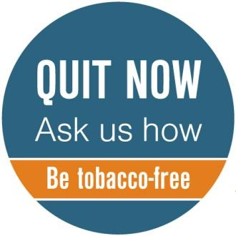
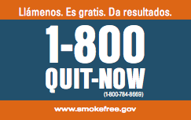
Lapel Pins
Spanish Language
English Language

Slide 62
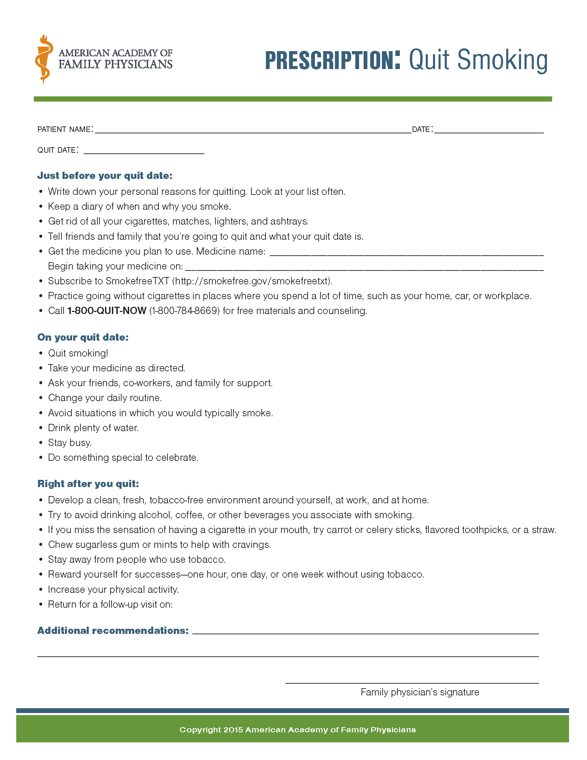
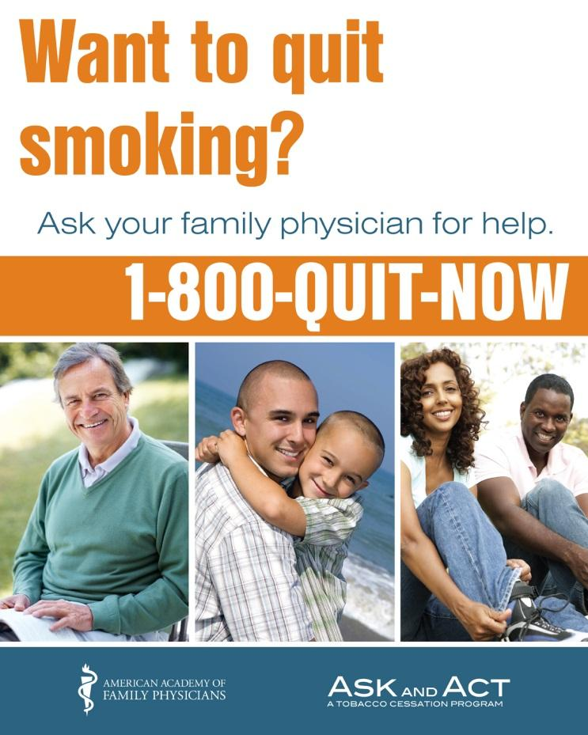
Prescription Pad
Wall Poster

Slide 63
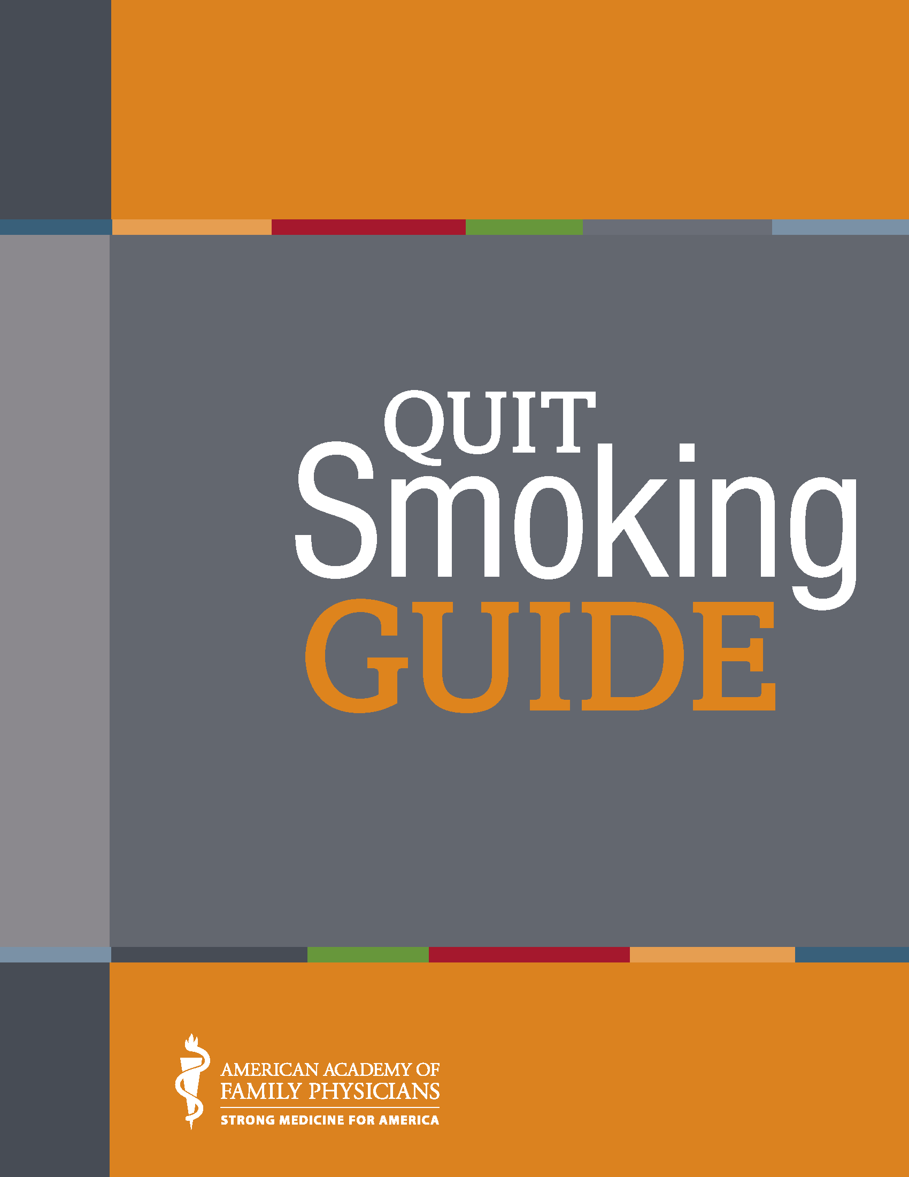

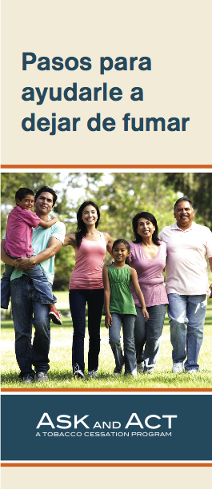
www.askandact.org
Notes:
Patient education materials
63

Slide 64
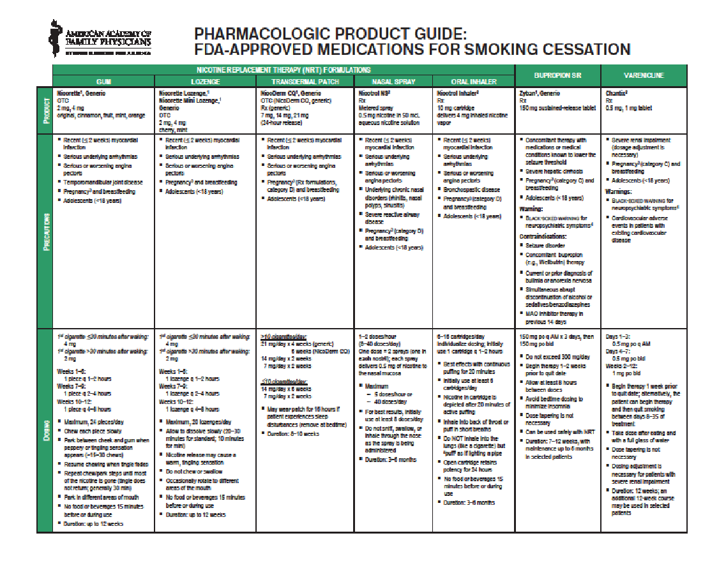
Notes:
This product guide includes dosing information, pros and cons, and side effects for nicotine replacement therapy (NRT), bupropion SR, and varenicline. It was updated in 2014 to include varenicline warnings and to update the cost per day for each medication.
64

Slide 65
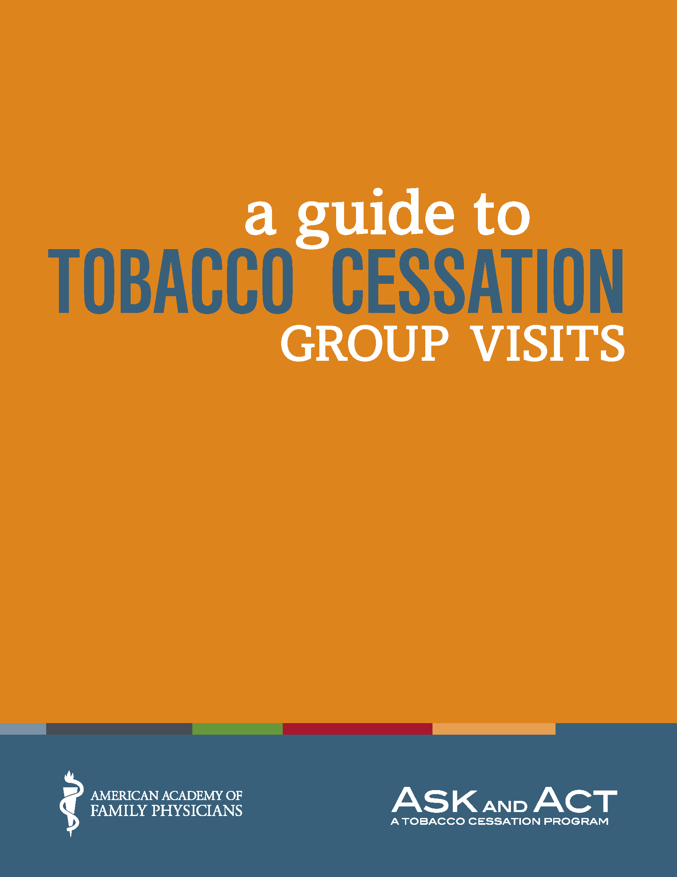
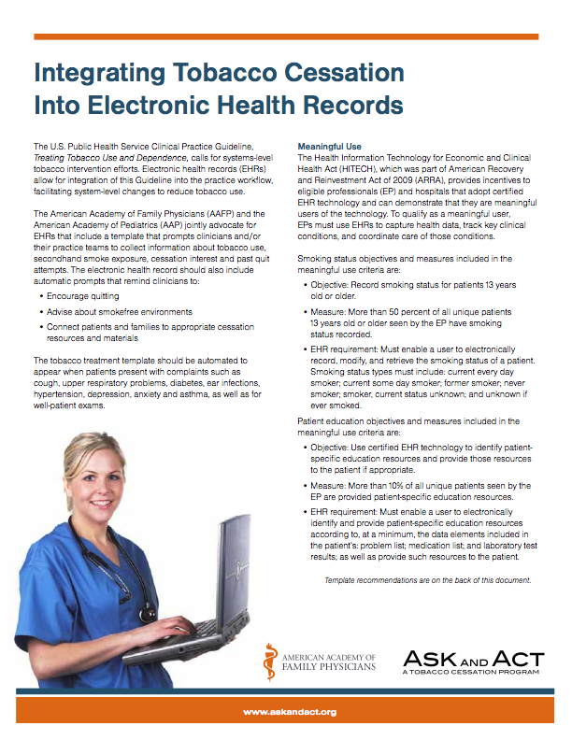
Notes:
65

