Slide 1

Building Cultural Competence & Proficiency
For more information, contact the Center for Diversity and Health Equity at healthequity @aafp.org

Slide 2

Learning Objectives
Define and describe cultural proficiency
Understand the need for culture competence and culturally proficient care
Identify the key aspects of cultural proficiency
Describe culturally proficient services that can be implemented in primary health care settings
Review Discussion Questions/Guide

Slide 3
Defining Cultural Proficiency
Cultural proficiency is:
  the knowledge, skills, attitudes, and beliefs that enable people to work well, respond effectively to, and be supportive of people in cross-cultural settings.
  Family physicians care for a wide variety of patients and need these skills to offer better patient care.
American Academy of Family Physicians. Cultural Proficiency: The Importance of Cultural Proficiency in Providing Effective Care for Diverse Populations, updated 2014. Leawood: American Academy of Family Physicians; 2014: Position Paper.

Slide 4
Defining Cultural Proficiency
Not solely the acceptance of cultural differences
Care and services are responsive to the cultural and linguistic needs of all individuals
American Academy of Family Physicians. Cultural Proficiency: The Importance of Cultural Proficiency in Providing Effective Care for Diverse Populations, updated 2014. Leawood: American Academy of Family Physicians; 2014: Position Paper.

Slide 5
Defining Cultural Competence
Cultural competence is a set of congruent behaviors, attitudes, and policies that come together and enable a system, agency or professionals to work effectively in cross-cultural situations.
Five essential elements contribute to the ability to become more culturally competent which include:
Valuing diversity
Having the capacity for cultural self-assessment
Being conscious of the dynamics inherent when cultures interact
Having institutionalized culture knowledge
Having developed adaptations to service delivery reflecting an understanding of cultural diversity
Policy Brief 1: Rationale for Culture Competence in Primary Care. Washington, DC: National Center for Cultural Competence, Georgetown University Center for Child and Human Development. Goode TD and Dunne C.

Slide 6
Need for Cultural Competence and Culturally Proficient Care
Respond to current and projected demographic changes in the United States.
Improve the quality of services and primary care outcomes.
Meet legislative, regulatory and accreditation mandates.
Eliminate long-standing disparities in the health status of people of diverse racial, ethnic and cultural backgrounds.
Decrease the likelihood of liability/malpractice claims.
Policy Brief 1: Rationale for Culture Competence in Primary Care. Washington, DC: National Center for Cultural Competence, Georgetown University Center for Child and Human Development. Goode TD and Dunne C.
Notes:
Respond to current and projected demographic changes in the United States. By 2060, over the next three decades, the U.S. Census Bureau projects significant changes in the demographic makeup of this nation’s population that characterized by age, race and ethnicity, and foreign-born status. The U.S. Census Bureau reports that between 2014 -2044, the U.S. population will become even more diverse and it is projected that the U.S. will become a plurality nation in 2044.
Eliminate long-standing disparities in the health status of people of diverse racial, ethnic and cultural backgrounds. Nowhere are the divisions of race, ethnicity and culture more sharply drawn than in the health of the people in the United States. Despite recent progress in overall national health, there are continuing disparities in the incidence of illness and death among African Americans, Latino/Hispanic Americans, Native Americans, Asian Americans, Alaskan Natives and Pacific Islanders as compared with the U.S. population as a whole.
Improve the quality of services and primary care outcomes. Despite similarities, fundamental differences among people arise from nationality, ethnicity and culture, as well as from family background and individual experience. These differences affect the health beliefs and behaviors of both patients and providers have of each other.
Meet legislative, regulatory and accreditation mandates. Title VI of the Civil Rights Act of 1964 mandates that no person in the United States shall, on ground of race, color, or national origin, be excluded from participation in, be denied the benefits of, or be subjected to discrimination under any program or activity receiving Federal financial assistance.
Decrease the likelihood of liability/malpractice claims. Lack of awareness about cultural differences may result in liability under tort principles in several ways. For example, providers may discover that they are liable for damages as a result of treatment in the absence of informed consent. Also, health care organizations and programs face potential claims that their failure to understand health beliefs, practices and behavior on the part of providers or patients breaches professional standards of care. In some states, failure to follow instructions because they conflict with values and beliefs may raise a presumption of negligence on the part of the provider.

Slide 7
Key Aspects of Cultural Proficiency
Organizational/Systems
Organizations embrace the principles of equal access and non-discriminatory practices in service delivery
Practice & Service Design
Tailored services are designed and implemented to meet the unique needs of the individuals and communities served
Community Engagement
The needs of the communities are determined by the community and members are full partners in decision making
Family & Consumers
There is an inherent awareness that “family” is defined differently by different cultures
Culturally Competent Guiding Values & Principles. Washington, DC: National Center for Cultural Competence, Georgetown University, Center for Child and Human Development. Goode TD and Dunne C.
Notes:
Organizational/Systems
Embracing the principles of equal access and non-discriminatory practices in service delivery.
Incorporate cultural knowledge into policy making, infrastructure and practice.
Practice & Service Design
Identify and understand the needs of individuals and families.
Design and implement services that are tailored to the unique needs of individuals and communities served.
Practice is driven in service delivery systems by client preferred choices.
Service delivery models should recognize that mental health as an integral and inseparable aspect of primary health care.
Community Engagement
Communities determine their own needs, extending the concept of self-determination to the community.
Community members are full partners in decision making; work in conjunction with natural, informal support and helping networks within culturally diverse communities (e.g. civic and advocacy associations; ethnic, social, and religious organizations; and spiritual leaders and healers).
Communities should economically benefit from collaboration.
Community engagement should result in the reciprocal transfer of knowledge and skills among all collaborators and partners.
Family & Consumers
Awareness that family is defined differently by different cultures.
Family usually is the primary system of support and preferred intervention.
Ultimate decision makers for services and support for their children and/or themselves.

Slide 8
Key Aspects of Cultural Proficiency
National Standards for Culturally and Linguistically Appropriate Services (CLAS):
The National CLAS Standards are a set of 15 action steps intended to advance health equity, improve quality, and help eliminate health care disparities by providing a blueprint for individuals and health and health care organizations to implement culturally and linguistically appropriate services.
National Standards for Culturally and Linguistically Appropriate Services in Health and Health Care: A Blueprint for Advancing and Sustaining CLAS Policy and Practice. Office of Minority Health, US Department of Health and Human Services, 2013.

Slide 9
Key Aspects of Cultural Proficiency
National CLAS Standards cont.
Principle Standard: Provide effective, equitable, understandable, and respectful quality care and services that are responsive to diverse cultural health beliefs and practices, preferred languages, health literacy, and other communication needs.
These standards are important because they provide guidance on effectively introducing cultural competence into healthcare services.

Slide 10
Cultural Proficiency in Primary Care
What can you do to improve the cultural proficiency in your organization?
Identify challenges or existing needs in your community
Brainstorm solutions
Determine needed resources
Take your first step
Notes:
Convene a cultural competence committee, work group or task force.
Ensure that the program's or organization's mission statement commits to cultural competence as an integral component of all of its activities.
Determine the racially, ethnically, culturally and linguistically diverse groups within your geographic locale
Determine what percentage of the population that resides in the geographic locale served by your program or organization is affected by the following six health disparities
Conduct a comprehensive program or organizational cultural competence self-assessment
Conduct an assessment of staff to determine their perceived staff development needs
Convene focus groups or use other approaches to solicit consumer input
Network and dialogue with other programs or organizations, concerned with primary and community-based health care, that have begun the journey towards developing, implementing and evaluating culturally competent service delivery systems
Seek resources from federally and privately funded technical assistance centers
Convene informal brown bag lunches or other forums to engage program or organization personnel
Identify and include budgetary expenditures
Build a network of natural helpers and other “experts” in the field
Network inf advocacy organizations

Slide 11
Cultural Proficiency in Primary Care
Convene cultural competent workgroup or task force
Determine percentage of population affected by healthcare disparities
Conduct assessment of staff to determine developmental needs
Seek Resources
Convene brown bag lunches to educate key staff
Build a network of helpers
Network with advocacy orgs.
Planning, Implementing and Evaluating Culturally Competent Service Delivery Systems in Primary Health Care Settings. Washington, DC: National Center for Cultural Competence, Georgetown University, Center for Child and Human Development. Goode TD
Notes:
Convene a cultural competence committee, work group or task force.
Ensure that the program's or organization's mission statement commits to cultural competence as an integral component of all of its activities.
Determine the racially, ethnically, culturally and linguistically diverse groups within your geographic locale
Determine what percentage of the population that resides in the geographic locale served by your program or organization is affected by the following six health disparities
Conduct a comprehensive program or organizational cultural competence self-assessment
Conduct an assessment of staff to determine their perceived staff development needs
Convene focus groups or use other approaches to solicit consumer input
Network and dialogue with other programs or organizations, concerned with primary and community-based health care, that have begun the journey towards developing, implementing and evaluating culturally competent service delivery systems
Seek resources from federally and privately funded technical assistance centers
Convene informal brown bag lunches or other forums to engage program or organization personnel
Identify and include budgetary expenditures
Build a network of natural helpers and other “experts” in the field
Network inf advocacy organizations

Slide 12
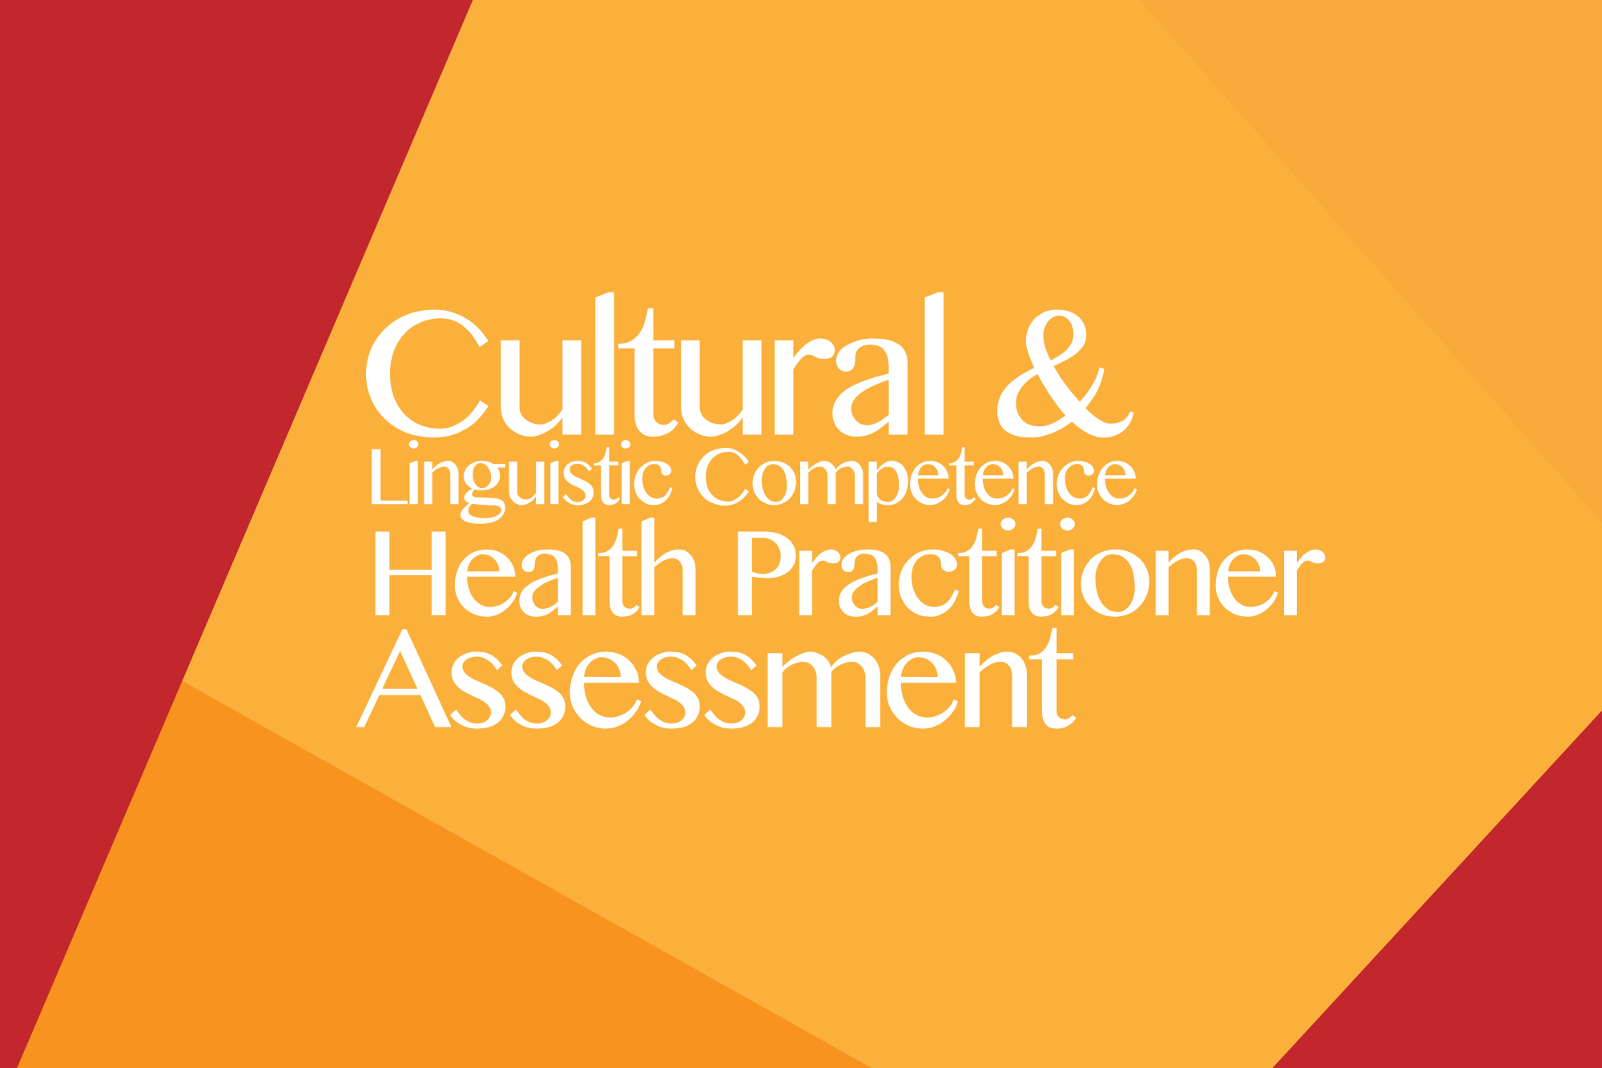
Self-Assessments
Cultural and Linguistic Competence Health Practitioner Assessment (CLCHPA)
Cultural and Linguistic Competence Policy Assessment (CLCPA)
Cultural Competence
Organizational Assessment
National Center for Cultural Competence, Georgetown University, Center for Child and Human Development. Washington, DC. Goode TD
Notes:
CLCHPA has 3 Factors: 1: Knowledge of culturally and linguistically diverse populations; 2: Adapting practice for culturally and linguistically diverse patient populations;
Factor 3: Promoting the health of culturally and linguistically diverse communities

Slide 13
Discussion Questions/Guide
Does the definition of Cultural Proficiency reflect your own thoughts?
What challenges do you experience as a practitioner or within your system when addressing the needs of diverse populations?
What simple improvements do you think could be implemented in the short term?
What additional resources are needed to become more successful at addressing the needs of diverse populations?
Have you personally or has your organization completed a self-assessment on cultural and linguistic competence?

Slide 14
© 2018 American Academy of Family Physicians. All rights reserved.
All materials/content herein are protected by copyright and are for the sole, personal use of the user.
No part of the materials/content may be copied, duplicated, distributed or retransmitted
in any form or medium without the prior permission of the applicable copyright owner.

Slide 15


