Slide 1

Course to Limit Implicit Bias:
Science and Health Effects
of Implicit Bias
Facilitator
MM/DD/YY

Slide 2
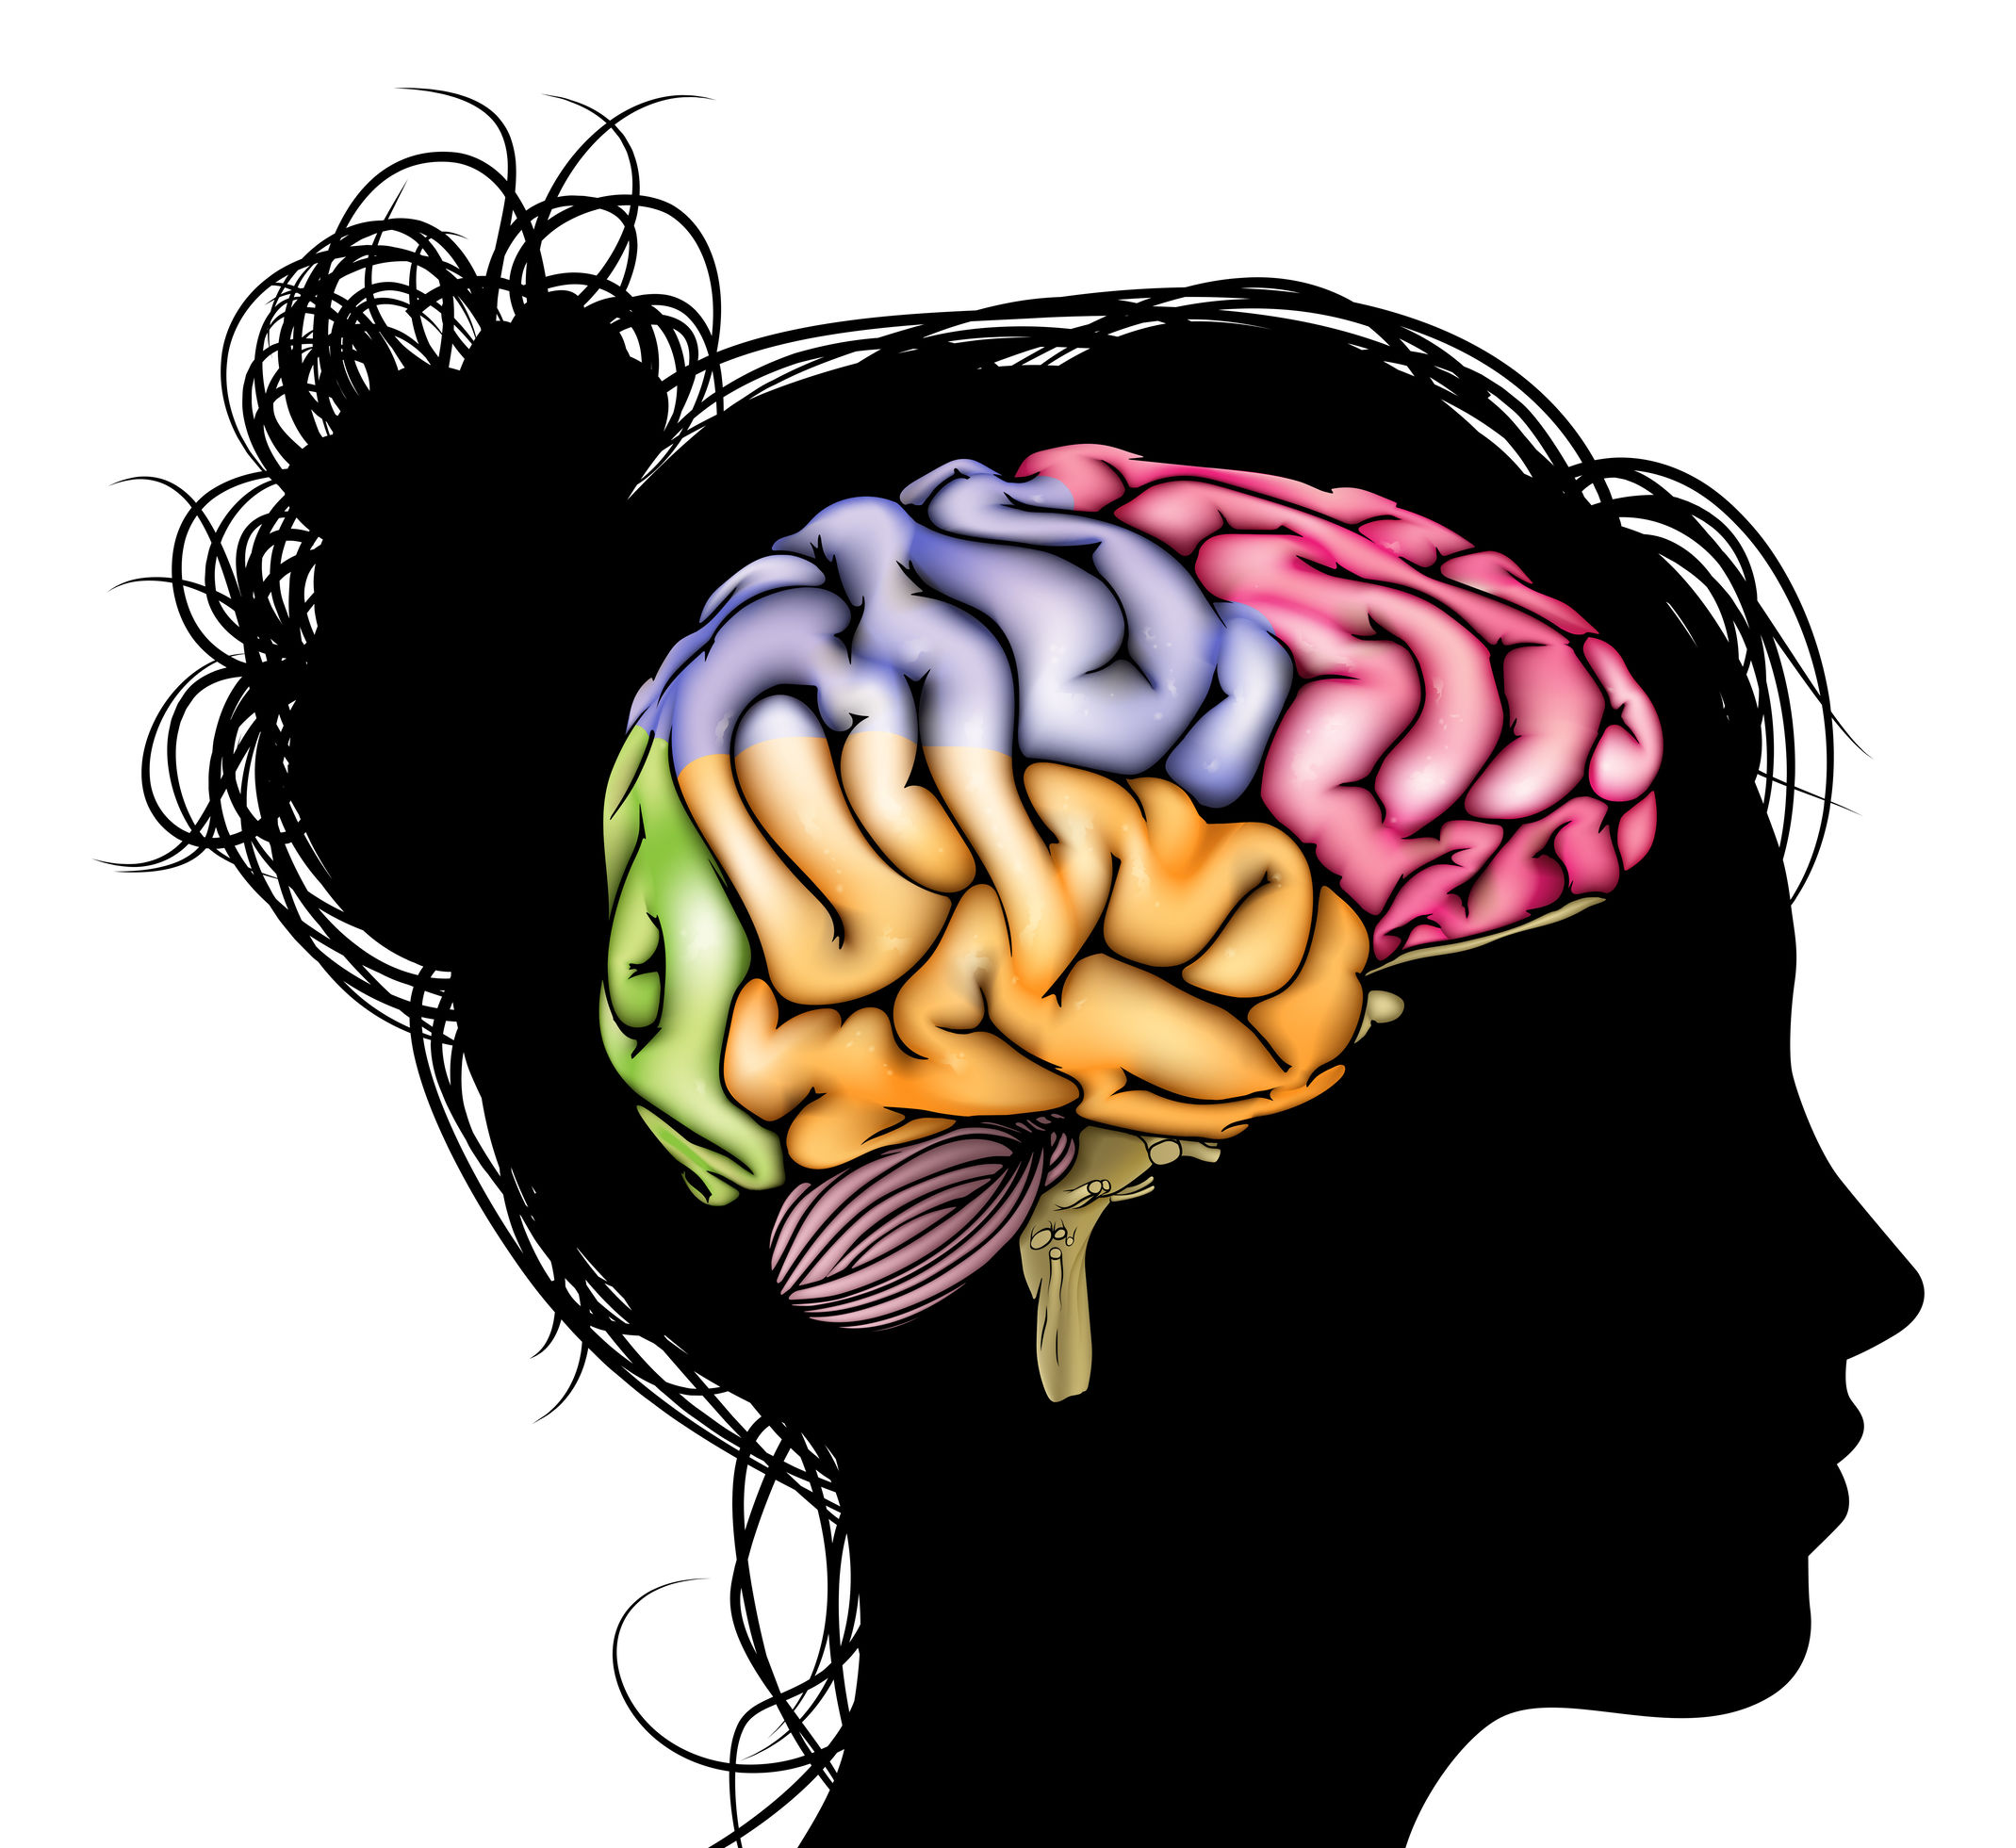
Frontal cortex: Associated with reasoning, first impressions, and empathy
Amygdala: Associated with automatic responses to stimuli and fear/“fight or flight” response
Temporal lobes: Store basic information about individuals and social stereotypes
Christos Georghiou © 123RF.com
Dalton S, Villagran M. Minimizing and addressing implicit bias in the workplace: be proactive, part one. College & Research Libraries News. 2018;79(9):478.
Notes:
Medical research has revealed that implicit bias is found throughout the brain. There are useful aspects of implicit bias that pertain to instinctual behaviors of environmental adaptation and survival, such as being able to quickly assess and respond to dangerous stimuli. However, automatic responses to facial stimuli, combined with social conditioning, can result in bias against individuals, often based on race. Acknowledging that we all have biases is the first step toward reducing our reliance on generalizations or stereotypes.

Slide 3
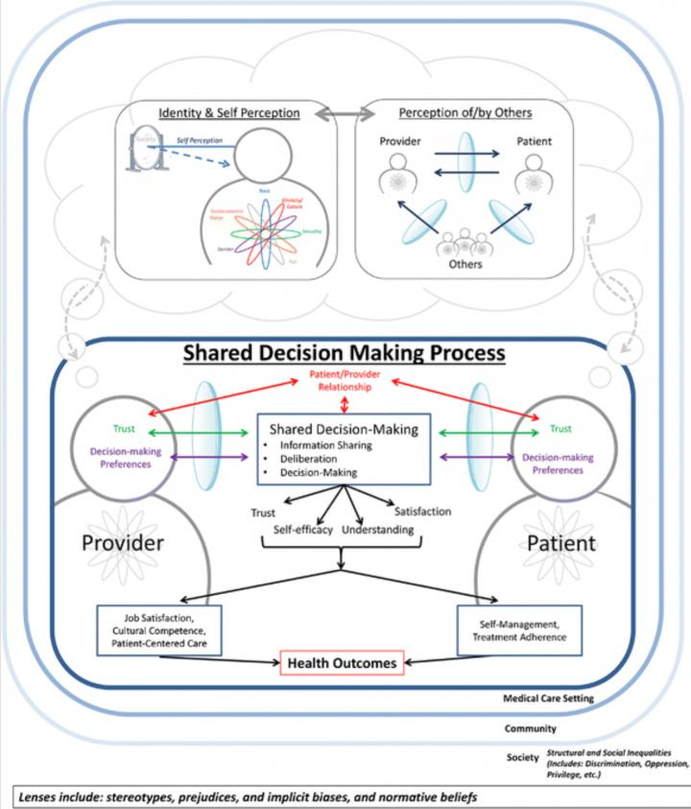
Reprinted with permission from Peek ME, Lopez FY, Williams HS, et al. Development of a conceptual framework for understanding shared decision making among African-American LGBT patients and their clinicians. J Gen Intern Med. 2016;31(6):677-687.
Notes:
This slide shows a conceptual framework depicting how bias operates in the interaction between a health care professional and a patient. Implicit biases modify the provider-patient relationship by decreasing trust, self-efficacy, understanding, and satisfaction.¹ This affects the patient’s ability to self-manage and adhere to treatment, and it limits the health care professional’s level of cultural proficiency, patient centeredness, and job satisfaction.
Health care professionals and patients have perceptions of themselves and each other that are based on their known or assumed roles, lived experiences, and intersecting social identities (e.g., race, ethnicity, gender), as well as the perceptions of others (e.g., societal beliefs). During the clinical encounter, their implicit biases influence communication, their behaviors, and the shared decision-making process, thereby increasing the risk of disparities in care and poorer health outcomes, especially for patients who are part of a minority group.
1. Peek ME, Lopez FY, Williams HS, et al. Development of a conceptual framework for understanding shared decision making among African-American LGBT patients and their clinicians. J Gen Intern Med. 2016;31(6):677-687.

Slide 4
Implicit Bias in Health Care
Fewer prescriptions for pain medication (Hoffman, 2016)
Fewer bypass surgeries (Daugherty, 2017)
Lower quality prenatal care (Kogan, 1994)
Notes:
Studies examining the health outcomes of implicit bias have revealed significant effects. For example:
In a study by Hoffman et al. involving a sample group of white medical students and residents, half endorsed false beliefs about biological differences between black people and white people. As a result, they viewed black patients’ pain levels as lower than white patients’ pain levels and made less accurate treatment recommendations for black patients.
A study of cardiologists by Daugherty et. al. found that implicit gender bias was associated with differences in simulated clinical decisions about cardiac testing for hypothetical male and female patients who had similar likelihoods of obstructive coronary artery disease.
Studies by Kogan et al. and others have shown that the implicit biases of health care professionals contribute to racial disparities in access to and quality of prenatal care.

Slide 5
Implicit Bias and Maternal Health Outcomes
The implicit biases of health care professionals toward women of color, particularly African-American women, have been indicated as a contributing factor to racial/ethnic disparities in:
Adverse maternal and child health outcomes
Rates of contraception use
Access to and quality of prenatal care
Clinical decision-making in the intrapartum and postpartum periods

Slide 6
How many women die from pregnancy-related complications in the United States each year?
425
1,250
700
1,600
6

Slide 7

The United States is “the most dangerous place to give birth in the developed world,” according to a USA Today investigation.
dolgachov © 123RF.com
https://www.usatoday.com/series/deadlydeliveries/
Notes:
In 2018, USA Today reported that the United States is the “most dangerous place to give birth in the developed world” for both mothers and infants.
According to statistics from the Centers for Disease Control and Prevention (CDC), in the United States:
Approximately 700 women die as a result of pregnancy or delivery complications each year.¹
More than 50,000 women experience severe maternal morbidity (e.g., heart attack, hemorrhage) each year. The rate of severe pregnancy complications has been steadily increasing in recent years.¹
More than 22,000 infants die from causes including birth defects, preterm birth, low birth weight, and pregnancy complications each year.²
1. Centers for Disease Control and Prevention, National Center for Chronic Disease Prevention and Health Promotion. Maternal health: at a glance 2016. Accessed September 23, 2019. https://www.cdc.gov/chronicdisease/resources/publications/aag/maternal.htm.
2. Centers for Disease Control and Prevention, Division of Reproductive Health, National Center for Chronic Disease Prevention and Health Promotion. Infant mortality. Accessed September 23, 2019. https://www.cdc.gov/reproductivehealth/maternalinfanthealth/infantmortality.htm.

Slide 8
Maternal Deaths Per 100,000 Live Births
16.9
Information from GBD 2015 Maternal Mortality Collaborators. Global, regional, and national levels of maternal mortality, 1990-2015: a systematic analysis for the Global Burden of Disease Study 2015. Lancet. 2016;388(10053):1775-1812.
Notes:
In most developed nations, including Canada, the United Kingdom, Japan, France, and Germany, the number of maternal deaths per 100,000 live births was flat or decreased from 1990 to 2015. However, in the United States, this number rose sharply from 16.9 to 26.4.

Slide 9
U.S. Maternal Mortality Ratio by Race (2011-2015)
42.8 deaths per 100,000 live births for black non-Hispanic women
32.5 deaths per 100,000 live births for American Indian/Alaskan Native non-Hispanic women
14.2 deaths per 100,000 live births for Asian/Pacific Islander non-Hispanic women
13.0 deaths per 100,000 live births for white non-Hispanic women
11.4 deaths per 100,000 live births for Hispanic women
Centers for Disease Control and Prevention, Division of Reproductive Health, National Center for Chronic Disease Prevention and Health Promotion. Pregnancy Mortality Surveillance System. Accessed September 20, 2019. https://www.cdc.gov/reproductivehealth/maternalinfanthealth/pregnancy-mortality-surveillance-system.htm.
Notes:
Considerable racial/ethnic disparities in pregnancy-related mortality exist. For example, statistics from the CDC show that in the United States, black non-Hispanic women are more than 3 times more likely to die from pregnancy-related complications than white non-Hispanic women.
In addition, the infant mortality rate for black non-Hispanic infants is more than twice the rate for white non-Hispanic infants (11.4 deaths per 1,000 live births compared with 4.9 deaths per 1,000 live births).¹
1. Centers for Disease Control and Prevention, Division of Reproductive Health, National Center for Chronic Disease Prevention and Health Promotion. Infant mortality. Accessed September 23, 2019. https://www.cdc.gov/reproductivehealth/maternalinfanthealth/infantmortality.htm.

Slide 10
Which of the following contribute to racial/ethnic disparities in maternal and infant health outcomes?
Genetic or biological differences between racial/ethnic groups
Social inequities
A and B
None of the above
10
Notes:
A number of studies examining the complex biopsychosocial factors associated with racial/ethnic disparities in maternal and infant health outcomes in the United States have determined that social inequity is a primary factor driving disparities.^{1,2,3}
1. Braveman PA, Heck K, Egerter S, et al. The role of socioeconomic factors in black-white disparities in preterm birth. Am J Public Health. 2015;105(4):694-702.
2. Geronimus AT. The weathering hypothesis and the health of African-American women and infants: evidence and speculations. Ethn Dis. 1992;2(3):207-221.
3. Wheeler S, Maxson P, Truong T, Swamy G. Psychosocial stress and preterm birth: the impact of parity and race. Matern Child Health J. 2018;22(10):1430-1435.

Slide 11
Factors Contributing to Racial/Ethnic Disparities
Higher level of chronic stress due to being a racial minority in the United States
Greater likelihood of pre-existing health conditions
Barriers to accessing care throughout pregnancy due to income inequality
Different (often worse) quality of maternity care in hospitals
Belluz J. Black moms die in childbirth 3 times as often as white moms. Except in North Carolina. Vox. July 3, 2017. Accessed September 23, 2019. https://www.vox.com/health-care/2017/7/3/15886892/black-white-moms-die-childbirth-north-carolina-less.
Notes:
In a 2017 interview, the chief of the Maternal and Infant Health Branch of the CDC’s Division of Reproductive Health identified the following factors that may contribute to higher rates of pregnancy-related complications in African-American women:
“The experience of being African American in the U.S. confers a different level of chronic stress from the beginning of life all the way through the life course…and that can change how one’s body reacts to any physical stress in life, including the physical stress in pregnancy.” For example, inequalities in housing, income, and employment can elevate individual stress levels. Elevated stress levels have been shown to trigger a pathophysiological response in which elevated levels of hormones such as cortisol can promote active labor and lead to preterm birth. ^{1,2} Stress can also elevate blood pressure, increasing the risk for postpartum hemorrhage.
Pre-existing health conditions that can contribute to pregnancy-related complications (e.g., heart disease, high blood pressure, diabetes) are more common among African-American women than white women.
Due to income inequality, African-American women may have more barriers to accessing adequate care throughout pregnancy and/or between pregnancies.
African-American women get different (often worse) maternity care in hospitals than white women.
1. Gillespie SL, Christian LM, Neal JL. A proposed bio-panel to predict risk for spontaneous preterm birth among African American women. Med Hypotheses. 2015;85(5):558-564.
2. Mendez DD, Hogan VK, Culhane JF. Institutional racism, neighborhood factors, stress, and preterm birth. Ethn Health. 2014;19(5):479-499.

Slide 12
Practice Recommendations
Conduct a systematic evaluation of patient outcomes to identify disparities (e.g., by race/ethnicity, socioeconomic status, gender)
Assess your own implicit biases (Implicit Association Test)
Develop skills that actively mitigate implicit bias in the delivery of health care
Notes:
As a health care professional, what can you do about implicit bias in your practice or organization?
Conduct a systematic evaluation of patient outcomes in your practice/organization to identify disparities (e.g., by race/ethnicity, socioeconomic status, gender). If disparities exist, the practice or organization should develop an overarching quality or performance improvement strategy to reduce disparity gaps and achieve health equity.
Assess your own implicit biases and encourage other members of the health care team to do so, too. The Implicit Association Test (IAT) used in this training course is a validated, reliable tool for assessing biases based on race, skin color, gender, disability, and more. Keep in mind that the IAT is designed for use as a prompt to trigger self-reflection, discussion, and awareness of personal biases. It should not be used to measure progress toward personal or organizational health equity and inclusion goals.
Encourage all members of the health care team to participate in periodic training that includes the demonstration and practice of skills that can mitigate implicit bias in health care delivery. These skills are discussed in the “Mitigating Implicit Bias in Clinical Practice” PowerPoint presentation.

Slide 13
References
Centers for Disease Control and Prevention, Division of Reproductive Health, National Center for Chronic Disease Prevention and Health Promotion. Infant mortality. Accessed September 20, 2019. https://www.cdc.gov/reproductivehealth/maternalinfanthealth/infantmortality.htm.
Centers for Disease Control and Prevention, National Center for Chronic Disease Prevention and Health Promotion. Maternal health: at a glance 2016. Accessed September 20, 2019. https://www.cdc.gov/chronicdisease/resources/publications/aag/maternal.htm.
Daugherty SL, Blair IV, Havranek EP, et al. Implicit gender bias and the use of cardiovascular tests among cardiologists. J Am Heart Assoc. 2017;6(12):e006872.
Hoffman KM, Trawalter S, Axt JR, Oliver MN. Racial bias in pain assessment and treatment recommendations, and false beliefs about biological differences between blacks and whites. Proc Natl Acad Sci U S A. 2016;113(16):4296-4301.
Kogan MD, Kotelchuck M, Alexander GR, Johnson WE. Racial disparities in reported prenatal care advice from health care providers. Am J Public Health. 1994;84(1):82-88.

Slide 14
© 2019 American Academy of Family Physicians. All rights reserved.
All materials/content herein are protected by copyright and are for the sole, personal use of the user.
No part of the materials/content may be copied, duplicated, distributed, or retransmitted
in any form or medium without the prior permission of the applicable copyright owner.

Slide 15
