Slide 1

Welcome to the BLSO Course
Third Edition

Slide 2

Introductions
Course Director
Course Coordinator
Faculty

Slide 3
Disclosure & Disclaimer
All individuals in a position to control content for this live activity have indicated if they have relevant financial relationship disclosures.
This material is not intended to represent the only, nor necessarily best, methods or procedures appropriate for the medical situations discussed. Rather, it is intended to present AN approach, view, statement, or opinion of the faculty, which may be helpful to others who face similar situations.

Slide 4
BLSO
Today we will​
acknowledge that
BLSO is not the only way.​
But we are here to learn the BLSO Way!​

Slide 5
Why BLSO?
Evidence-based
Multidisciplinary/Interprofessional content
Standardized educational approach
Mnemonics
Longevity of the program
Proven outcomes
Gets the ENTIRE pregnancy care team on the same page, including first responders

Slide 6
Housekeeping Items…
Bathrooms
Room locations
Lunch
Phones on silent
  Pictures as long as not a distraction
  Encourage posts on Facebook, Instagram, TikTok, etc.

Slide 7
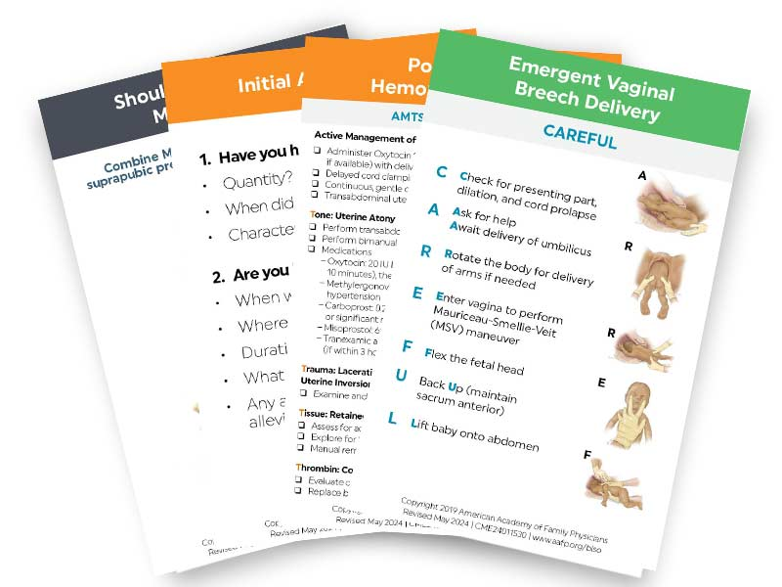
Mnemonic Cards
May use during the course
Do not reference during Group Testing sessions

Slide 8
Course Documents
Agenda
  Time management
  Repetitive learning-stay engaged with your group!
Workstation Checklists
  Must be signed by Instructor
  Keep until the end of the day
  Must turn into Course Director

Slide 9
Required Elements
Course Evaluations
  We'd like feedback from every Learner
  Must turn in your evaluation to the Course Coordinator or Director

Slide 10
Pointers
Not all workstations are equal.
Please pay special attention to how long your breaks are & be back in the room on time. This is the key to us getting out on time today!
Repetitive learning-stay engaged!
Scope
  You may not perform some tasks, but it is still in the best interest of the patient that you are informed as a member of the pregnancy care team.
Keep it fun!

Slide 11

BLSO Online Course Questions

Slide 12
© 2024 American Academy of Family Physicians. All rights reserved.
All materials/content herein are protected by copyright and are for the sole, personal use of the user.
No part of the materials/content may be copied, duplicated, distributed or retransmitted
In any form or medium without the prior permission of the applicable copyright owner.

Slide 13


