Slide 1

Implicit Bias Training:
Mitigating Implicit Bias in Clinical Practice
Facilitator
MM/DD/YY

Slide 2
Mitigating Implicit Bias in Clinical Practice
Mitigation
Self check-in
Awareness
An ongoing, deliberate process
Notes:
Mitigating implicit bias in clinical practice is a deliberate, ongoing process that requires self-awareness and self-regulation. It requires health care professionals to check in with themselves on a regular basis to ensure that they are acting based on a rational assessment of clinical situations rather than on stereotypes and prejudices.

Slide 3
Ways to Mitigate Implicit Bias
Increasing self-awareness and taking the social perspective of others
Building empathy
Practicing mindfulness techniques that develop self-regulation and monitoring of behaviors
Activating goals that promote fairness and equality
Collecting counter-stereotypical information
Notes:
What skills can mitigate implicit bias in the delivery of health care?
Increasing self-awareness and taking the social perspective of others: Recognizing privilege in your personal life, at work, and in the lives of others helps health care professionals develop greater empathy and be more aware of implicit bias and its effect on patients.
Building empathy: Empathy brings patients and health care professionals together within the context of shared experiences, helping to protect patients against stereotyping and discrimination. It also shifts the position of power that health care professionals hold in the relationship so that providers and patients can share decision-making.
Practicing mindfulness techniques that develop self-regulation and monitoring of behaviors: Studies have shown that mindfulness practice (e.g., mindful breathing or movement, body scan meditation) can help address implicit bias by "reducing the likelihood that implicit biases will be activated in the mind, increasing [health care professionals’] awareness of and ability to control responses to implicit biases once activated, [and] increasing self-compassion and compassion toward patients.”¹
Activating goals that promote fairness and equality: When activated, these goals undermine and counteract stereotypes before they are unconsciously or consciously recalled.
Collecting counter-stereotypical information: Collecting information that is opposite of cultural stereotypes about the attitudes and behaviors of a group can help limit implicit biases. This information allows for the development of new associations that eventually become automatically activated when meeting a patient from the stereotyped group.
1. Burgess DJ, Beach MC, Saha S. Mindfulness practice: a promising approach to reducing the effects of clinician implicit bias on patients. Patient Educ Couns. 2017;100(2):372-376.

Slide 4
Learner Activity
Think of a number between 1 and 10.
Add 2.
Double the number.
Subtract your original number.
Add 8.
Subtract your original number.
Divide by 3.
Find the corresponding letter of the alphabet (1=A, 2=B, 3=C, etc.).
Think of a country that starts with that letter.
Think of an animal that starts with last letter of the country.
Think of a fruit that starts with the last letter of the animal.

Slide 5
Denmark Kangaroo Orange
Countries that start with D | Animals that start with K | Fruits that start with O
Denmark | Kangaroo | Orange
Djibouti | Komodo Dragon | Olive
Dominica | Kitten | Okra
Dominican Republic | Koala
 | Koi
Notes:
On average, about 70%-90% of participants will respond with the phrase “Denmark kangaroo orange.”
Ask learners what they think this exercise reveals about how our culture, beliefs, and/or experiences shape our responses and how this might cause us to generalize or perpetuate stereotypes, even if we know that these types of bias exist. Think about the possibilities that were excluded. For example, is it significant that the three other countries that start with D have majority non-white populations?
Key takeaways for learners from this activity include the following:
Cultural norms, language, and experiences shape our individual knowledge and decision-making.
Shared knowledge between “like” individuals and/or groups (e.g., in clinical consults among health care professionals) may drive confirmation bias.

Slide 6
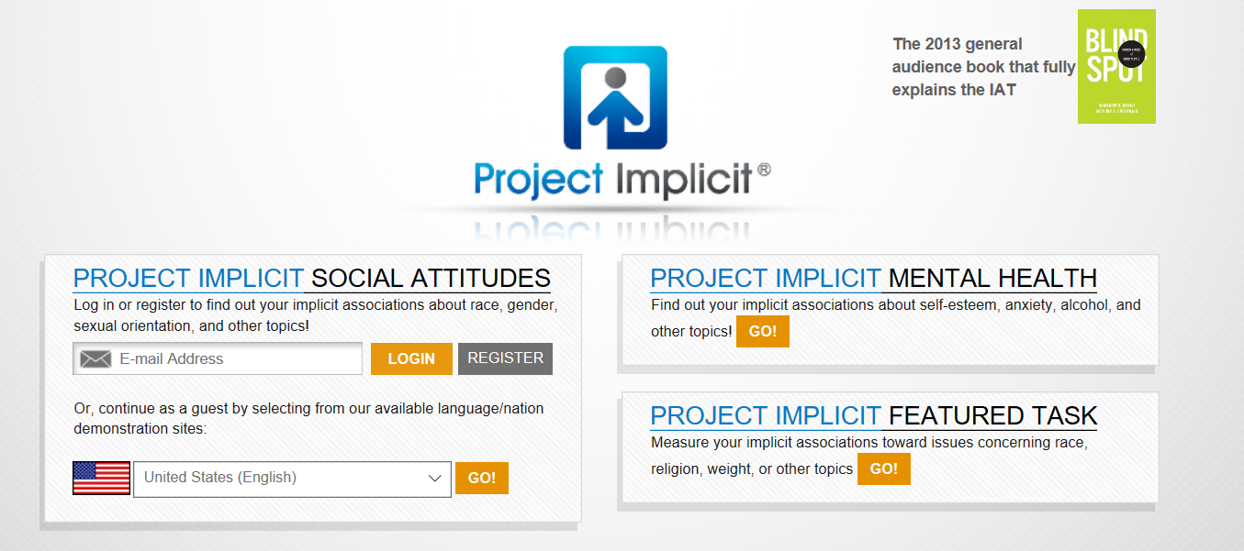
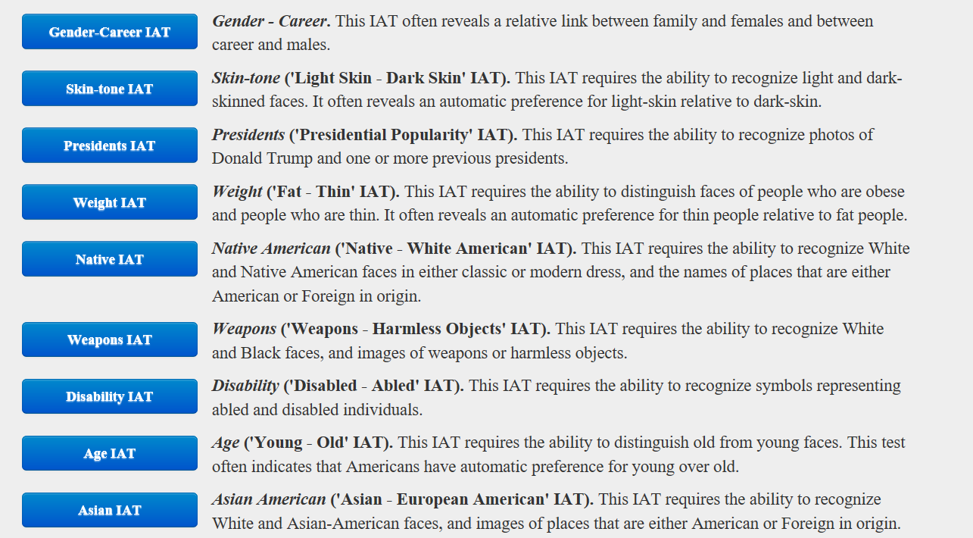
Implicit Association Test (IAT)
Series of free, publicly available computer-based exercises
Developed by Project Implicit®, a long-term research project based at Harvard University
Asks participants to associate words with images to assess automatic associations between concepts by measuring the time and latency of their responses
Copyright 2011 Project Implicit®. All Rights Reserved. Reprinted with permission.
Notes:
The Implicit Association Test (IAT) (available online at https://implicit.harvard.edu/implicit/takeatest.html) is a series of free, publicly available computer-based exercises developed by Project Implicit®, a long-term research project based at Harvard University. The test asks participants to associate words with images to assess participants’ automatic associations between concepts by measuring the time and latency of their responses. While the IAT is considered more reliable and valid than survey evaluations, it is designed to be used as a prompt to trigger self-reflection, discussion, and awareness of personal biases, not as a metric for measuring implicit bias or evaluating curricular outcomes.

Slide 7
Discussion of IAT Results
  Was anyone disturbed by their results? If so, please explain.
  How did your results make you feel? Please explain.
  Do your results make you feel differently about how you approach patient care? If so, how?

Slide 8
Social Perspective-Taking Survey
Read each statement on the survey and select those that you feel describe your experience.
Count your total number of affirmative responses and write the number in the space below the survey.
Stand when you are finished.

Slide 9
Please Sit If Your Total Is…
0-5
6-10
11-15
Notes:
Once all learners are standing, ask them to sit down in order of their respective totals. Start by saying, “Please sit if your total is less than 5,” then move on to less than 10, and so on. Only individuals with the greatest privilege (i.e., the highest total) should still be standing at the end of the exercise.

Slide 10
Reflection
  What types of identities are reflected in these statements?
  What stood out to you?
  Were there any statements that you had never thought of before? If so, which ones?
  Were there any statements that you had thought about before? Please explain.
  Are there any statements you really wanted to select but couldn’t?
  Are there any statements you would add? If so, why?
  Why is this important to the work we do as health care professionals?

Slide 11
© 2019 American Academy of Family Physicians. All rights reserved.
All materials/content herein are protected by copyright and are for the sole, personal use of the user.
No part of the materials/content may be copied, duplicated, distributed, or retransmitted
in any form or medium without the prior permission of the applicable copyright owner.

Slide 12


