Slide 1

Implicit Bias Training:
Creating a Safe and Inclusive Learning Environment
Facilitator
MM/DD/YY

Slide 2
Purpose
Create a space for learners to talk about their identities and experiences in a more personal way than they might otherwise
Discuss intersectionality in the context of health care

Slide 3

Identity Signs
Notes:
If you hang identity signs around the room:
Say, “We are going to be doing an activity now that requires us to move around the room. I’m going to read a statement and then you’re going to answer that statement by placing yourself under one of the signs that I’ve hung up around the room. The statements relate to your experience of these identities. We’ll then have a chance to talk in small groups and reflect as a large group. This activity is a way to explore the parts of your identity that give you privilege and those that don’t. There are likely some that you have never had to think about before.”
If you place identity signs on tables as tents:
Say, “We are going to be doing an activity now that requires us to move around the room. I’m going to read a statement and then you’re going to answer that statement by placing yourself by one of the signs that are on the tables. The statements relate to your experience of these identities. We’ll then have a chance to talk in small groups and reflect as a large group. This activity is a way to explore the parts of your identity that give you privilege and those that don’t. There are likely some that you have never had to think about before.”

Slide 4
Ground Rules
What you share within the context of the group is confidential, honored, and respected.
Use “I” statements to avoid speaking for another person or for an entire group.
Focus on your own experiences and avoid critiquing others’ experiences.
Be honest and willing to share. If you tend to be quiet in groups, challenge yourself to share.
Resist the desire to interrupt.
Be mindful of time.

Slide 5
The part of my identity that I am most aware of on a daily basis is_________.

Slide 6
The part of my identity that I am the least aware of on a daily basis is_________.

Slide 7
The part of my identity that I wish I knew more about is _________.

Slide 8
The part of my identity that provides me the most privilege is _________.

Slide 9
The part of my identity that I believe is the most misunderstood by others is _________.

Slide 10
The part of my identity that I feel is difficult to discuss with others who identify differently is _________.

Slide 11
The part of my identity that makes me feel discriminated against is _________.

Slide 12

Reflection
How did it feel to do this activity?
What did you find surprising?
What do you want to explore further?
rawpixel © 123RF.com

Slide 13
Takeaways
Human lives cannot be reduced to single characteristics.
Human experiences cannot be accurately understood by prioritizing any one single factor over another.
Categories such as race/ethnicity, gender, class, and ability are socially constructed, fluid, and flexible.
Identities are inseparable and shaped by interactions between social processes and structures influenced by time and place.
Hankivsky O. Women’s health, men’s health, and gender and health: implications of intersectionality. Soc Sci Med. 2012;74(11):1712-1720.
Notes:
Every person’s identity is comprised of multiple parts that intersect, are inseparable, and are shaped by the person’s interactions with others and with societal structures. This is a central premise of intersectionality theory.

Slide 14
What Is Intersectionality Theory?
A framework that aims to identify how systems impact marginalized populations based on socially constructed categories, such as class, race, and gender

Slide 15
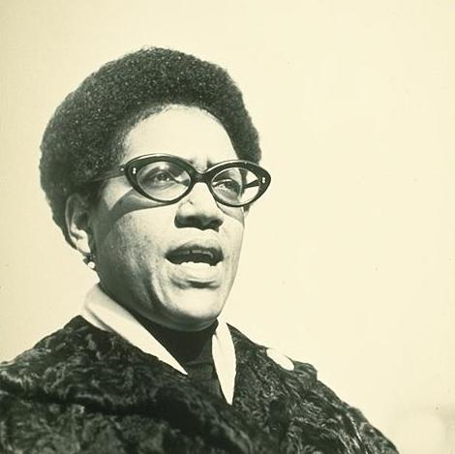
“There is no such thing as a single-issue struggle, because we do not live single-issue lives.”
- Audre Lorde
"Audre Lorde" by Elsa Dorfman (en:User:Elsad - https://commons.wikimedia.org/wiki/File:Audre_lorde.jpg) is licensed under CC BY-SA 3.0.
Notes:
Audre Lorde (February 18, 1934 – November 17, 1992) was a writer, feminist, womanist, and civil rights activist. This quotation is from “Learning From the 60s,” an address she delivered at Harvard University in February 1982.

Slide 16
Practice Implications of Intersectionality
Transform how you perceive the mechanisms of power that shape health inequities
Reflect upon your own intersecting social identities and consider how they shape treatment decisions, care delivery, and the way you view medical conditions and your patients
Develop skills to encourage your patients to reveal their social identities during the clinical encounter
Conduct training, research, and/or education that explores the impact of intersectionality on health in your organization

Slide 17
Additional Reading
Bauer GR. Incorporating intersectionality theory into population health research methodology: challenges and the potential to advance health equity. Soc Sci Med. 2014;110:10-17.
Davy Z. The promise of intersectionality theory in primary care. Qual Prim Care. 2011;19(5):279-281.
Hankivsky O. Women’s health, men’s health, and gender and health: implications of intersectionality. Soc Sci Med. 2012;74(11):1712-1720.
Powell Sears K. Improving cultural competence education: the utility of an intersectional framework. Med Educ. 2012;46(6):545-551.

Slide 18
© 2019 American Academy of Family Physicians. All rights reserved.
All materials/content herein are protected by copyright and are for the sole, personal use of the user.
No part of the materials/content may be copied, duplicated, distributed, or retransmitted
in any form or medium without the prior permission of the applicable copyright owner.

Slide 19


