Slide 1
AAFP Updated Presentation Template
January 2021

Slide 2
Best Use of PowerPoint for Presentations
Most effectively used as a recall aid for presentations
Utilize the title and bullet points to reinforce key points
More powerful when visuals are utilized
  Graphs, diagrams or images that help tell the story
PowerPoint may not be the best tool for all presentations
For ideation sessions consider a white board or flip chart
Best for presentations that don’t require too much content
If you have a report with longer form content, we can develop a template to meet your needs

Slide 3

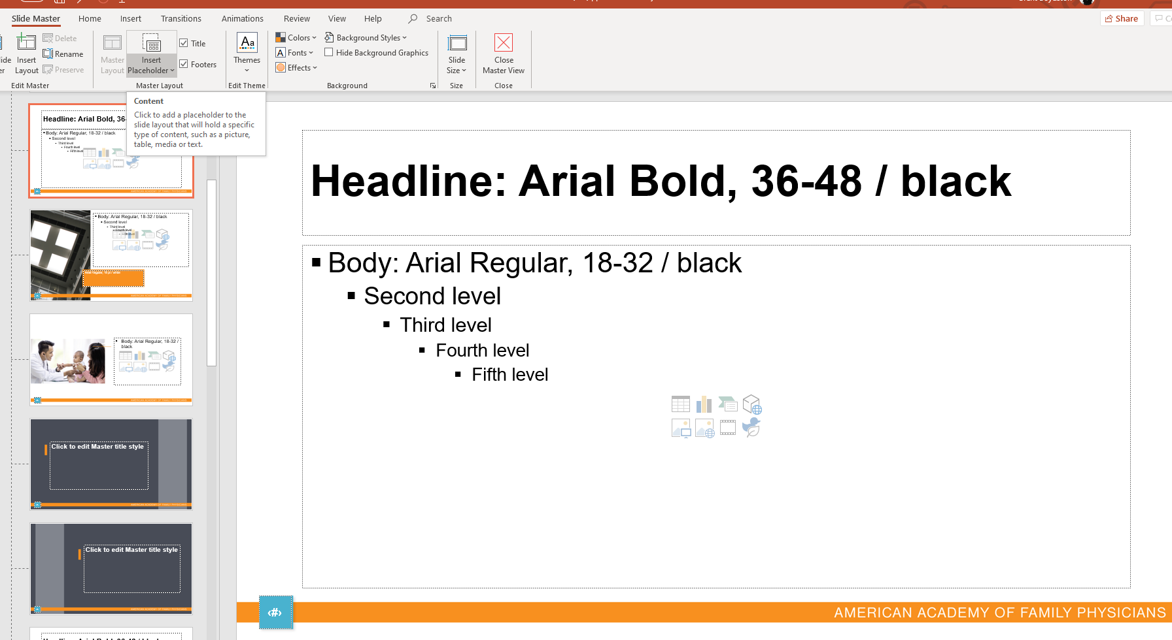
AAFP Template Overview
We hope you enjoy the new design and have some fun while building out your presentations
This is the recommended AAFP PPT template
If you have questions, comments, suggestions please let Brent Boydston or Karen Heins know
Charts are built to autofill with AAFP color palette
Additional slide options can be found in the drop down:
  View Slide Master

Slide 4
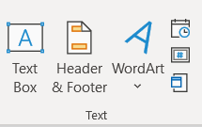

Review PPT Presentation Slide Numbers
When changing the PowerPoint template for an existing presentation or when adding a slide from other presentations, page numbers may be disrupted.
Solution(s):
  If slide number is missing, insert a text box
  and size to slide number square provided
  in lower left-hand corner, then insert
  slide number
  If slide number is outside of box; click on the number and drag into slide number square provided in template

Slide 5
PowerPoint Design Ideas
PowerPoint offers a tool that can offer design features to your presentations
If you decide to use this feature please double check the page number and formatting to ensure the overall look and feel of the template remain
We would request that you utilize the Design Idea feature sparingly in your AAFP presentations

Slide 6






Sample photos for content slides
Feel free to edit and crop these photos as needed for your presentation needed
We wanted to provide imagery if it would help bring your presentation to life

Slide 7
Chart Examples

Slide 8
Divider Slide
Use when needed
Arial Bold 36-48 pt. / White

Slide 9
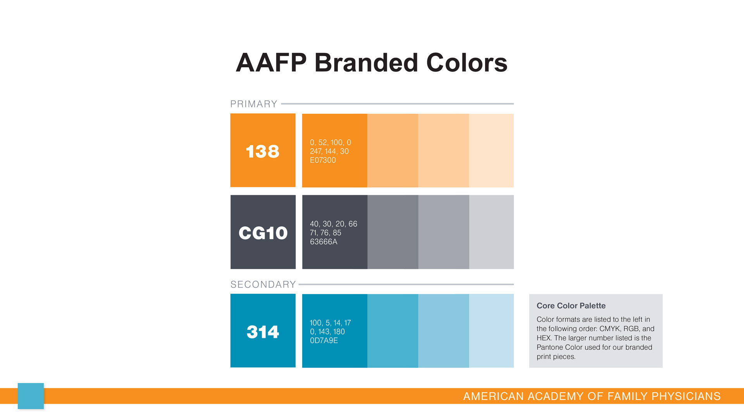

Slide 10













Slide 11
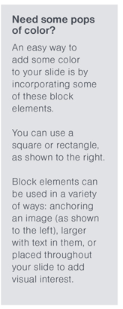
Secondary Block Elements

Slide 12
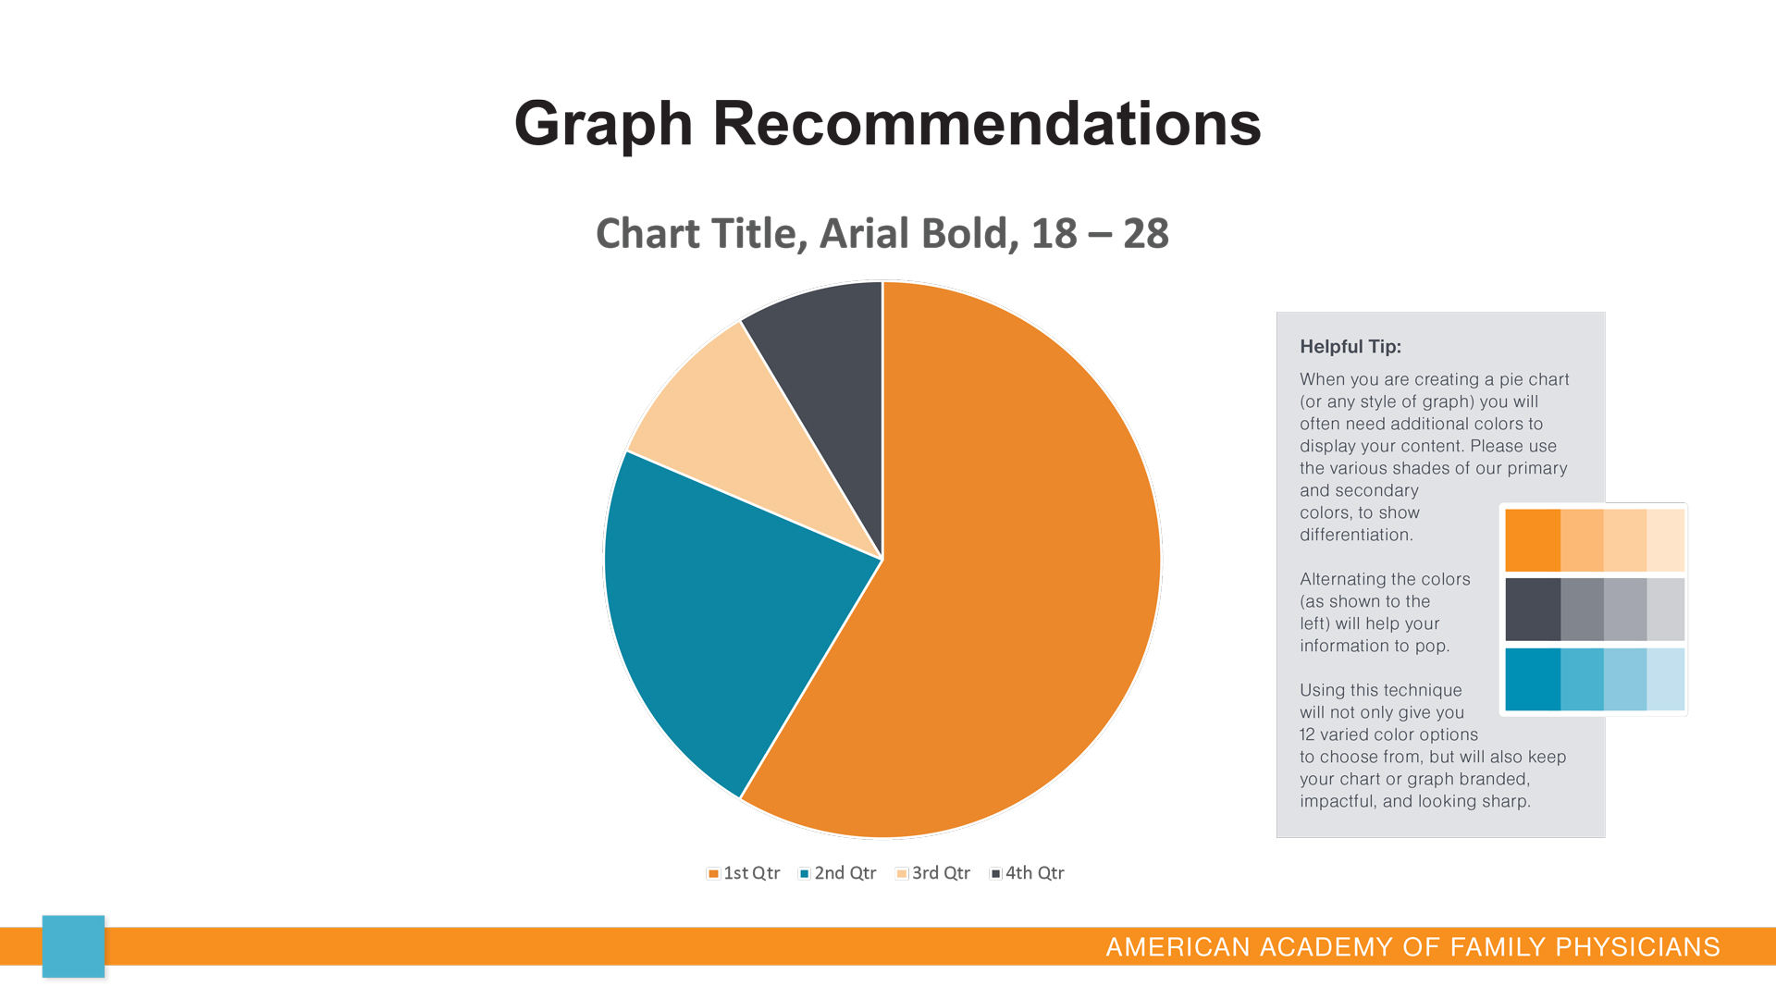
12

Slide 13
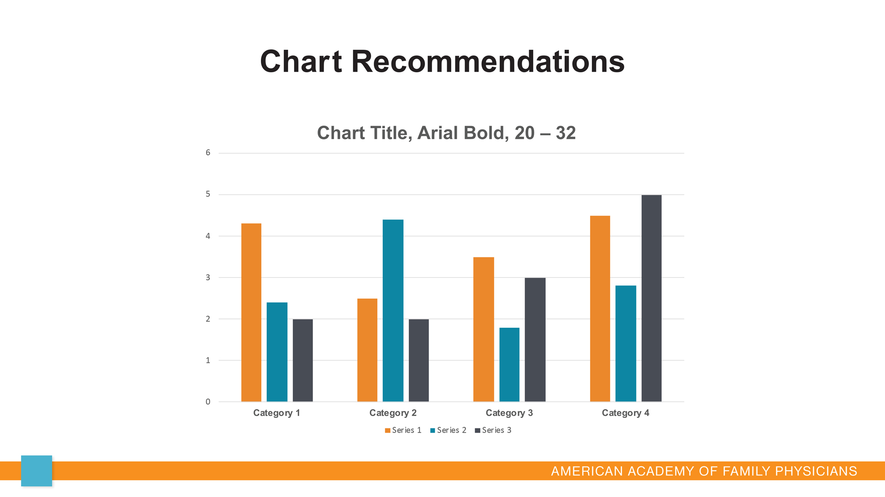

Slide 14
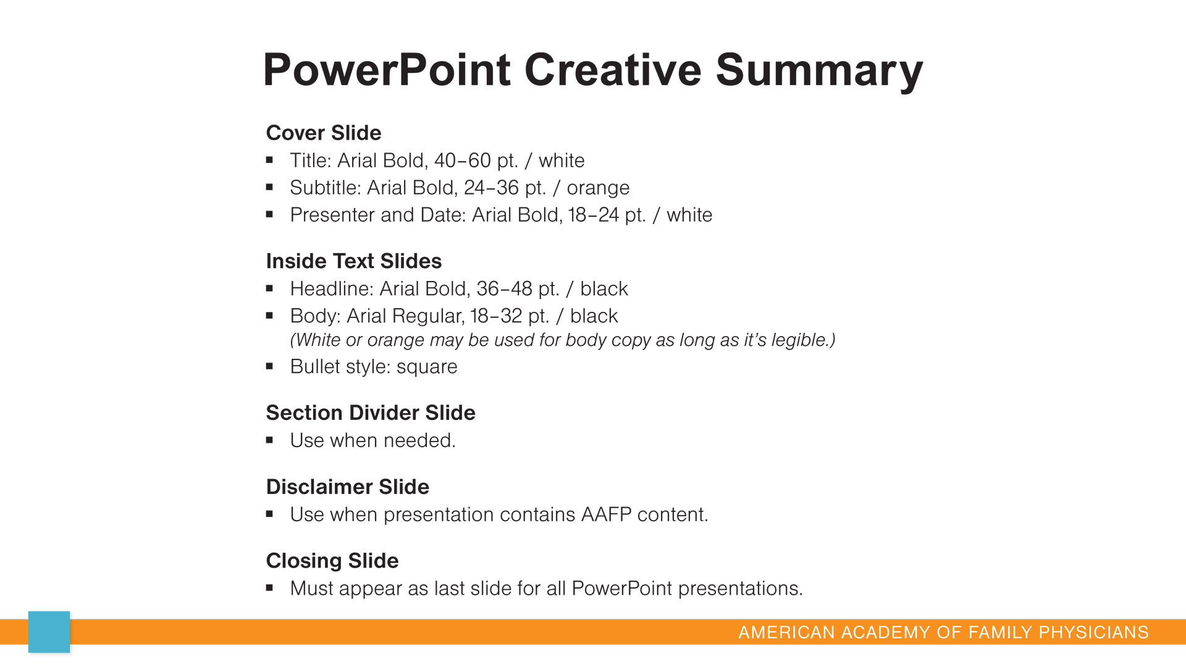

Slide 15
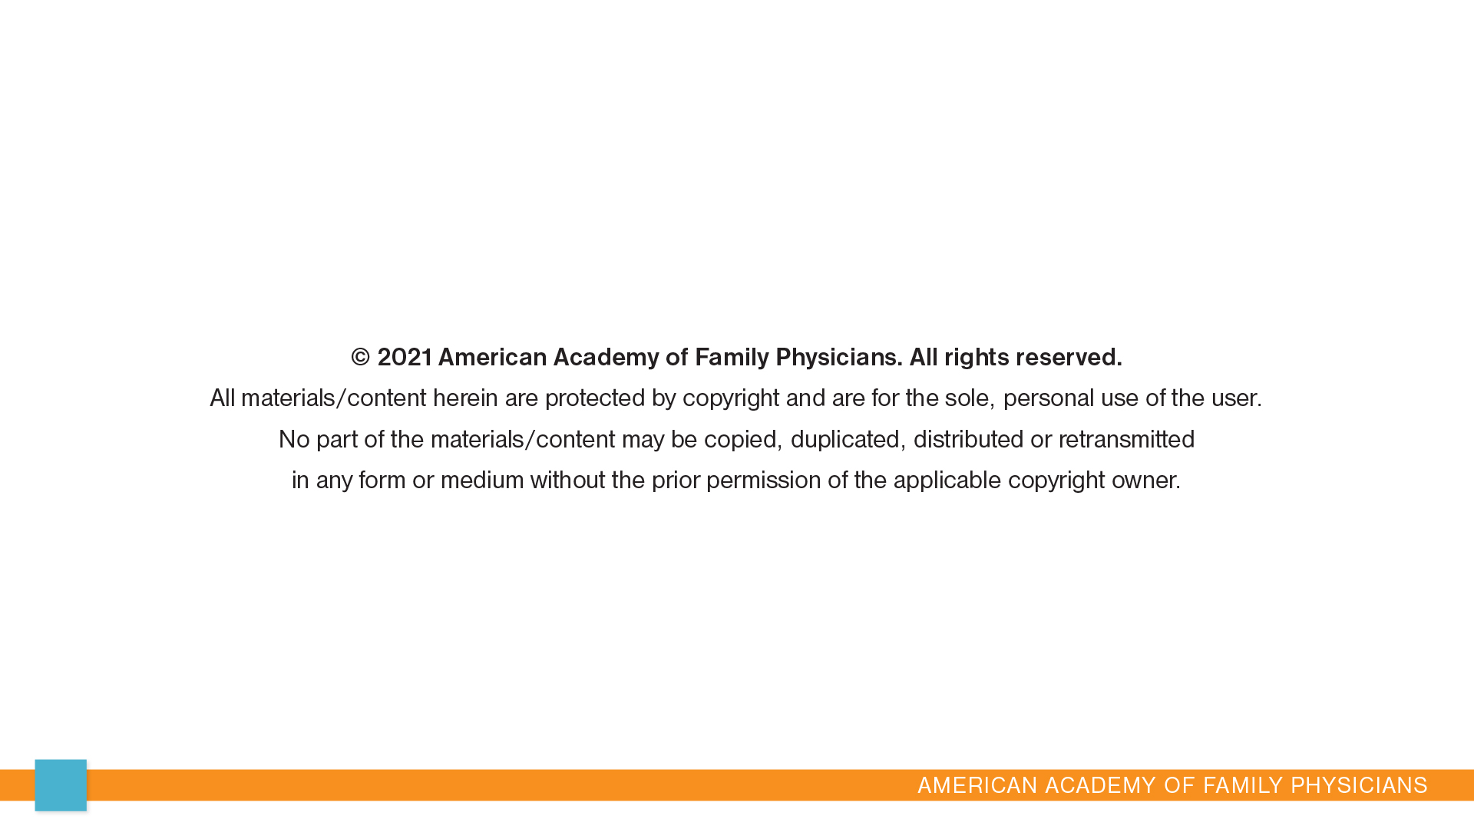
15

Slide 16


