Slide 1

Title Text, Arial Regular, size 40-72
Subtitle of Presentation, size 36-48
Presenter’s Name, size 24
March 16, 2018, size 24

Slide 2

Title of Interior Slide. Size 36-48
Body text for interior slide, Arial Regular.
Size 18-32.
All text in Dark Gray, R-68, G-68, B-68.

Slide 3
© 2018 American Academy of Family Physicians. All rights reserved.
All materials/content herein are protected by copyright and are for the sole, personal use of the user.
No part of the materials/content may be copied, duplicated, distributed or retransmitted
in any form or medium without the prior permission of the applicable copyright owner.

Slide 4


Slide 5
PowerPoint Creative Summary
Cover Slide
  • Text in Arial Regular, white
  • Title - 40-72 point; Subtitle - 36-48 point; Presenter and Date - 24 point.
Inside Slides
• Text in Arial Regular, gray (R-68, G-68, B-68).
• Headline - 36-48 point; Body copy - 18-32 point.
Disclaimer Slide
• Use when presentation contains AAFP content.
Closing Slide
• Must appear as last slide for all PowerPoint presentations.

Slide 6
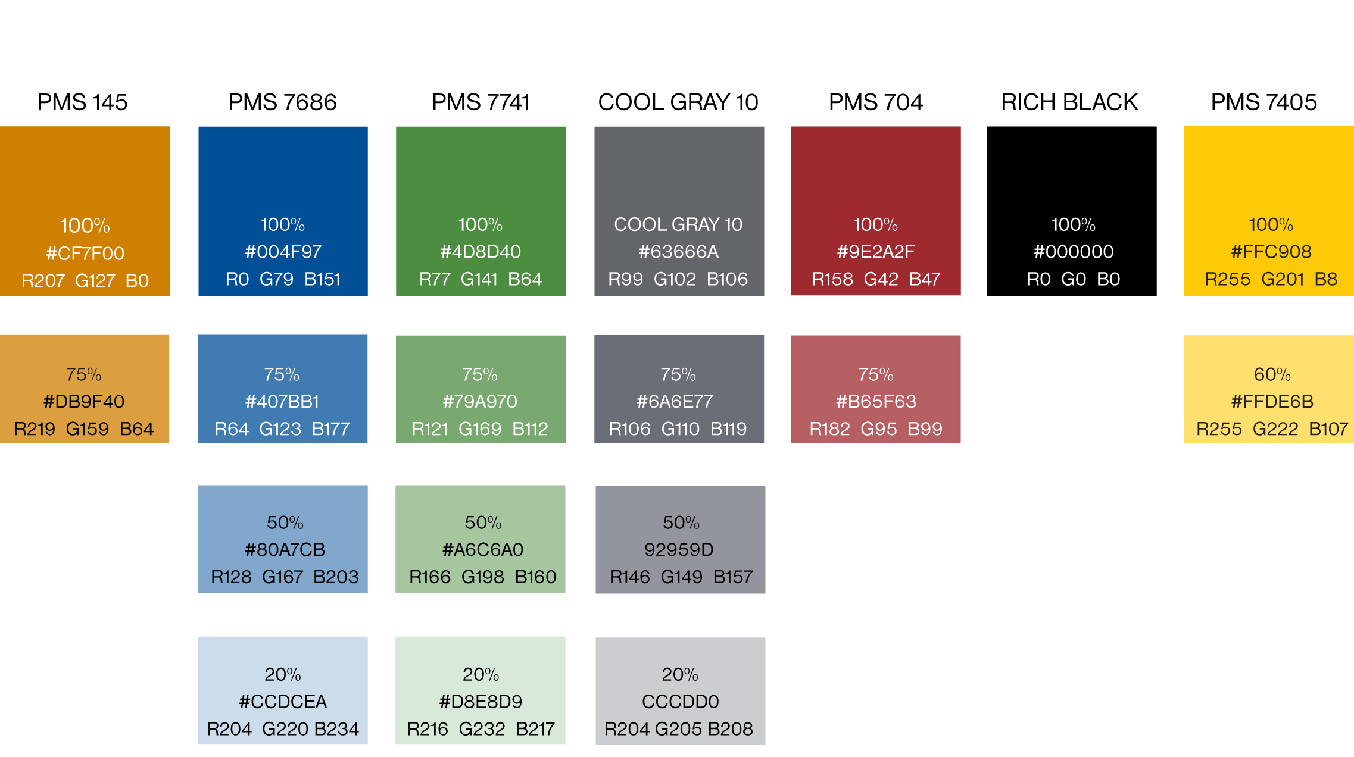
PowerPoint Brand Colors

