Slide 1
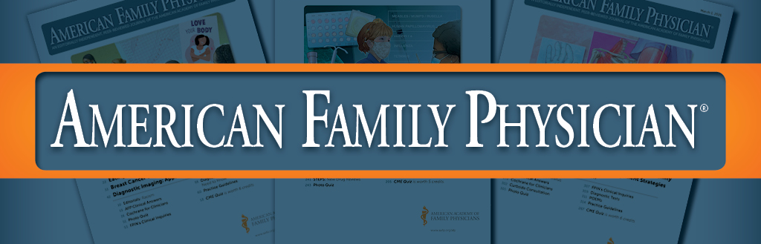
How to Do an Effective Peer Review
Notes:
Sumi: Hello, I am Dr. Sumi Sexton, American Family Physician’s editor-in-chief and this presentation briefly outlines how to do an effective peer review for our journal.

Slide 2

Learning Objectives
Define the role of the peer reviewer for American Family Physician
Before you get started
Important “Dos”
Important “Don’ts”
Before you hit submit
Notes:
Sumi: The learning objectives for this presentation include:
Defining the role of the peer reviewer for American Family Physician
What to do before you get started
The important Do’s
The important Don’ts
And finally, what to remember before you submit your review

Slide 3
Presenter Introductions
American Family Physician Jay Siwek Medical Editing Fellows (2020-2021):
Joanna Drowos DO, MPH, MBA
Natasha Pyzocha DO, FAWM, FAAFP
Notes:
Sumi: I’d like to introduce our other presenters for today who are the 2020 to 2021 American Family Physician Jay Siwek Medical Editing Fellows.
Next, we will be hearing from Dr. Joanna Drowos and Dr. Natasha Pyzocha.

Slide 4
What is your role as a reviewer for AFP?
To provide constructive suggestions on how to meet these goals:
Relevant to Family Physicians
Timely
Balanced
Accurate
Evidence-based
High-quality
Notes:
Joanna: Thank you Dr. Sexton. This is Dr. Joanna Drowos, and I’d first like to give an overview of what the role of an AFP reviewer entails.
Overall, you should plan to provide constructive suggestions that are:
Relevant to family physicians, since this is the target audience of our journal
Submitted on time
Balanced, or looking out for biases
Accurate, or fact checked
Evidence-based and not only the opinion of the writer
And high-quality, or ensuring that all nothing integral is missed on the topic

Slide 5
Planning to Begin as a Peer Reviewer
Read the Reviewers’ Guide: https://www.aafp.org/journals/afp/reviewers.html
Complete the reviewer profile
Ensure no conflict of interest
Find a mentor
Read supplemental articles
Dedicate time
Notes:
Joanna: To be a stellar peer reviewer it is first recommended to read the reviewers’ guide at the link provided here. This will have all of the information you will need to get started. From there, please complete the reviewer profile which will be our pre-screen ensuring that you do not have any major conflicts of interest in reviewing this topic. Next, if you’re starting out for the first time as a peer reviewer or do not have a lot of experience, it can be really helpful to find a mentor or someone who has lots of experience as a reviewer who can edit your work. Often other attendings, peers, or senior physicians are good at this role. The next step is to read supplemental articles that pertain to the topic so that you ensure you have a good understanding of what is going on and don’t miss pertinent information when reviewing. Finally, blocking off time in your busy schedule can often be helpful in order to complete your review on time.
Sumi: Dr. Drowos can you speak more to how you’ve dedicated time out of your busy schedule to fit in various reviews as the AFP Editorial Fellow this year?
Joanna: Sure, Dr. Sexton that is a great question! (Joanna to elaborate on what has been successful for her).

Slide 6
Making a Peer Review Great
Read
Article several times
Look for
Evaluate
Provide
Confidentiality
Author guidelines: https://www.aafp.org/journals/afp/authors.html
Incorrect and missing information
Bias
Clarity of information
Constructive comments on strengths and weaknesses
Clear and balanced review of the entire manuscript in a timely manner
The use of race, ethnicity, gender
Notes:
Joanna: Once you are assigned a peer review article here are some tips on making your work great!
-First read the author guidelines thoroughly at the link provided and then read the article several times.
Sumi: Dr. Drowos why do you read the article several times?
Joanna: By reading the article several times this allows for me to have a good understanding of the author’s intentions. Usually, the first time I read it, I get a general idea of what is going on and the scope that has been presented. After that, the second time I read through it I look specifically for incorrect and missing information or any bias that may be present. Sometimes during the second read through, I also evaluate for clarity of information or the use of race, ethnicity, or gender to ensure that they are clinically relevant and accurate, but often I save that for my third time reading through the article so that I can make sure I look for key points each time I read. The second and third times I read through the article, I separately record constructive comments on the strengths and weaknesses of the article.
Joanna: It is also important to remember when you are doing these reviews to keep the information confidential because the article has yet to be published. Focus on providing a clear and balanced review of the entire manuscript by the deadline requested.
Sumi: That all makes sense Dr. Drowos. Can you give an example of a statement using constructive feedback?
Joanna: Sure, let’s say for example your review is about skin fungal infection treatment and the author only talks about oral medications. Since you have done your literature search, you know that there are also topical medicines that can treat fungal infections but want to know as a family physician when to use these over the oral medicines or why this was omitted from the article when this is a common practice. Saying something along the lines of: “I noticed that you provided some great information on the use of oral medications in the treatment of skin fungal infections but that there was no guidance on when to use topical medications. Would you be able to comment on when the use of these is appropriate, some of the different options available, and how this compares to the oral medications”?
Sumi: Great example! That is a constructive comment that focused on the article’s strength, weaknesses, and gave clear information on how to improve the article.

Slide 7
Peer Review Pitfalls to Avoid
Do Not review the article
If you have a conflict of interest
Do Not share this article
With anyone
Or contact the author directly
Notes:
Joanna: Now Dr. Pyzocha will present the remaining slides of the presentation.
Natasha: Thanks Dr. Drowos. Next, we’ll review some pitfalls to avoid when reviewing.
As Dr. Drowos previously mentioned, you should not review the article if you have a conflict of interest. The form that is provided will go over what some of these examples may entail. If you are not sure if you have a conflict of interest, it is better to be on the safe side and enclose everything that you think may be an issue with you reviewing the work and AFP will be able to tell you if you are eligible to review.
Natasha: Also again, it is important not to share this article that you have reviewed with anyone, except the mentor you may have chosen to help you. Most mentors are aware of this confidentiality component of reviewing but it could also be helpful to remind them as well when you first ask for help. Remember not to contact the author directly for questions. Place all your questions on your review sheet and editor in charge of the manuscript will forward these to the author for you.

Slide 8
Final Steps Before Hitting Submit
Final Steps
Double check your comments
Ensure the feedback is constructive and clear
Focus on the scientific accuracy
Cross-reference mentor's comments
After: Read other peer reviewer comments, learn and sign up for another review
Notes:
Natasha: Since I’ve been the AFP editing fellow, I have found it helpful to remember to do these final steps before submitting my reviews.
First, I double check my comments to make sure they make sense and that the feedback is constructive and clear.
Next, if I had a mentor read over my work, then I make sure all of their comments are included on the summary. I make sure that I have clarified any questions my mentor posed prior to the deadline so that I am able to submit my work prior to the deadline.
Ensuring that I’ve focused on the scientific accuracy is the last thing I check.
Sumi: Dr. Pyzocha can you give an example what it means to check the scientific accuracy?
Natasha: Sure, here I am looking through the references to make sure they are high quality and mostly from primary journal articles. I also focus specifically to make sure that I have verified any statistics that were mentioned in the article and that they were translated appropriately to the manuscript.

Slide 9
Thank you!
Additional Resources:
Neale AV, Schwartz KL, Bowman MA. Peer Reviewing for the Journal of the American Board of Family Medicine: What Does It Take? J Am Board Fam Med. 2006;19:643-647.
Cummings P, Rivara FP. Reviewing Manuscripts for Archives of Pediatrics & Adolescent Medicine. Arch Pediatr Adolesc Med. 2002 Jan;156(1):11-13. doi:10.1001/archpedi.156.1.11.
Kelly J, Sadeghieh T, Adeli K. Peer Review in Scientific Publications: Benefits, Critiques, & A Survival Guide. EJIFCC. 2014;25(3):227-243. Published 2014 Oct 24.
Gannon F. The essential role of peer review. EMBO Rep. 2001;2(9):743. doi:10.1093/embo-reports/kve188
Training modules:
https://www.bmj.com/sites/default/files/attachments/resources/2011/07/moher.pdf
https://researcheracademy.elsevier.com/navigating-peer-review/becoming-peer-reviewer
Notes:
Natasha: Here are some additional resources to help you with the peer review process and an example training module that can really help if you are brand new to this process and want to dig into the literature more.

Slide 10
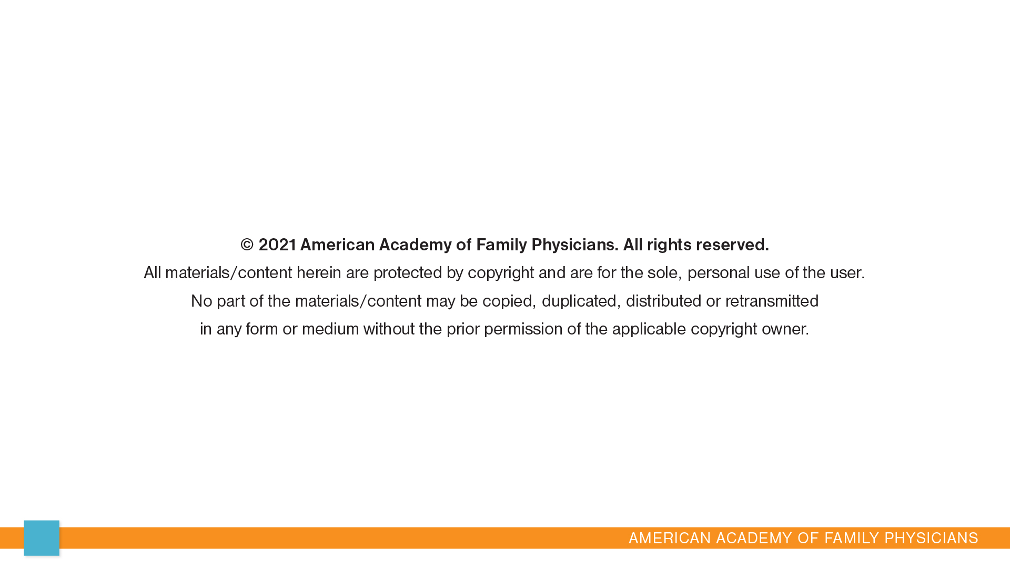
10
Notes:
Natasha: That concludes this presentation. Thank you for your time. We hope this presentation helps you be a great peer reviewer!

Slide 11


