Slide 1
Breastfeeding Basics
June 2015

Slide 2
Objectives
At the end of this presentation, the learner will be able to:
  Educate their patients about the benefits of breastfeeding.
  Assist their patients with some of the basic breastfeeding positions.
  Recognize and treat common breastfeeding challenges.
  Inform others about what is needed to create a baby-friendly office and hospital.

Slide 3
“All family physicians have a unique role in the promotion of breastfeeding.”
Family Physicians Supporting Breastfeeding
AAFP Policy and Position Statement on Breastfeeding
Notes:
Initially adopted in 2001 and updated in 2014, our Academy’s position paper on breastfeeding opens with the lines, “The AAFP has long supported breastfeeding. All family physicians, whether or not they provide maternity care, have a unique role in the promotion of breastfeeding.”
Breastfeeding is best supported through the comprehensive, continuous, family-centered, and community-responsive care family physicians provide. Our commitment to breastfeeding led the Academy to adopt the following policy statement.

Slide 4
American Academy of Family Physicians
“Family physicians should have the knowledge to promote, protect, and support breastfeeding.”
Family Physicians Supporting Breastfeeding
AAFP Policy on Breastfeeding
Notes:
“Family physicians should have the knowledge to promote, protect, and support breastfeeding.”
Of course, we are not alone in our support of breastfeeding. Every major medical organization in the U.S. that concerns itself with women and children is on record supporting breastfeeding.
So let’s take a few minutes to review why.

Slide 5
American Academy of Family Physicians
“Breastfeeding is the physiologic norm for both mothers and their children. Breastmilk offers medical and psychological benefits not available from human milk substitutes. The AAFP recommends that all babies, with rare exceptions, be breastfed and/or receive expressed human milk exclusively for the first six months of life.”
Family Physicians Supporting Breastfeeding
AAFP Policy on Breastfeeding

Slide 6
American Academy of Family Physicians
“Breastfeeding should continue with the addition of complementary foods throughout the second half of the first year. Breastfeeding beyond the first year offers considerable benefits to both mother and child, and should continue as long as mutually desired.”
Family Physicians Supporting Breastfeeding
AAFP Policy on Breastfeeding

Slide 7

Benefits of Breastfeeding
Breastfeeding has benefits for:
Infants
Mothers
Family
Society
Notes:
Breastfeeding has benefits for:

Slide 8
Benefits of Breastfeeding to Infants
Decreased morbidity and mortality from infections
  Respiratory
  Gastrointestinal
Decreased risk of SIDS
Optimal nutrition
  Species-specific nutrients
  No overfeeding
Improved outcomes for premature infants
  Fewer infections
  Decreased risk of NEC
  Earlier discharge
Notes:
Breastfed children are less likely to suffer from serious lung infections and infections of the intestines causing diarrhea and dehydration. They also have normal growth and development due to the nutrients in their mother’s milk specifically designed for them. Babies who feed from the breast can regulate the amount of milk they take, and, therefore, are less likely to be overfed and become overweight or obese.

Slide 9

Benefits of Breastfeeding to the Older Child
Functional competent immune system
Protective effect against type-2 diabetes
Decreased risk of some childhood leukemias (with longer duration)
Optimal growth and development
Decreased prevalence of overweight/obesity – 10% reduction
Increased IQ
Normal development of the mouth and jaws
Decreased risk of dental occlusion
Notes:
Mother’s milk programs the child’s immune system so there are fewer chronic immune diseases in later life. Unlike bottles, which can deform the inside of the baby’s mouth, breastfeeding promotes the normal development of the mouth and jaws, causing less need for orthodontics.

Slide 10
Benefits of Breastfeeding to Mothers
Immediately after birth
Decreased risk of postpartum hemorrhage
Delayed onset of menses
- Decreased incidence of iron deficiency
- Child spacing
Long-term health
Decreased risk of breast, ovarian, and uterine cancers
Decreased risk of central obesity and metabolic syndrome

Slide 11
Benefits of Breastfeeding to Families
Financial costs
Breastfeeding is free vs. the cost of formula and accessories
Decreased medical care costs
Less lost work time
Decreased emotional stress caused by illness
Healthier mother and baby short term and long term

Slide 12
Benefits of Breastfeeding to Society
Lower health care costs
Higher work productivity
Environmentally friendly
No waste
No product transportation or packaging
No grazing land

Slide 13
Contraindications to Breastfeeding
Mothers with HIV (in the United States)
Mothers with human T-cell lymphotropic virus type I or II
Mothers with active herpes lesions on the breast (can breastfeed once healed)
Mothers with untreated active tuberculosis or varicella – infant should be separated from mother but can be fed breastmilk
Infants with type 1 galactosemia
Notes:
Almost all women can breastfeed, with rare exceptions. Also use caution in women receiving chemotherapy or radioactive medication and women with substance abuse issues.

Slide 14
Getting Off to a Good Start
Early breastfeeding increases success
Early experience with breastfeeding is critical and non supportive hospital experiences and lack of support from healthcare providers have been identified as barriers to breastfeeding, especially among African American women. (HHS Blueprint for Action on Breastfeeding)
“Baby Friendly Hospital Initiative”
- 10 steps to successful breastfeeding
Notes:
Ideally the mom and her supporter(s) have received education and support prior to delivery. If not, we should still make every effort and support breastfeeding.

Slide 15
Baby Friendly Hospitals
10 steps to successful breastfeeding
Written breastfeeding policy
Staff trained to implement the policy
All pregnant women informed about benefits and management of breastfeeding
Help mothers initiate breastfeeding within 30 minutes after birth
Show mothers how to breastfeed and how to maintain lactation when separated

Slide 16
Baby Friendly Hospitals
10 steps to successful breastfeeding
Give newborns no food or drink besides breastmilk unless medically indicated
Practice rooming in
Encourage breastfeeding on demand
Give no pacifiers or artificial nipples to breastfeeding infants
Foster breastfeeding support groups and refer mothers to them on discharge

Slide 17

The First Breastfeeding
Provide skin-to-skin contact from the moment of birth. Do not separate mom and baby.
Vitamin K and hepatitis B injections, and eye ointment can wait until after first feeding
Ideally, first feed will happen within 30
minutes, during baby’s quiet alert period
Okay if first feeding is not optimal

Slide 18
Positioning is Critical
The infant needs access to the breast.
Both mother and infant need to be comfortable.
Commonly recommended positions include the cradle, cross-cradle, football, and side-lying.
More recently, biological nurturing or laidback breastfeeding has been promoted.

Slide 19
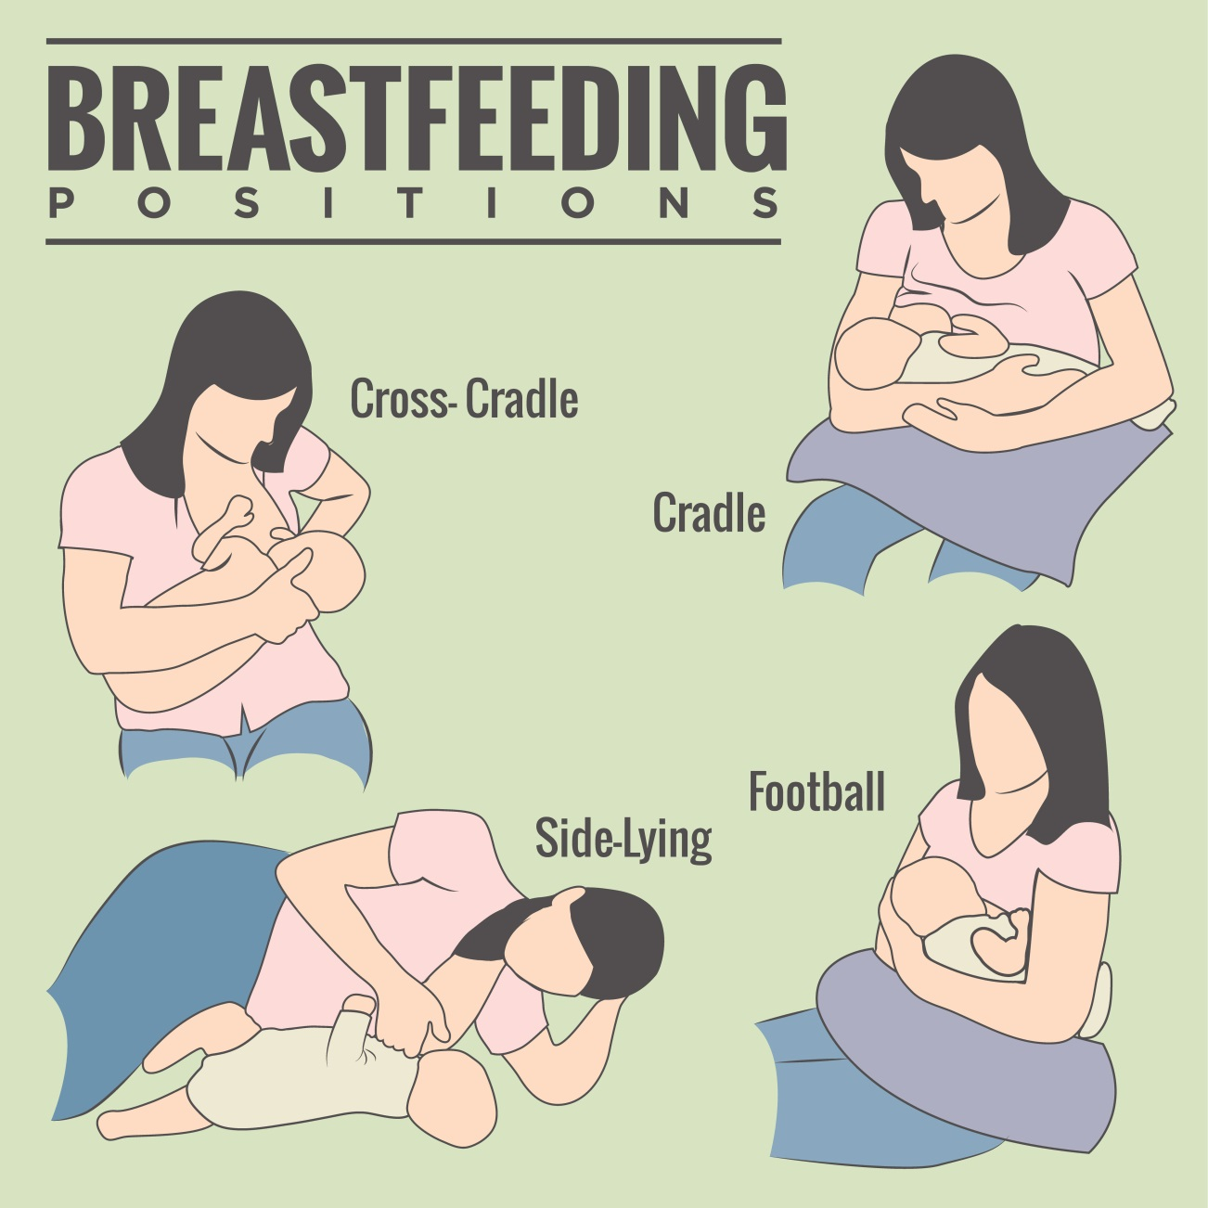

Slide 20
Mom’s Positioning
Back support
Roll bed or sit in supportive chair
Elbow support
Lots of pillows
Prevent back strain
Foot stool
Notes:
Get mother comfortable first.
The mother sits for 30-40 minutes so she must be comfortable. Create support for her back, elbows, and feet with pillows and a foot stool.

Slide 21

Cross-Cradle Position
Position the baby at breast height
Roll the baby “belly to belly”
Line up the baby “nose to nipple”
Hold the baby’s head behind his/her ears
Notes:
The cross-cradle position is an excellent position for newborns as it provides good control of the baby’s head. The mother can guide the head quickly when the baby is ready to latch.
Position the baby at breast height
Roll the baby “belly to belly”
Line up the baby “nose to nipple”
Hold the baby’s head behind his/her ears
The mother can more easily transition to the cradle hold after the baby latches, if her arm tires.

Slide 22
Football Hold
Position the baby at breast height
Roll the baby “belly to belly.”
Line up the baby “nose to nipple.”
Hold the baby’s head behind his/her ears.
Blanket roll or pillow to provide wrist support.
Notes:
The football or clutch hold is another position that offers excellent ability to guide the baby’s head during latch. This hold is also helpful to recommend during the newborn period for that reason.
Position the baby at breast height.
Roll the baby “belly to belly.”
Line up the baby “nose to nipple.”
Hold the baby’s head behind his/her ears.
Blanket roll or pillow to provide wrist support.
This hold is good for obese mothers or mothers with large breasts, as they can recline a bit and not feel as concerned their breasts may cover the baby’s face.
This hold is also helpful for feeding multiples.

Slide 23
Cradle Hold
Position the baby at breast height.
Roll the baby “belly to belly.”
Line up the baby “nose to nipple.”
Hold the baby’s head in the bend of the elbow or on the forearm.
Notes:
The head of the baby is in the bend of the mother’s arm where she cannot direct the latch as much. This position may be better for the baby with more head control and has learned to latch.
Position the baby at breast height.
Roll the baby “belly to belly.”
Line up the baby “nose to nipple.”
Hold the baby’s head in the bend of the elbow or on the forearm.

Slide 24

Side-lying Position
Side lying facing the baby “belly to belly.”
Line up the baby “nose to nipple.”
Hold the baby’s head behind the ears for the latch.
Support both mom and baby with
pillows.
Notes:
Side lying facing the baby “belly to belly.”
Line up the baby “nose to nipple.”
Hold the baby’s head behind the ears for the latch.
Support both mom and baby with pillows.

Slide 25
Supplementation
Remember, colostrum is adequate in the first newborn days.
Supplement only if medically necessary.
Academy of Breastfeeding Medicine has hypoglycemia protocol.
Ideally supplement with colostrum.
Colostrum has more calories than D5.

Slide 26
Signs of Good Breastfeeding in the Newborn Period
Frequent feedings, at least eight times in 24-hour period
Episodes of rhythmic sucking with audible swallows
What goes in comes out
At least one to two wet cloth diapers in the first two days, then six to eight wet cloth diapers every 24 hours
Transitional stools first two days, yellow by day four
After day three, at least three bowel movements >1 tablespoon in 24 hours (usually four to 10 small stools per day)

Slide 27
Jaundice
Ensure that infant has adequate intake
- Jaundice in breastfed infants most commonly associated with inadequate feeding
More frequent and effective breastfeeding prevents and treats jaundice.
Breastmilk jaundice
Begins after day of life 5-7
Total bilirubin >12 mg/dL
Occurs in less than 1 in 200
Increased bilirubin reabsorption from intestine
May last several weeks to months

Slide 28
Painful Breasts
What to do about them
Painful nipples due to poor latch
Engorgement
Mastitis
Notes:
Problems that may interfere with breastfeeding.

Slide 29
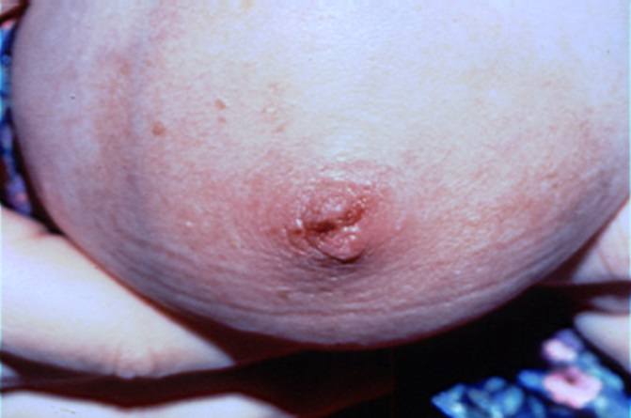
Painful Nipples
Normal “latch-on pain” vs. abnormal pain
Abnormal pain usually due to poor latch
Persistent pain, cracks, and bleeding are not normal
Ensure appropriate positioning and latch
Applying lanolin cream or breastmilk to nipples may be soothing

Slide 30
Engorgement
Development of swollen, tender breasts as the mature milk “comes in”
Combination of milk, as well as interstitial edema, increased blood and lymphatic flow
Can cause difficulties with latching as breast is full and nipple flattens
A common time for women to stop nursing, which can be managed preventively or actively

Slide 31
Treatment of Engorgement
Prevention – anticipatory guidance
Frequent nursing
Cool compresses
Warm breasts before nursing
If trouble latching, express a small amount prior to the infant latching on

Slide 32
Mastitis
Breast inflammation with fever, breast pain, erythema, and general malaise
Estimated to occur in 20% of women
If the breast is red and tender, but no fever or systemic symptoms, then it is more likely to be a plugged duct
Risk factors: Decreased feedings, poor latch with decreased milk removal and possible trauma, rapid weaning, oversupply, pressure on the breast, maternal fatigue, and malnutrition

Slide 33
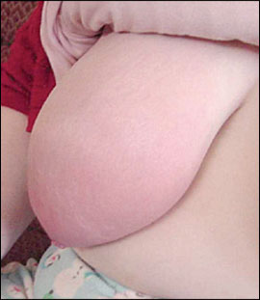
Mastitis
Most common organisms: Penicillin-resistant S. aureus, followed by strep and E. coli
Treatment: Pencillinase-resistant penicillins such as dicloxacillin or flucloxacillin, cephalexin, clindamycin, or erythromycin
Important to continue regularly emptying the breast
Adequate fluids and nutrition
Analgesia – consider anti-inflammatory
Academy of Breastfeeding Medicine Clinical Protocol #4: Mastitis

Slide 34
Breastfeeding Friendly Office
A physician’s practice that enthusiastically promotes and supports breastfeeding through the combination of a conducive office environment and education of healthcare professionals, office staff, and families.
Academy of Breastfeeding Medicine Clinical Protocol #14: Breastfeeding-Friendly Physician’s Office:
Optimizing Care for Infants and Children
Notes:
Once mom has left the hospital, she needs continued support. When your patients know that you care about breastfeeding, they are more likely to ask questions whether or not they are pregnant or breastfeeding.

Slide 35
Billing and Coding
Mother’s Issues ICD-9
Nipple Abscess 675.0
Breast Abscess 675.1
Mastitis NOS 675.2
Breast/Nipple Infection, other specified 675.8
Breast/Nipple Infection, unspecified 675.9
Retracted Nipple 676.0
Cracked Nipple 676.1
Breast Engorgement 676.2
Disorder of Breast, other and unspecified 676.3
Agalactia (failure of lactation) 676.4
Suppressed Lactation 676.5
Unspecified Disorder of Lactation 676.9
Postpartum Care; Lactating Mother Supervision V24.1

Slide 36
Billing and Coding
Baby’s Issues ICD-9
Failure to Thrive, newborn <28 days 779.34
Change in Bowel Habits 787.99
Weight loss 783.21
Jaundice, neonatal 774.6
Slow feeding, newborn <28 days (feeding problems) 779.31
Fussy Baby 780.91
Dehydration, neonatal 775.5

Slide 37
AAFP Policies and Position Paper
Breastfeeding, Family Physicians Supporting (Position Paper)
Introduction
History
Health Effects
Key Recommendations
Appendices 1-6
Ten Steps to Successful Breastfeeding
Breastfeeding (Policy Statement)
Hospital Use of Infant Formula in Breastfeeding Infants
Notes:
Go to aafp.org to read the position paper and all of the additional information provided in the appendices.

Slide 38

Questions

