Slide 1
Health Literacy
For more information, contact the Center for Diversity and Health Equity at healthequity @aafp.org

Slide 2
Objectives
Defining health literacy
Understand the need for health literacy
Key aspects of health literacy
Effective Health Literacy in Primary Care
Review Discussion Questions/Guide

Slide 3
Defining Health Literacy
Health Literacy is:
The degree to which individuals have the capacity to obtain, process, and understand basic health information and services needed to make appropriate health decisions.
Health Literacy includes basic skills like reading, writing, numeracy, communication, and understanding electronic technology.
American Family Physician. Health Literacy in Primary Care Practice. 2015;92(2):118-124. American Academy of Family Physicians. Leawood

Slide 4
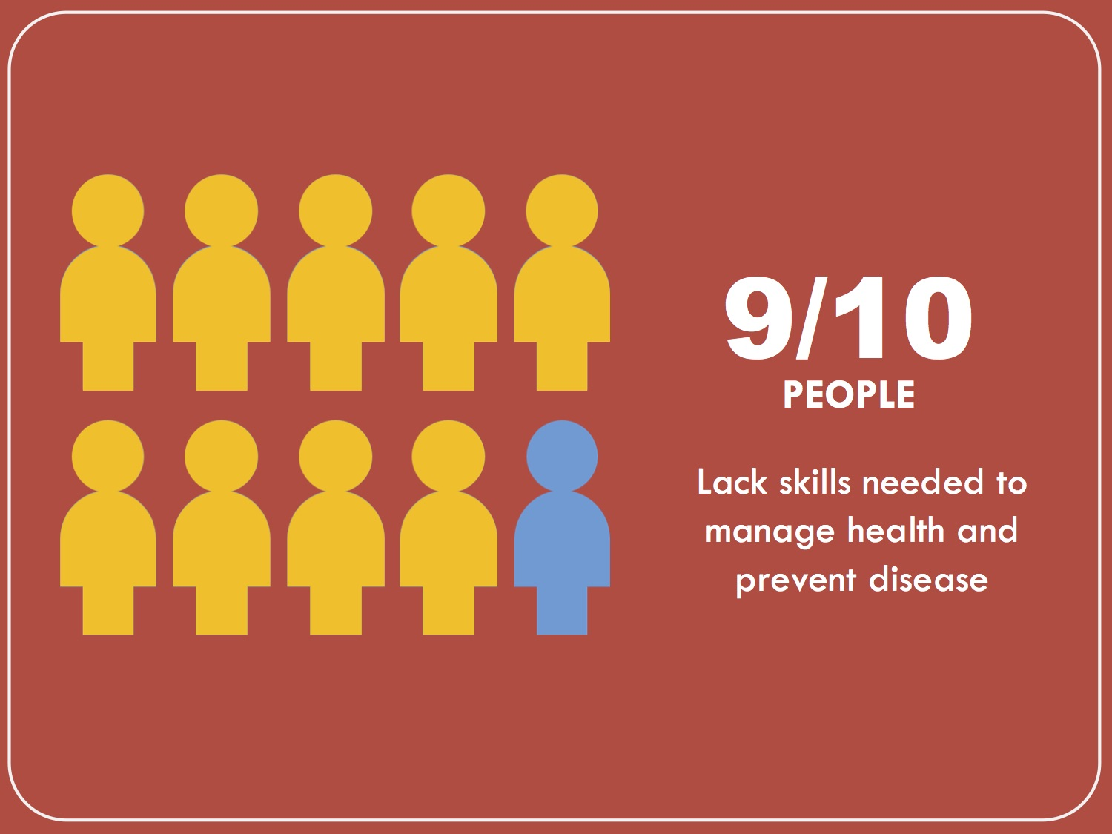
The Need for Health Literacy
Source: https://upstream.mj.unc.edu/tag/health-literacy/
Nine out of 10 adults may not possess the skills they need to manage their health and prevent disease.
American Academy of Family Physicians. Addressing Social Determinants of Health in Primary Care: A Team based Approach for Advancing Health Equity. Leawood. 2018

Slide 5
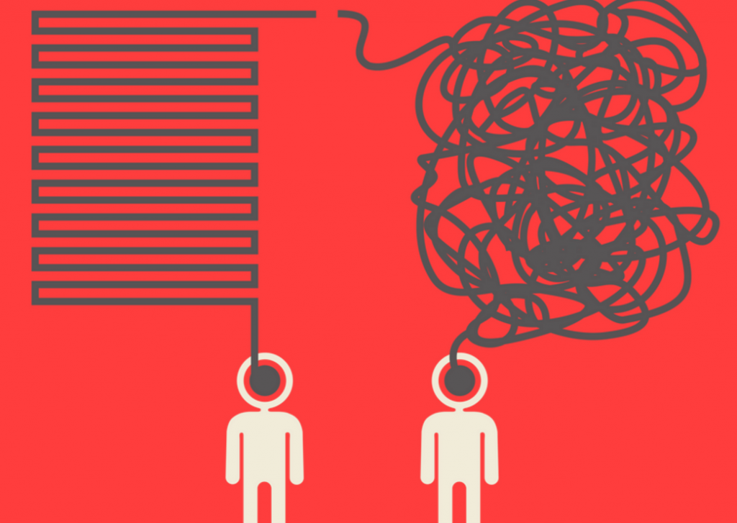
The Need for Health Literacy
Source: Parson, K., M. P. Allen, W. Alvarado-Little, R. Rudd. 2017. Health literacy insights for health crises. NAM Perspectives. Discussion Paper, National Academy of Medicine, Washington, DC. doi: 10.31478/201707f
Patients with low health literacy may not comprehend drug labeling or medical instructions, potentially appearing that they are unwilling to follow recommendations.
American Academy of Family Physicians. Addressing Social Determinants of Health in Primary Care: A Team based Approach for Advancing Health Equity. Leawood. 2018

Slide 6
The Need for Health Literacy
…
???
Patients may have difficulty with understanding health publications, giving adequate history or comprehending content, and completing medical and insurance forms.
American Academy of Family Physicians. Addressing Social Determinants of Health in Primary Care: A Team based Approach for Advancing Health Equity. Leawood. 2018

Slide 7
Who is at Risk?
Older Adults
Racial and Ethnic minorities
Non-native speakers of English
People with less than a high school degree OR GED certificate
People with low-income levels
People with compromised health status
Education, language, culture, access to resources, and age are all factors that affect a person's health literacy skills.

Slide 8
Literacy vs. Health Literacy
The Need for Health Literacy
Literacy
Literacy is a set of tangible skills: reading, writing, numeracy, and oral expression.
It is the ability to use printed and written information to function and to develop one’s knowledge and potential.
Health Literacy
The degree to which individuals have the capacity to obtain, process, and understand basic health information and services needed to make appropriate health decisions.
Addressing Literacy and Health Literacy. Washington, DC: National Center for Cultural Competence, Georgetown University, Center for Child and Human Development. Goode TD

Slide 9
Skills needed for Health Literacy
Patients need health literacy skills to:
Evaluate information, analyzing risks & benefits
Understand dosage calculations
Understand the interpretation of test results
Locate health information
Understand visual information (graphs)
Calculate or reason numerically
Addressing Literacy and Health Literacy. Washington, DC: National Center for Cultural Competence, Georgetown University, Center for Child and Human Development. Goode TD

Slide 10
Effective health literacy in primary care settings: Language Barriers
Determine the need for services in your practice
Determine the method of communication to be used during patient encounters
Develop a policy
Obtain financial support for medical interpretation
Provide language appropriate patient forms and educational resources
American Family Physician. Health Literacy in Primary Care Practice. 2015;92(2):118-124. American Academy of Family Physicians. Leawood

Slide 11
National Standards for Culturally and Linguistically Appropriate Services (CLAS) and Health Literacy:
Key Aspects of Health Literacy
Offer language assistance to individuals who have limited English proficiency and/or other communication needs.
Inform all individuals of the availability of language assistance services.
Avoid the use of untrained individuals and/or minors as interpreters.
Provide materials and signage in the languages commonly used by the populations in the service area.
National Standards for Culturally and Linguistically Appropriate Services in Health and Health Care: A Blueprint for Advancing and Sustaining CLAS Policy and Practice. Office of Minority Health, US Department of Health and Human Services, 2013.

Slide 12
Effective health literacy in primary care settings
Use plain language instead of medical jargon or technical language
Sit down to achieve eye-level communication
Use teach-back method
Use visual models to illustrate a procedure or condition
American Family Physician. Health Literacy in Primary Care Practice. 2015;92(2):118-124. American Academy of Family Physicians. Leawood

Slide 13
Discussion Questions
What is the primary language of the patient population you serve?
What challenges do you experience as a practitioner or within your system when addressing health literacy needs?
Are all the resources provided available in the most common languages?
What other changes can be made within your practice to improve health literacy?

Slide 14
© 2018 American Academy of Family Physicians. All rights reserved.
All materials/content herein are protected by copyright and are for the sole, personal use of the user.
No part of the materials/content may be copied, duplicated, distributed or retransmitted
in any form or medium without the prior permission of the applicable copyright owner.

