Slide 1

How Social Determinants Influence Health: A Conceptual Framework for Family Medicine
For more information, contact the Center for Diversity and Health Equity at healthequity @aafp.org

Slide 2

Learning Objectives
Define and describe social determinants of health
Communicate how social determinants influence health outcomes
Describe and demonstrate tools that can be implemented in practice
Describe and demonstrate non-clinical strategies that can be implemented in the community

Slide 3
Key Definitions
Health Disparity
Health Inequity
“A disproportionate difference in health between groups of people.”
By itself, disparity does not address the chain of events that produces it.
“Differences in population health status and mortality rates that are systemic, patterned, unfair, unjust, and actionable, as opposed to random or caused by those who become ill.” - Margaret Whitehead
Social Determinants of Health
Health Equity
The conditions under which people are born, grow, live, work, and age. (2013 AAFP)
A fair, just distribution of the social resources and social opportunities needed to achieve well-being.
Notes:
Health Inequities are defined by the CDC as differences in health that are avoidable, unfair, and unjust. A complex system of political, economic, social, behavioral, and medical factors (the SDoH), influence health equity.. Avoidable, unfair and unjust allocation of these resources lead to health inequities. Growing research shows that addressing these factors and unequal access to opportunities for health will reduce health disparities and promote health equity across the population.

Slide 4
Factors that strongly influence health outcomes include a person's
Access to medical care
Access to nutritious foods
Access to clean water and functioning utilities (e.g., electricity, sanitation, heating, and cooling)
Early childhood social and physical environment, including childcare
Education and health literacy
Ethnicity and cultural orientation
Familial and other social support
Gender
Housing and transportation resources
Linguistic and other communication capabilities
Neighborhood safety and recreational facilities
Occupation and job security
Other social stressors, such as exposure to violence and other adverse factors in the home environment
Sexual identification
Social status (degree of integration vs isolation)
Socioeconomic status
Spiritual/religious values
Notes:
The full policy is available at https://www.aafp.org/about/policies/all/social-determinants.html

Slide 5
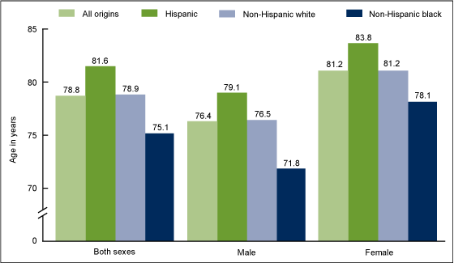
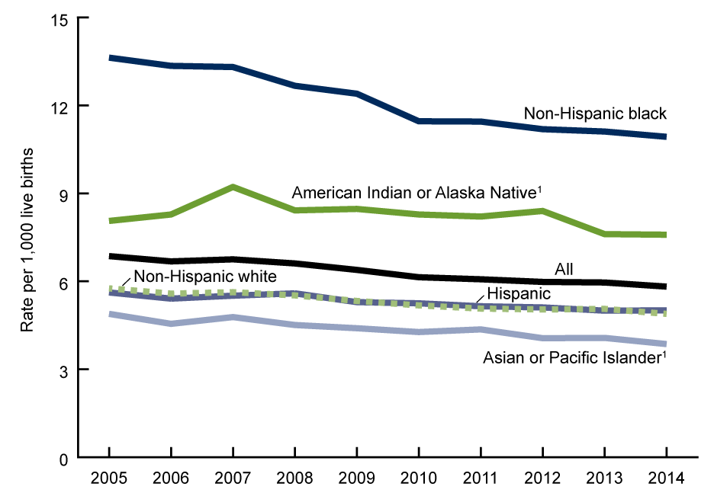
Health Disparities by Race and Ethnicity
Life Expectancy at Birth, By Hispanic Origin, Race, and Sex: U.S., 2013
Infant Mortality Rates, By Hispanic Origin and Race of Mother: U.S., 2005 - 2014
CDC. How Does Cause of Death Contribute to Hispanic Mortality Advantage in the United States? NCHS Data Brief No. 221. https://www.cdc.gov/nchs/products/databriefs/db221.htm. Published 2015. Accessed August 21, 2017.
CDC. Trends in Infant Mortality in the United States, 2005 -2014. NCHS Data Brief No. 279. https://www.cdc.gov/nchs/products/databriefs/db279.htm. Published 2017. Accessed August 21, 2017.

Slide 6
Health Disparities by Income
J. S., Schiller, J. W. Lucas, and J. A. Peregoy, “Summary Health Statistics for U.S. Adults: National Health Interview Survey, 2011.”
Vital and Health Statistics 10, no. 256 (2012): 1–207, tables 1, 4, 8, and 12.

Slide 7
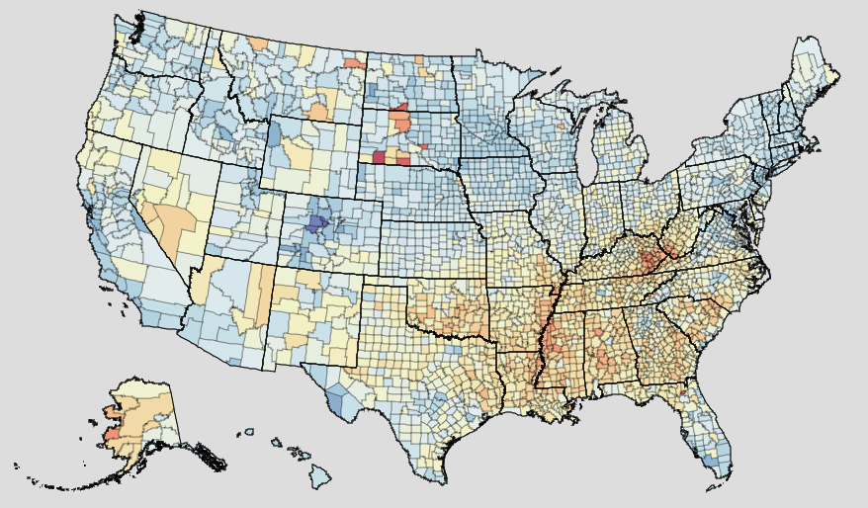
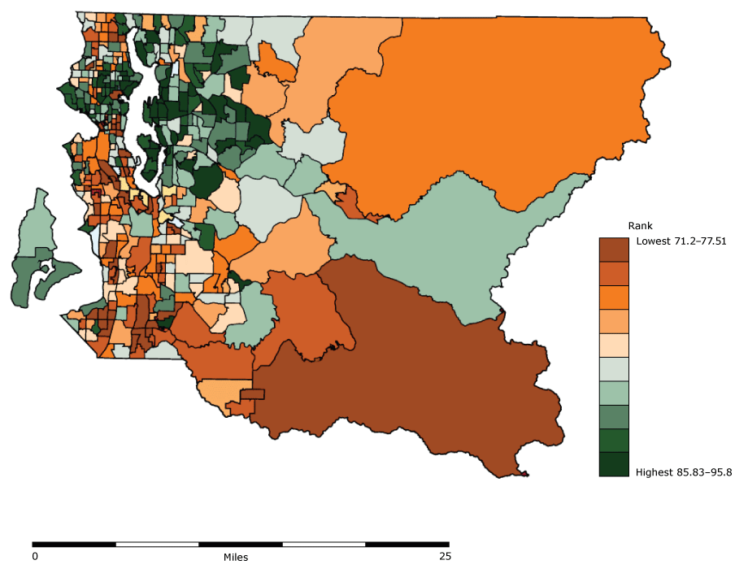
Health Disparities by Geography
County Life Expectancy at Birth, Both Sexes, 2014
Institute for Health Metrics and Evaluation. US Health Map: IHME, University of Washington, 2016. Available from https://vizhub.healthdata.org/subnational/usa. Accessed 2018
Life Expectancy at Birth in Seattle-King County
Centers for Disease Control and Prevention: Sub-County Life Expectancy: A Tool to Improve Community Health and Advance Health Equity. https://www.cdc.gov/pcd/issues/2018/17_0187.htm. Published 2018
7
Notes:
Place matters. Almost all health outcomes vary based on the part of the country and even part of the city someone lives in. Data has shown that there is up to a 20 year gap in life expectancy based on the part of the country and part of the city that people live in.

Slide 8
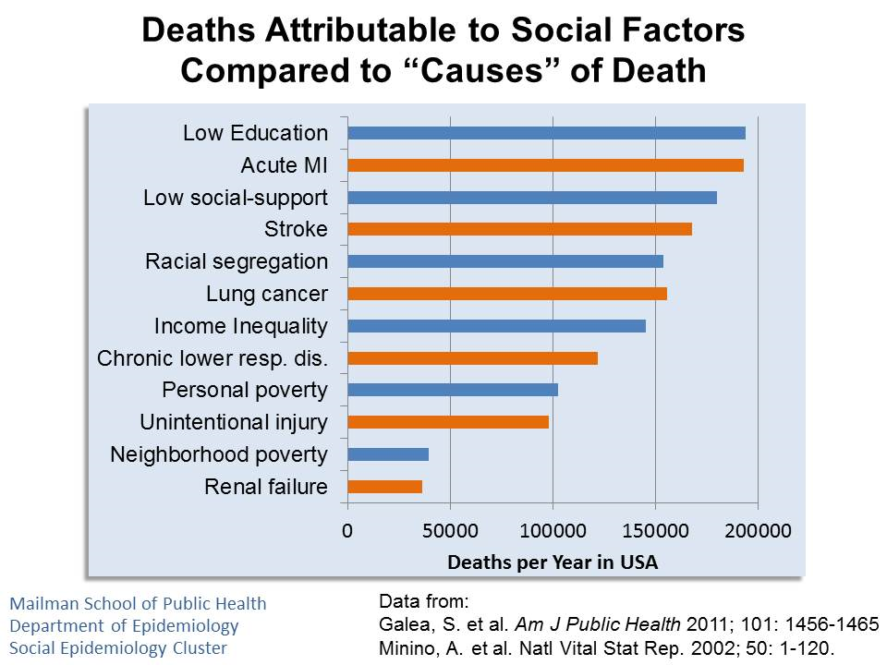
Notes:
Studies have estimated that if properly measured, social factors such as low education, income and racial segregation exceed that of medical conditions (cardiovascular disease, injury, etc.) as the root cause of death in the United States.

Slide 9
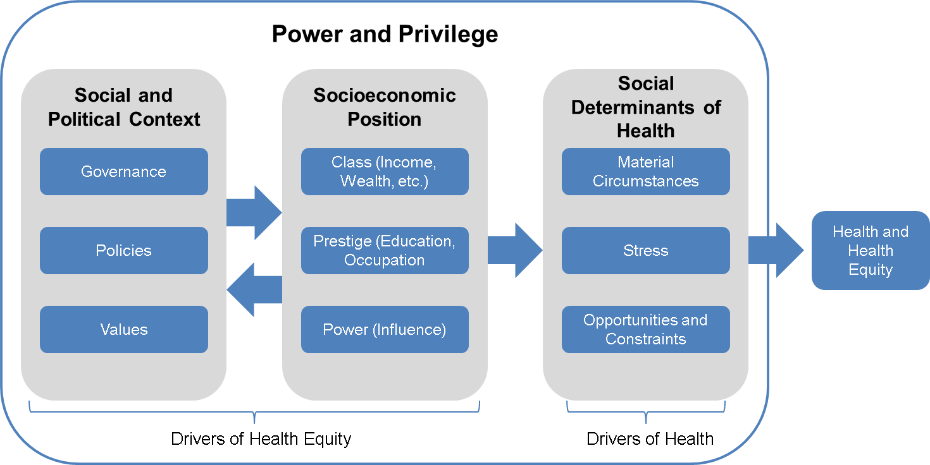
Social Drivers of Health and Health Equity
Notes:
Socioeconomic and political context refers to macro-level factors that do not occur at the individual level. These factors primarily refer to governmental and corporate decisions and their decision-making process, which can have substantial impact on shaping the conditions that support or threaten the health of the public.⁹ SDoH are shaped by the distribution of money, power, and resources at global, national, and local levels and lead to differences in health status among patients with otherwise similar demographic and physical characteristics. Examples include issues like the degree that government helps subsidize access to health care or education, decisions about pollution, such as minimum standards and the location for storage or release of toxic substances, and decisions about the built environment, such as what changes are made and what communities are impacted most. Jim Crow laws and redlining are a more specific example. These laws and corporate policies legislated segregation, restricted access to good housing to black Americans, and reduced their ability to influence governmental decisions or live in a healthy neighborhood.
Socioeconomic position refers to one’s status in society and creates advantages of some people over others.¹² Socioeconomic position is multidimensional and is generally said to be made up of people’s class, prestige, and power.¹² Class represents economic components of socioeconomic position (wealth, income, property, etc.). Prestige represents social components of socioeconomic position (education, occupation, etc.), and signifies “how people are regarded by others.” Class and prestige influence people’s ability to acquire resources that support their health, such as access to health care, nutritious foods, or safe housing.¹³ Power represents political components of socioeconomic position and is characterized by the ability of people and groups to achieve their goals despite opposition from others.^{9,12} While class, prestige, and power are linked and all impact health, power may be the most important aspect of socioeconomic position. Power allows people and groups to change the socioeconomic and political context and secure resources for their communities necessary for assuring their health and wellbeing. Power is not fully determined by class and prestige, and power can be built in disadvantaged communities through partnerships and shared capacity building.^{14–16}

Slide 10


Purpose
Create and support a culture of health equity to empower family physicians
Collaboration with family physicians, their practice teams, chapters, and other partners
Offer tools and resources to help educate family physicians
Support research and policy development to support advocacy
Encourage workforce diversity
Notes:
To support family physicians in addressing the social determinants of health and advance health equity in their communities, the AAFP launched The EveryOne Project as a resource to help you take action. The EveryOne Project focuses on providing family physicians and their practice teams with education and resources, advocating for health equity, promoting workforce diversity, and collaborating with other disciplines and organizations to advance health equity.
The EveryONE Project aims to address social determinants of health by:
Providing AAFP members with education and information about health equity.
Identifying and developing clinical tools and resources to address patients’ social needs.
Supporting research and policy development.
Advocating for policies that encourage health equity.
Encouraging workforce diversity.
Serving as a resource center for AAFP members.

Slide 11

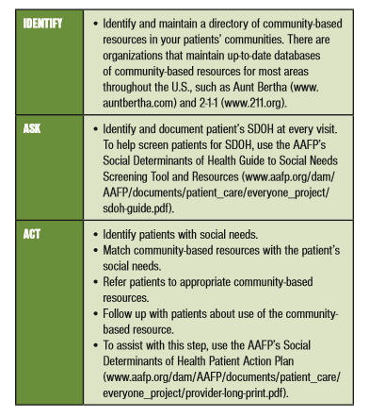

Clinical Interventions
Notes:
Within the SDoH toolkit, is the AAFP developed “Identify, Ask, and Act” framework, to use as a simple and flexible way for incorporating SDoH into your practice.
· Identify: Identify and maintain a directory of community-based resources in your patients’ communities. The AAFP has developed the Neighborhood Navigator, utilizing the Aunt Bertha platform, that can be used during patient visits to connect them to thousands of social services in their area. (https://www.aafp.org/patient-care/social-determinants-of-health/everyone-project/neighborhood-navigator.htm)
· Ask: Identify and document patient’s SDOH at every visit using a validated SDoH screening tool, such as the Social Determinants of Health Guide to Social Needs Screening Tool and Resources provided by the AAFP (www.aafp.org/dam/AAFP/documents/patient_care/everyone_project/sdoh-guide.pdf).
· Act: Identify patients with social needs. Match community-based resources with the patient’s social needs. Refer patients to appropriate community-based resources. Follow up with patients about use of the community-based resource. To assist with this step, use the AAFP’s Social Determinants of Health Patient Action Plan (www.aafp.org/dam/AAFP/documents/patient_care/everyone_project/provider-long-print.pdf).

Slide 12
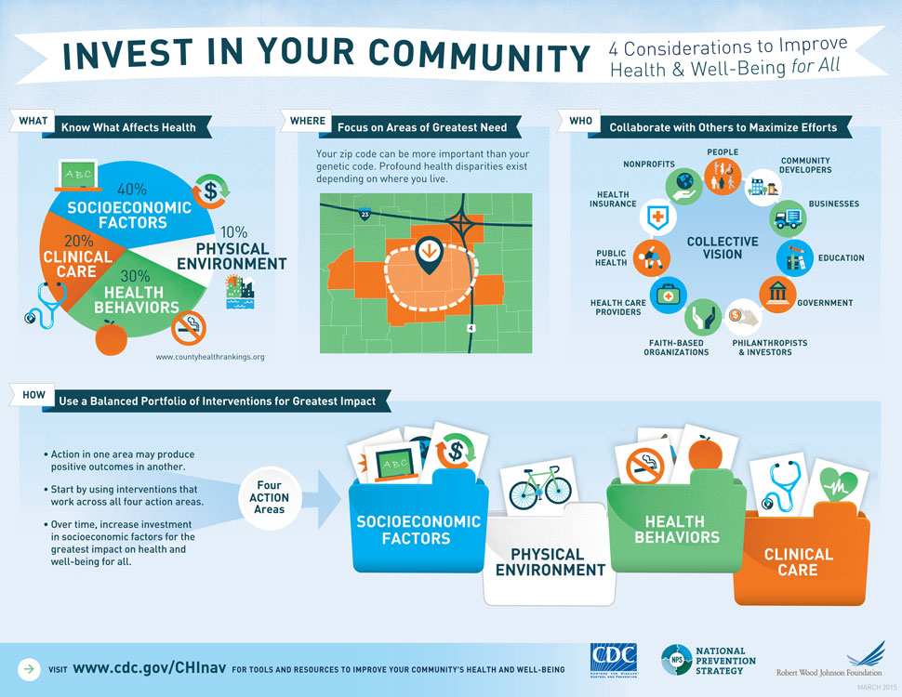
Community Interventions
Notes:
A first step for family physicians can include studying the “community vital signs” in a given practice’s catchment area to gain understanding of the specific socioeconomic factors relevant for a given practice or health center.²⁹ Health Landscape, a product of the AAFP Robert Graham Center, is one tool that can be used to review community demographics. (https://www.healthlandscape.org/). It allows users to create and display maps and tables based on a growing array of data relevant to health and primary care. Users can combine, analyze and display information spatially in order to promote understanding and improvement of health and health care.
The local health department’s community health assessment and community health improvement plan can also provide community demographic information and may also provide contextual information from community listening sessions, focus groups, as well as local initiatives that are ongoing to address local health priorities. Local health department’s websites can be found at (https://www.naccho.org/membership/lhd-directory).

Slide 13
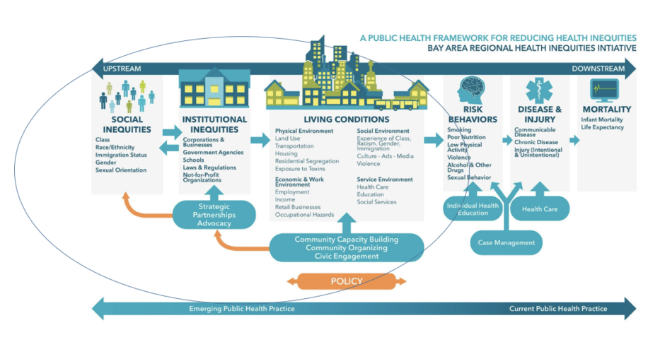
Advocate Using the Health In All Policies Approach
Notes:
Health in All Policies (HiAP) is a change in the systems that determine how decisions are made and implemented by local, state, and federal government to ensure that policy decisions have neutral or beneficial affects on the determinants of health. HiAP emphasizes the need to collaborate across sectors to achieve common health goals, and is an innovative approach to the processes through which policies are created and implemented.
Health disparities often arise due to inequitable policies, systems and infrastructures that disproportionately affect marginalized populations.
While 75% of members surveyed indicated that FPs should advocate for public policies that address the SDOH, only a quarter have written to or spoken with elected officials to support SDOH policies and less than 10% have provided testimony at hearing.

Slide 14
Integrating Health In All Policies Into Practice
What are the opportunities for Policy Change?
Identify agencies to promote cross-sector collaboration.
Define mutually beneficial goals.
Engage stakeholders.
Engagement Level
Patient panel
Clinic
Health System
State
National
Agencies
Social Services
Behavioral Health
Education
Justice
Short and Long Term
Reduce health disparities
Close gaps
Care coordination
Equity
Partners
Businesses
Government
Faith-based
Civic & Social organizations

Slide 15
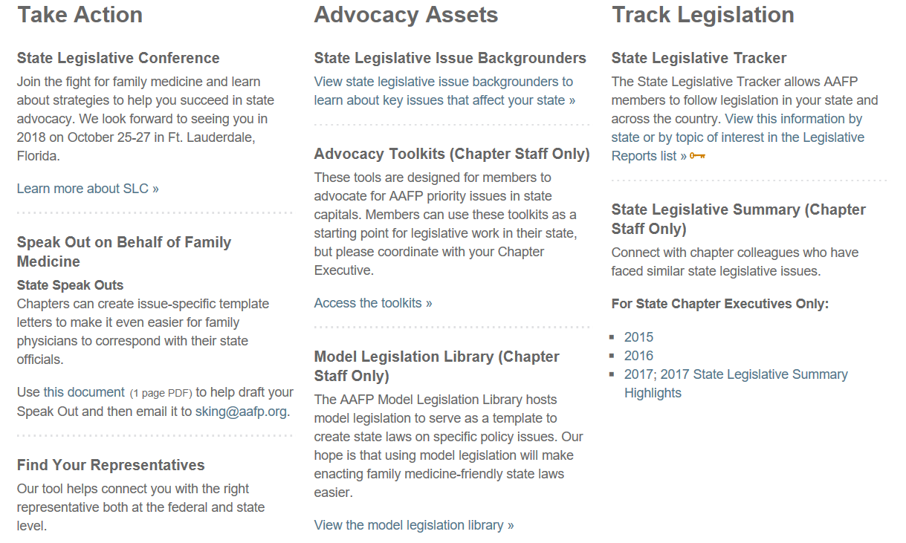
AAFP Advocacy Resources
Notes:
Areas for opportunities for Family Physician engagement in community interventions and state and national advocacy include:
· Working with health care delivery systems to develop community partnerships advocating for community or population health.³³
· Working with health care delivery systems to develop linkages between these systems and social services, such as housing and education. Preliminary studies suggest these linkages may significantly improve population health outcomes.^{33,34}
· Learning about evidence-based and promising policy and systems changes to advance health equity, such as those identified by the Center for Disease Control and Prevention’s Guide to Community Preventive Services (https://www.thecommunityguide.org/topic/health-equity).
· Becoming involved in community, regional or national organizations dedicated to health advocacy, especially as it applies to disadvantaged populations and health equity.⁵⁵

Slide 16


