Slide 1
COVID-19 Vaccine Update
Sample presentation for members
October 2021

Slide 2
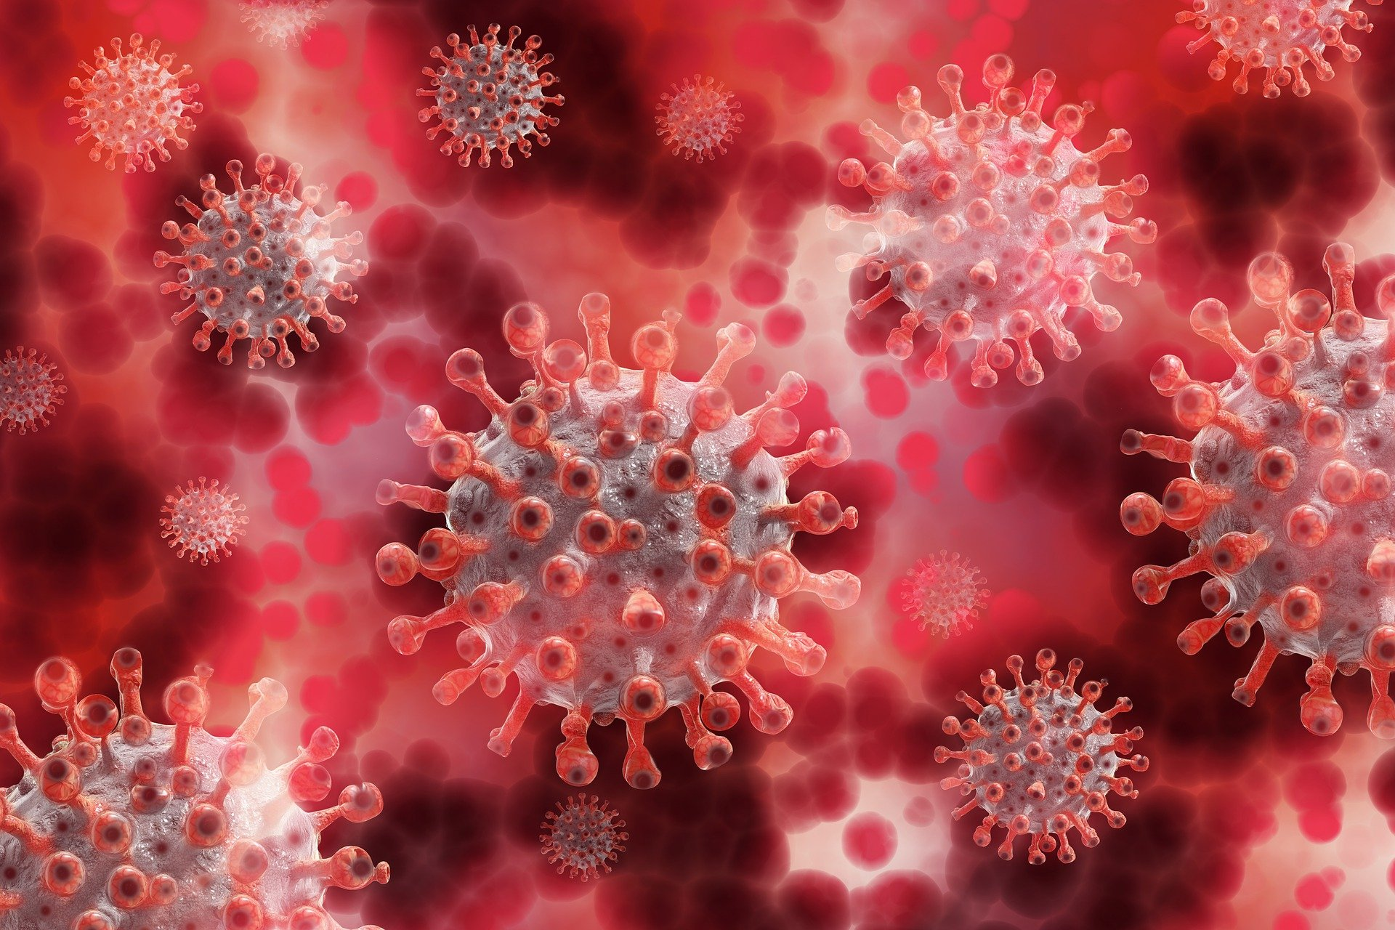
Coronaviruses in General
Coronavirus is a name derived from the Latin "corona," meaning crown.
The viral envelope under the electron microscope looks "crownlike" due to the small bulbar projections formed by the viral spike proteins.
Seasonal coronaviruses can cause the common cold.
They also can cause Severe Acute Respiratory Syndrome (SARS 2002-2003) and Middle East Respiratory Syndrome (MERS 2012).
pixabay.com
2

Slide 3
SARS-CoV-2 vs COVID-19
SARS-CoV-2 is the name of the novel virus identified (severe acute respiratory distress coronavirus 2)
SARS-CoV-2 causes the disease COVID-19 (novel Coronavirus Disease-2019)

Slide 4
SARS-CoV-2 Variants of Concern
4 Major Variants in the US
B.1.1.7 (Alpha): This variant was first detected in the United States in December 2020. It was initially detected in the United Kingdom.
B.1.351 (Beta): This variant was first detected in the United States at the end of January 2021. It was initially detected in South Africa in December 2020.
P.1 (Gamma): This variant was first detected in the United States in January 2021. P.1 was initially identified in travelers from Brazil, who were tested during routine screening at an airport in Japan, in early January.
B.1.617.2 (Delta): This variant was first detected in the United States in March 2021. It was initially identified in India in December 2020. It is now the predominant strain in the U.S.
The variants, especially Delta, are much more contagious and spread easily even among people who are fully vaccinated.
To date, data suggest the current vaccines work on the circulating variants (e.g. prevent hospitalization and death).
https://www.cdc.gov/coronavirus/2019-ncov/transmission/variant.html

Slide 5
COVID-19 Disease
Incubation period: 2-5 days
Infectious period (when someone can transmit): starts 2 days prior to appearance of symptoms and lasts for at least 10 days
Symptomatic period: usually 2-14 days after exposure, usually begins around Day 5
If illness becomes severe, and patients ultimately die, the time from first symptom to death: around 9-25 days

Slide 6
COVID-19 Symptoms
Fever (44%-98%)
Cough (46%-82%)
Shortness of breath at onset (31%)
Myalgia or fatigue (11%-44%)
Loss of taste or smell
Less common: pharyngitis, headache, productive cough, N/V/D, hemoptysis, chest pain/pressure, confusion, cyanosis, skin changes (COVID toes)
Johns Hopkins ABX Guide Coronavirus COVID-19 Paul G. Auwaerter, MD 11/30/2020

Slide 7
Groups at Increased Risk
Medical Conditions
Older age, especially >65
Systemic and social inequities have put some groups at higher risk including individuals identifying as BIPOC and people with disabilities
Those with comorbid conditions; CDC reports 94% of COVID-19- related deaths have at least one additional medical condition.
Cancer
CVD
CKD
Chronic lung diseases
Dementia or other neurological conditions
Diabetes (type 1 or type 2)
Down Syndrome
Heart conditions
HIV
Immunocompromised state
Obesity
Pregnancy
Sickle cell anemia
Substance use disorders
Thalassemia

Slide 8
Transmission
Primary mode of transmission = respiratory droplets
Why masks are recommended to reduce spread
Aerosolization is possible from speaking or singing.
Some evidence shows smaller droplets can infect even at an increased distance. Supports recommendations for physical distancing.
Viral shedding can predate symptoms. Viral titers are highest 1-2 days before the onset of symptoms.
Asymptomatic individuals are a major contributor to viral spread.

Slide 9
Treatments
Remdesivir (RDV) is the only FDA-approved treatment.
FDA approved 10/2020 for hospitalized patients aged >12 or 40kg.
EUA for <12yo wt. 3.5-40kg
Most beneficial if given for severe disease prior to mechanical ventilation.

Slide 10
Monoclonal Antibody Treatments IL-6 Receptor Inhibitor (tocilizumab)
Basic Information on Use
FDA issued EUA for use in hospitalized patients over 2 years of age and older
Binds the IL-6 receptor blocking IL-6 induced inflammation
Already a prescription medication given by intravenous infusion that is FDA-approved for multiple inflammatory diseases, including rheumatoid arthritis
Recommended in the NIH COVID-19 guidelines for use with dexmathasone in certain patients who are hospitalized with COVID-19
https://www.covid19treatmentguidelines.nih.gov/therapies/immunomodulators/interleukin-6-inhibitors/

Slide 11
Monoclonal Antibody Treatments Bamlanivimab/etesevimab, Casirivimab/imdevimab, Sotrovimab
Basic Information on Use
FDA emergency use authorization
Used in the outpatient setting with infusion capabilities
Binds SARS-CoV-2 at specific epitopes
All 3 therapies are recommended in the NIH COVID-19 guidelines https://www.covid19treatmentguidelines.nih.gov/anti-sars-cov-2-antibody-products/anti-sars-cov-2-monoclonal-antibodies/
Available for individuals with mild to moderate COVID-19 symptoms to prevent progression to severe disease.
Also authorized for post-exposure prophylaxis for certain individuals.
Must have a positive test, at least 12 years of age and weigh at least 40kg, and be at high risk for progression to severe disease or hospitalization.
Must be prescribed within 10 days of symptom onset.
Important Updates
Bamlanivimab alone not effective against new viral variants and is no longer authorized by the FDA.
Bamlanivimab/etesevimab is only authorized in certain states given the limited efficacy against the beta and gamma variants. See list here: https://www.fda.gov/media/151719/download
MORE INFO:
https://www.aafp.org/family-physician/patient-care/current-hot-topics/recent-outbreaks/covid-19/covid-19-clinical-resources/monoclonal-antibody-approved.html

Slide 12
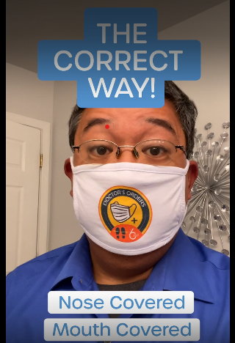
Mitigation Strategies
Washing your hands
Physical distancing
Wearing a mask (even if vaccinated)
Getting vaccinated
Watch Now: How to Not Wear a Mask

Slide 13
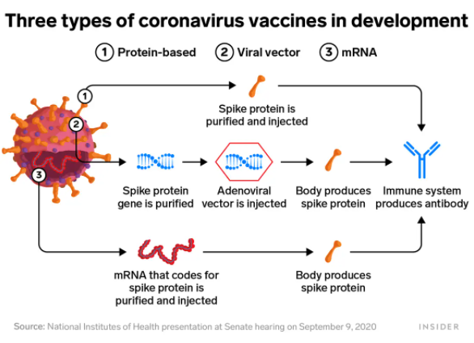
COVID-19 Vaccine Development
3 types of vaccines
mRNA
Non-replicating viral vector
Purified viral protein
All three types involve the presentation of the spike protein to immune cells, resulting in neutralizing antibodies.

Slide 14
mRNA Vaccines
Use small piece of messenger RNA as a blueprint for cells to make a viral protein.
SARS-CoV-2 spike protein, which allows the virus to enter host cells and cause disease.
This process happens in the cytoplasm. The mRNA never enters the nucleus of the cell, where DNA lives.
No transcription is needed for the protein; it is already available to be translated into protein.
No viral DNA is present in the vaccine.
The immune cells react to the viral protein, leading to production of neutralizing antibodies.
The antibodies bind to any invading virus and prevent it from entering host cells.
These vaccines contain no live virus and cannot give the recipient COVID-19.

Slide 15
Biochemistry Refresher
Ribonucleic Acid (RNA) is similar to DNA, but
RNA is shorter and single stranded.
Cells access information in DNA by creating RNA to direct synthesis of proteins through translation.
DNA is transcribed into mRNA.
The mRNA code is then translated into a protein.
mRNA is relatively unstable and short-lived in the cell, ensuring proteins are made only when needed.
DNA
mRNA
Protein

Slide 16
mRNA Vaccines, cont.
mRNA vaccines are not really “new”— they have been studied for many years and used as novel therapies for certain cancers.
Katalin Kariko, a Hungarian-born scientist, worked unsuccessfully on mRNA vaccine technology from 1990 to 2004.
In 2005, she and an immunologist collaborator, Drew Weissman, M.D., had a breakthrough and modified one of the four nucleoside proteins on the mRNA so it could “sneak” into cells without alerting the body’s defense.
mRNA is not DNA and does not interact with DNA in any way.
It does not cause mutations or infertility.

Slide 17
Other Vaccine Platforms – Adenovirus vectors
Used in Janssen (Johnson & Johnson) and the Astra Zeneca COVID-19 vaccines
Adenoviruses= source of common cold; effective at entering human cells.
Double-stranded DNA virus
Modified to be replication incompetent (e.g. does not cause disease)
Modified to encode section of the SARS-CoV-2 spike protein
Does not interact/alter host DNA
Been used for decades and most recently used in other vaccines
17
https://www.nytimes.com/interactive/2020/health/johnson-johnson-covid-19-vaccine.html

Slide 18
Other Vaccine Platforms – Protein + Adjuvant
Purified recombinant SARS-CoV-2 spike protein
Combined with a saponin-based adjuvant (plant glycoside) to stimulate the immune response
Used in Novovax COVID-19 vaccine
Phase 3 trial data from 29,960 adult participants:
90.4% efficacy against symptomatic COVID-19 disease
91% in adults over 65 with comorbidities
100% efficacy against moderate and severe disease
No major safety concerns were observed
Still waiting for review by FDA to potential EUA
https://www.nih.gov/news-events/news-releases/us-clinical-trial-results-show-novavax-vaccine-safe-prevents-covid-19
18

Slide 19
COVID-19 Vaccine Approval/EUA
Currently, there are 3 COVID-19 Vaccines available in the US and recommended by the CDC’s Advisory Committee on Immunization Practices (ACIP)
Only the Pfizer/BioNTech mRNA vaccine(Cominarty) has received full approval for use in ages 16 and older.
It is still under Emergency Use Authorization (EUA) for use in ages 12-15, for an additional dose for individuals with moderate to severe immunosuppression, and for a booster dose at 6 months following completion of a primary series in certain groups of individuals at increased risk of severe COVID-19.
Moderna mRNA vaccine has received EUA for use in ages 18 and older and for an additional dose in immunocompromised individuals.
Janssen (Johnson & Johnson) vaccine has also received EUA for use in ages 18 and older.
NOTE:
EUA is not full approval or licensure. Full licensure is determined after a thorough review of additional safety/efficacy data by the FDA.
EUA can be revoked at any point if the benefits no longer outweigh the risks.

Slide 20
COVID-19 Vaccines—Key Points
All 3 vaccines have demonstrated efficacy against disease, hospitalization, and death due to COVID-19
No preferential recommendation from CDC’s ACIP
There are no trials evaluating the vaccines head-to-head
Caution in making comparisons-- trials took place at different time points in the pandemic and in different locations
To date, none of the vaccines have been demonstrated to effectively prevent infection.
Public health measures will still be important to prevent potential transmission until the majority of the population are vaccinated. e.g. masks, hand hygiene, ventilation, physical distancing

Slide 21
Considerations for Use
 | Pfizer-BioNTech | Moderna | Janssen (J&J)
EUA/Approval | Approved for 16 and older EUA for ages 12-15 additional dose for immunocompromised individuals, and booster for certain groups at increased risk | EUA for ages 18 and older and for an additional dose for immunocompromised individuals | EUA for ages 18 and older
Ages eligible for vaccine | 12 and older | 18 and older | 18 and older
Length of time between doses | 21 days | 28 days | n/a single dose
Storage requirements | -80 C; stable at -20 C for 2 weeks and at 4 C for 30 days once mixed | -20 C; stable at 4 C for 30 days | -20 C; stable at 4 C for 90 days
Preparation of vaccine | Reconstitution of lyophilized powder—5 doses per vial | No dilution needed— 10 doses per vial | No dilution needed— 5 doses per vial
UPDATE: CDC says okay to puncture vial for a single dose to avoid missed opportunities for vaccination

Slide 22
Considerations for Use
Additional Dose for Immunocompromised Individuals
In August, the FDA authorized and the ACIP recommended additional doses of mRNA COVID-19 vaccines for individuals who are moderately to severely immunosuppressed.
E.g. those with immunosuppressing similar to organ transplant recipients
The additional dose should be given 28 days following completion of the primary series
Additional considerations here: https://www.cdc.gov/coronavirus/2019-ncov/vaccines/recommendations/immuno.html

Slide 23
Considerations for Use
Booster Doses at 6 mos following primary series
In September, the FDA authorized, and the CDC recommended a booster dose of the Pfizer-BioNTech COVID-19 vaccine for the following groups:
people 65 years and older and residents in long-term care settings
people aged 50–64 years with underlying medical conditions
people aged 18–49 years with underlying medical conditions based on their individual benefits and risks
people aged 18-64 years who are at increased risk for COVID-19 exposure and transmission because of occupational or institutional setting based on their individual benefits and risks.

Slide 24
Summary of Vaccines
 | Pfizer-BioNTech | Moderna | Janssen (J&J)
Efficacy | 95% overall; 92.9% in 65-74yo no significant differences in those with comorbidities 100% efficacy in adolescents aged 12-15 | 94.5% overall; 86% for those aged 65+ No significant difference for those with comorbidities | 66.9% overall; 76.5% for those aged 65+ No significant difference for those with comorbidities
Safety | No serious safety concerns; most common reactions after 2nd dose: Injection site pain(66%), fatigue(59%), headache(51%), chills(35%), muscle pain(37%), joint pain(21%), fever(15%) Rare reports of myocarditis | No serious safety concerns; most common reactions after 2nd dose: Injection site pain(88%), fatigue (67%), HA(62%), chills(45%), muscle pain(61%), joint pain(45%), fever(17%) Rare reports of myocarditis | Rare occurrence of TTS (15 cases in 8 million doses); most commonly reported adverse events: injection site pain (48.6%), headache (38.9%), fatigue (38.2%), muscle pain (33.2%), nausea (14.2%), and fever (9.0%)
NOTE: surveillance studies have shown that most of the vaccines are effective against the new variants. Studies are ongoing to determine if booster doses will be needed for any of the vaccines.

Slide 25
Safety and Adverse Events
Higher rates of local and systemic reactions were seen in the vaccine groups for all vaccines.
Occurred more frequently after 2nd dose in the mRNA vaccines
Most commonly reported reactions included injection site pain/swelling, fever, myalgia, and fatigue

Slide 26
Adverse Events--mRNA vaccines
Serious safety events were rare
Anaphylaxis has been observed with mRNA vaccines
CDC has provided guidance for contraindication and observation after vaccination https://www.cdc.gov/vaccines/covid-19/clinical-considerations/index.html
Myocarditis/pericarditis cases have been observed following receipt of the mRNA COVID-19 vaccines
Reported events have been rare and most cases have been mild
Cases have been observed in adolescents and young adults within a few days after vaccination.
Clinical Considerations: Myocarditis and Pericarditis

Slide 27
Adverse Events—Janssen vaccine
Cases of Thrombosis with Thrombocytopenia Syndrome (TTS) have been observed following receipt of the Janssen (Johnson & Johnson) vaccine.
Events are rare (15 cases in almost 8 million doses)
Almost all cases reported so far have been in women under 50 years of age. Symptoms were reported to have started between 6 and 15 days after vaccination.
Symptoms may include severe or persistent headache, backache, chest pain, severe abdominal pain, shortness of breath, leg swelling, petechiae or bruising.
Treatment with heparin should be avoided unless HIT test is negative
Treatment with non-heparin therapies and high-dose IVIG recommended
https://www.cdc.gov/vaccines/covid-19/info-by-product/clinical-considerations.html
https://www.hematology.org/covid-19/vaccine-induced-immune-thrombotic-thrombocytopenia

Slide 28
Update on mRNA Vaccine Safety Data – MMWR
December 14, 2020–January 13, 2021
13,794,904 vaccine doses were administered
6,994 reports of adverse events reported to VAERS
6,354 (90.8%) classified as nonserious
640 (9.2%) classified as serious
Symptoms most frequently reported: headache (22.4%), fatigue (16.5%), and dizziness (16.5%)
113 deaths were reported to VAERS, including 78 (65%) among LTCF residents;
Rare cases of anaphylaxis after receipt of both vaccines were reported
https://www.cdc.gov/mmwr/volumes/70/wr/mm7008e3.htm

Slide 29
Update on Janssen Vaccine Safety Data – MMWR
March 2, 2021–April 21, 2021
7.98 million vaccine doses were administered
13,725 reports of adverse events reported to VAERS
13,294 (97%) were classified as nonserious
343 (3%) were classified as serious
Symptoms most frequently reported: Headache (34%), fever (34%), chills (33%), injection site pain (26%), and fatigue (24%)
88 deaths were reported to VAERS
17 cases of TTS were reported including 3 cases that did not involve CVST
https://www.cdc.gov/mmwr/volumes/70/wr/mm7018e2.htm?s_cid=mm7018e2_w

Slide 30
COVID-19 Vaccines – Clinical Considerations
Unless there is a contraindication, most individuals are recommended to receive the vaccine:
Pregnant/lactating individuals
Persons who are immunocompromised
Persons with underlying medical conditions
Persons who have had COVID-19 (unless receiving antibody treatment or convalescent plasma, then wait 90 days)
COVID-19 vaccines are not interchangeable, however, if a person is unable to complete mRNA series due to contraindication, single dose of Janssen COVID-19 vaccine may be administered 28 days later
https://www.cdc.gov/vaccines/covid-19/clinical-considerations/index.html

Slide 31
COVID-19 Vaccines – Clinical Considerations
COVID-19 vaccines and other vaccines may be co-administered without regard to timing based on increased evidence for the safety of these vaccines.
It is unknown whether reactogenicity of COVID-19 vaccine is increased with coadministration.
Clinicians should consider whether the patient is behind or at risk of becoming behind on recommended vaccines, their risk of disease, and the reactogenicity profile of the vaccines.
Lymphadenopathy has been observed following vaccine, persons due for screening mammography should:
Schedule mammography before vaccine OR Wait 4-6 weeks after vaccination
Diagnostic imaging should NOT be delayed
https://www.cdc.gov/vaccines/covid-19/clinical-considerations/index.html
https://www.midstateradiology.com/blog/breast-imaging/covid-vaccination-mammograms/

Slide 32
Contraindications/Precautions
Contraindications
Severe allergic reaction (anaphylaxis) to a previous dose of mRNA COVID19 vaccine or any of its components Known allergy to PEG (mRNA vaccines) or polysorbate (Janssen vaccine) Immediate allergic reaction to a previous dose of any or its components
Precautions
History of an immediate allergic reaction to any other vaccine or injectable therapy Contraindication to one type of vaccine indicates a precaution to another type of COVID-19 vaccine
NOTE: PEG and Polysorbate are structurally similar and there may be cross-reactivity
If someone received one mRNA COVID-19 dose but for whom the second dose is contraindicated, consideration may be given to vaccination with Janssen COVID-19 vaccine after consultation with an allergist
People with a contraindication to the Janssen vaccine can receive one of the mRNA vaccines after consultation with an allergist

Slide 33
Vaccine Distribution
All individuals over aged 12 are eligible to receive a vaccine. Find a vaccine at vaccines.gov
To administer the vaccine in your office, you need to register: https://www.cdc.gov/vaccines/covid-19/provider-enrollment.html
Each state/jurisdiction is distributing the vaccine differently. Find your area’s plan at https://www.aafp.org/family-physician/patient-care/current-hot-topics/recent-outbreaks/covid-19/covid-19-vaccine/distribution.html
Updates on distribution for the US and each state:
https://covid.cdc.gov/covid-data-tracker/#datatracker-home

Slide 34
Upcoming Trials – Children/Adolescents
For ages 12-15, Pfizer/BioNTech vaccine already authorized
Moderna announced 96% efficacy and no safety concerns in their trial, could apply for EUA soon
Janssen has expanded its trial to include ages 12-17
Pfizer/BioNTech and Moderna are currently conducting trials in children ages 2-11. Results may be available in the fall.

Slide 35
Talking With Your Patients
Get vaccinated yourself.
Engage in effective conversations.
Give strong recommendations.
"I strongly recommend you get the COVID-19 vaccine once it is widely available."
"I believe in the vaccine so strongly, I have already gotten it.“
“I have or plan to vaccinate my children against COVID-19”
Be prepared for questions and be proactive in combatting misinformation
There are many myths and misconceptions along with active disinformation circulating about COVID-19 and the vaccines.
Physicians are encouraged to talk about the disinformation and provide community outreach to boost vaccine confidence.

Slide 36
AAFP Resources
AAFP COVID-19 Vaccine webpage: aafp.org/covidvaccine
COVID-19 Vaccine FAQs
COVID-19 Vaccine Myths
familydoctor.org (patient education articles)

