Slide 1
Tobacco, E-cigarettes, and Vaping Cessation Education
Presentation For Health Care Workers
March 2021

Slide 2
Introduction
This presentation is a comprehensive overview to help implement tobacco, electronic cigarette (e-cigarette), and vaping cessation in your practice. Remove slides or move the order of them as you use this presentation to educate your staff, administrators, government/policymakers, or other key stakeholders.
Includes information on:
E-cigarette and vapes with pictures and safety concerns of devices
Clinic team roles for cessation
Assessing the current cessation efforts in your practice
Workflow to implement the 5 A’s (Ask, Advise, Assess, Assist, and Arrange) for cessation
Motivational interviewing and brief intervention tips
Developing a quit plan
Referrals and resources
Pharmacotherapy options for cessation treatment
Behavioral health considerations
Payment and coding information
Resources such as the teen text quitline

Slide 3
E-cigarettes/Vapes
Called electronic cigarettes, e-cigarettes, electronic nicotine delivery systems (ENDS), JUUL®, vapes, vape pens, mods
Battery-powered devices used to smoke or “vape” liquid solutions, sometimes called “juice”
Almost always contain nicotine, flavoring, and other chemicals
E-cigarettes can look like cigarettes, cigars, pipes, USB flash drives, pens, and other common items
The Truth Initiative’s Vaping Lingo Dictionary defines many of these terms

Slide 4
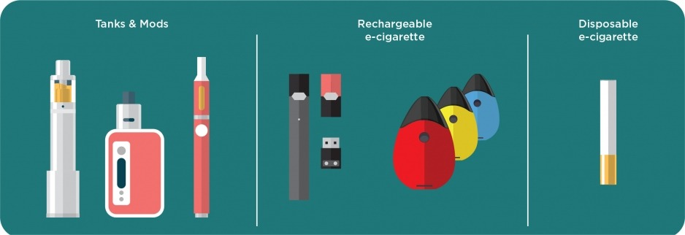
Vaping Devices
Image source: Centers for Disease Control and Prevention. About electronic cigarettes (e-cigarettes). Accessed March 14, 2021. www.cdc.gov/tobacco/basic_information/e-cigarettes/about-e-cigarettes.html

Slide 5
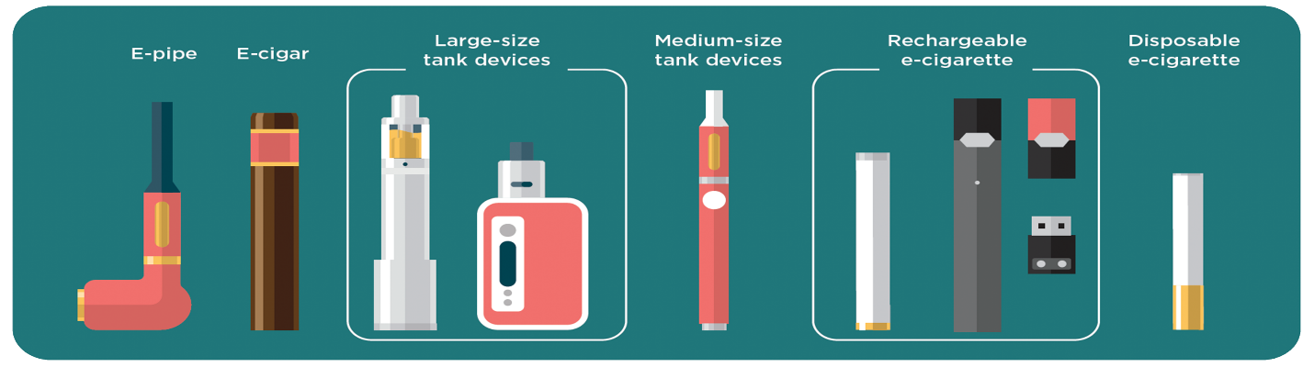
Vaping Products
When the user puffs on the mouthpiece, it activates a battery-powered vaporizer (inhalation device).
The vaporizer heats the liquid and turns it into an aerosol to inhale.
Image source: Centers for Disease Control and Prevention. Electronic cigarettes. What’s the bottom line?. Accessed March 14, 2021. www.cdc.gov/tobacco/basic_information/e-cigarettes/pdfs/Electronic-Cigarettes-Infographic-508.pdf
Notes:
These are a few examples of the different types of vaping devices. They are constantly changing in design and style, however, they all work similarly.

Slide 6
Safety and Health Effects
ENDS do not contain the same harmful substances found in cigarette smoke (i.e., tar and carbon monoxide)
ENDS do contain many toxic substances, including:
Nicotine
Heavy metals
Volatile organic compounds
Cancer-causing agents
JUUL® uses liquid “pods” formulated with nicotine salts
Absorbed at the same rate as nicotine from a combustible cigarette
Nicotine salt vapor is smooth and doesn’t produce the irritating feeling in the chest
Single pod contains as much nicotine as an entire pack of regular cigarettes

Slide 7
Safety and Health Effects
Most flavored e-cigarette liquids contain diacetyl and 2,3-pentanedione.
Linked to serious and irreversible lung diseases like bronchiolitis obliterans or “popcorn lung” disease
E-cigarette liquids and cartridges also contain high concentrations of microbial toxins like endotoxins and glucan.
Linked to the development of airflow obstruction, reduced lung function, atopic and nonatopic asthma
Risks aren’t limited to e-cigarette users—bystanders can breathe in aerosol when it is exhaled.

Slide 8
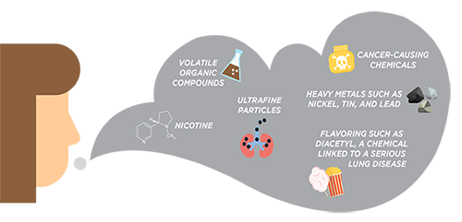
E-Cigarette Aerosol
Image source: Centers for Disease Control and Prevention. Electronic cigarettes. What is in e-cigarette aerosol? Accessed March 22, 2021. www.cdc.gov/tobacco/basic_information/e-cigarettes/pdfs/Electronic-Cigarettes-Infographic-508.pdf

Slide 9
Risks to Youth
Majority of adult smokers—more than 90% —began smoking when they were teenagers or younger.
E-cigarettes are the most commonly used tobacco products among youth.
Use by middle and high school students in the U.S. more than tripled between 2013 and 2014.
Between 2017 and 2018, use rose 77.8% among high school students and 48.5% among middle school students.
Youth and young adults who use e-cigarettes are significantly more likely to use combustible cigarettes.
Sources: Centers for Disease Control and Prevention (CDC). E-cigarette use triples among middle and high school students in just one year. Accessed March 14, 2021. www.cdc.gov/media/releases/2015/p0416-E-cigarette-use.html
CDC. Notes from the Field. Use of electronic cigarettes and any tobacco product among middle and high school students – United States, 2011-2018. Accessed March 14, 2021. www.cdc.gov/mmwr/volumes/67/wr/mm6745a5.htm
National Academies of Sciences, Engineering, and Medicine. Public health consequences of e-cigarettes. Accessed March 14, 2021. www.ncbi.nlm.nih.gov/books/NBK507171/

Slide 10
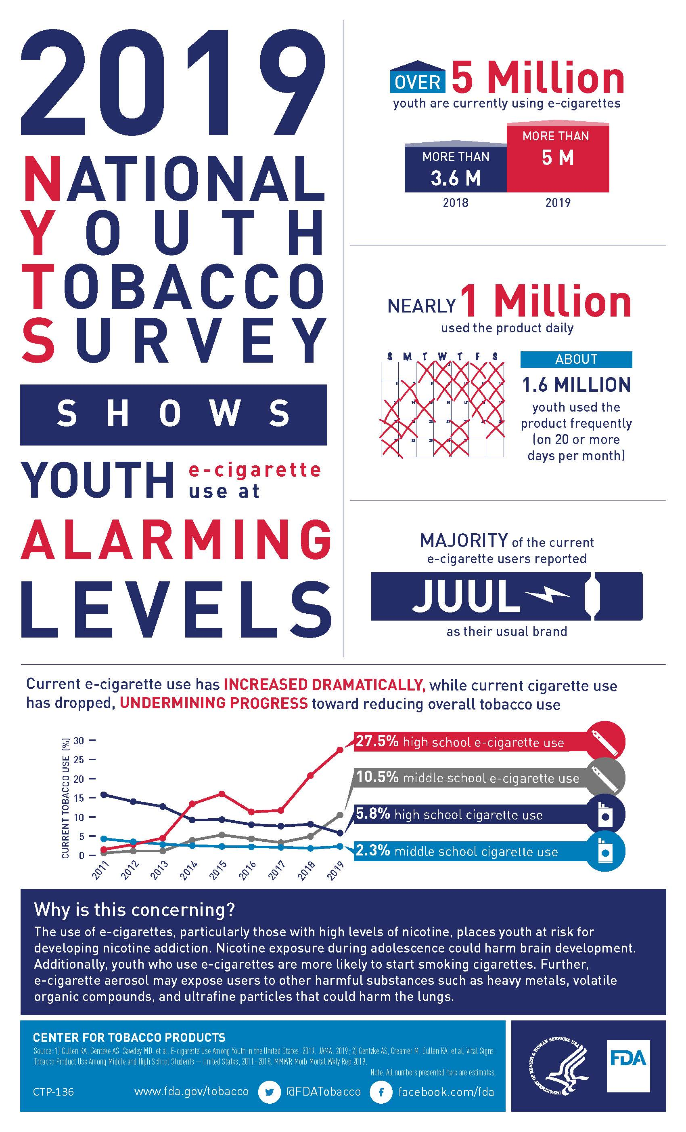
Image source: U.S. Food and Drug Administration. 2019 National Youth Tobacco Survey. Accessed March 14, 2021. www.fda.gov/media/132299/download

Slide 11
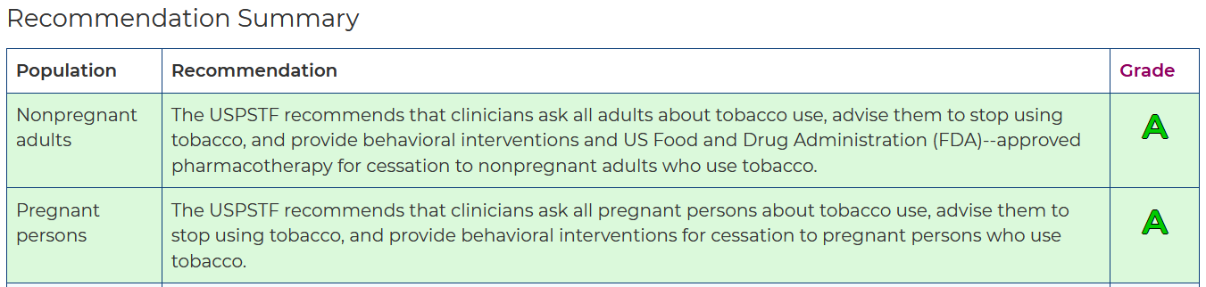
Recommendation for Adults
Tobacco Use in Adults, Including Pregnant Women: The AAFP supports the U.S. Preventive Services Task Force (USPSTF) clinical preventive service recommendation on this topic.
Image source: U.S. Preventive Services Task Force. Interventions for tobacco smoking cessation in adults, including pregnant persons. Accessed March 14, 2021. www.uspreventiveservicestaskforce.org/uspstf/recommendation/tobacco-use-in-adults-and-pregnant-women-counseling-and-interventions

Slide 12
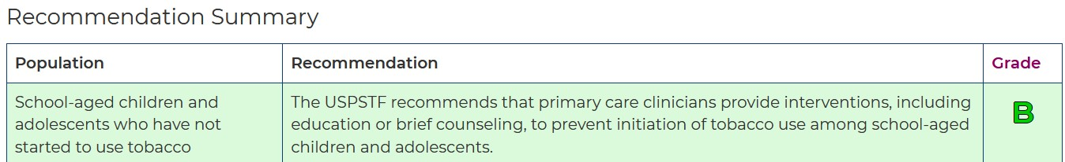
Recommendation for Children and Adolescents who have not used tobacco
This article from American Family Physician includes a summary of recommendations and evidence: Primary care interventions for prevention and cessation of tobacco use in children and adolescents: recommendation statement.
Image source: U.S. Preventive Services Task Force. Prevention and cessation of tobacco use in children and adolescents: primary care interventions. Accessed March 14, 2021. www.uspreventiveservicestaskforce.org/uspstf/recommendation/tobacco-and-nicotine-use-prevention-in-children-and-adolescents-primary-care-interventions

Slide 13
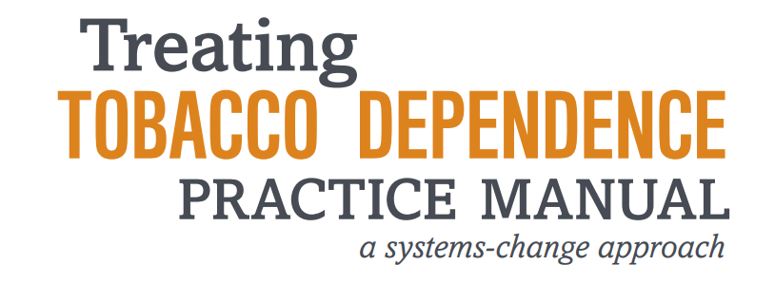

Treating Tobacco Dependence

Slide 14
Physicians Have the Opportunity to “Ask and Act”
70% of tobacco users see their doctor every year
Nearly 70% of current tobacco users want to quit
Most tobacco users try to quit on their own
Sources: Jamal A, Dube SR, Malarcher AM, Shaw L, Engstrom MC. Tobacco use screening and counseling during physician office visits among adults--National Ambulatory Medical Care Survey and National Health Interview Survey, United States, 2005-2009. 1. MMWR Suppl. 2012;61(2):38-45.
Centers for Disease Control. Smoking & tobacco use. Smoking cessation: fast facts. Accessed March 22, 2021. www.cdc.gov/tobacco/data_statistics/fact_sheets/cessation/quitting/index.htm.
Babb S, Malarcher A, Schauer G, et al. Quitting smoking among adults - United States, 2000-2015. MMWR Morb Mortal Wkly Rep. 2017;65(52):1457-1464.
Hughes JR, Keely J, Naud S. Shape of the relapse curve and long-term abstinence among untreated smokers. Addiction. 2004;99(1):29-38.

Slide 15
Physicians Have the Opportunity to “Ask and Act”
Physicians using evidence-based programs can more than double the quit rates
Up to 42,000 lives could be saved annually if Ask and Act was practiced universally
For more information, please visit the AAFP Tobacco: Preventing and Treating Nicotine Dependence and Tobacco Use (Position Paper)
Sources: Fiore MC, Jaén CR, Baker TB, et al. Treating tobacco use and dependence: 2008 update. Clinical Practice Guideline. U.S. Department of Health and Human Services, Public Health Service. Accessed March 22, 2021. www.ahrq.gov/sites/default/files/wysiwyg/professionals/clinicians-providers/guidelines-recommendations/tobacco/clinicians/update/treating_tobacco_use08.pdf
Partnership for Prevention. Preventive care: a national profile on use, disparities, and health benefits. Accessed March 22, 2021. www.rwjf.org/content/dam/farm/reports/reports/2007/rwjf13325

Slide 16
Goals for all Family Physicians
Make system changes that increase intervention and tobacco cessation rates to include ENDS
Conduct productive counseling sessions
Use the most recent evidence on pharmacotherapy for nicotine dependence
Maximize payment for tobacco and vaping cessation treatment and counseling

Slide 17
Multidisciplinary Team Approach

Slide 18
Team Member Roles
Physicians
Strong personal advice to quitting
Assess readiness to quit and deliver brief interventions
Prescribe pharmacological supports
Refer patients to other team members
Perform follow up
Nurses, physician assistants, and health educators
Assess readiness and provide counseling
Support education about use of medications
Perform follow up

Slide 19
Team Member Roles
Reception and medical assistants
Distribute health questionnaires and screening tools to identify tobacco use status
Collect information about history readiness to quit
Ensure education and information available in waiting areas and exam rooms
Coordinate with pharmacy for patient payment information and pharmacotherapy guidance form—to determine which methods are covered for each patient
Schedule follow-up visits and make follow-up calls
Administrators
Ensure adequate human resource support
Create tobacco-free policies to include ENDS
Support electronic health record (EHR) integration and ensure data are tracked
Arrange training for staff
Communicate outcomes to staff and members of the team

Slide 20
Assess Your Practice

Slide 21
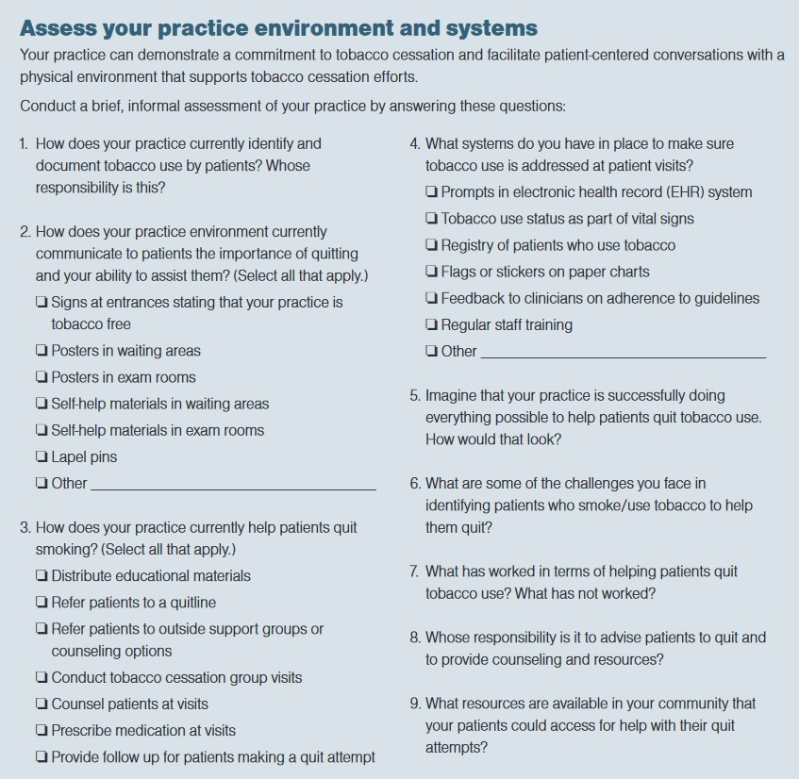
Assess Your Practice
Magazines in the waiting room
Posters, brochures, visual cues throughout office
Worksite tobacco policies
Availability of training and continuing education about tobacco and nicotine dependence

Slide 22
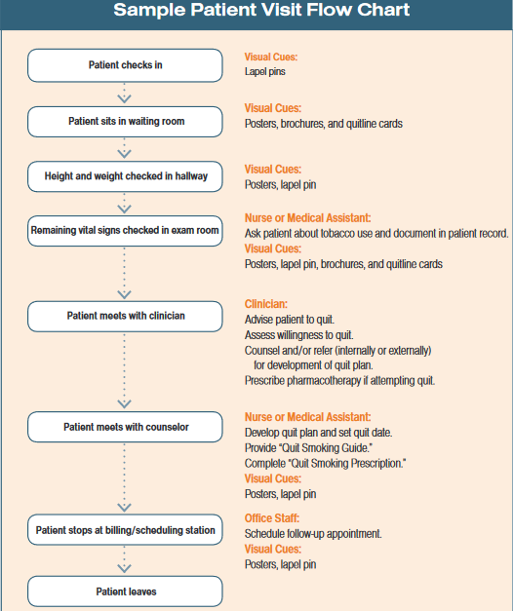
Assess Your Practice
Patient flow, opportunities for exposure to cessation messages and support
Internal processes
Decide who will Ask and Act, when, and how?
22

Slide 23
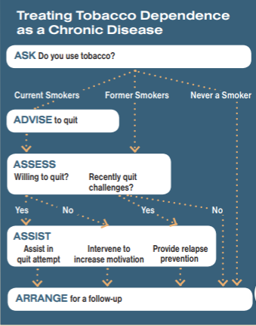
Define Your New System
What is your goal?
5 A’s
Every patient beginning at age 10
Every visit
23
Notes:
Define which patients you will screen, and which visits if every visit is not allowable at first. Recommendations are for patients 11+ years old.

Slide 24
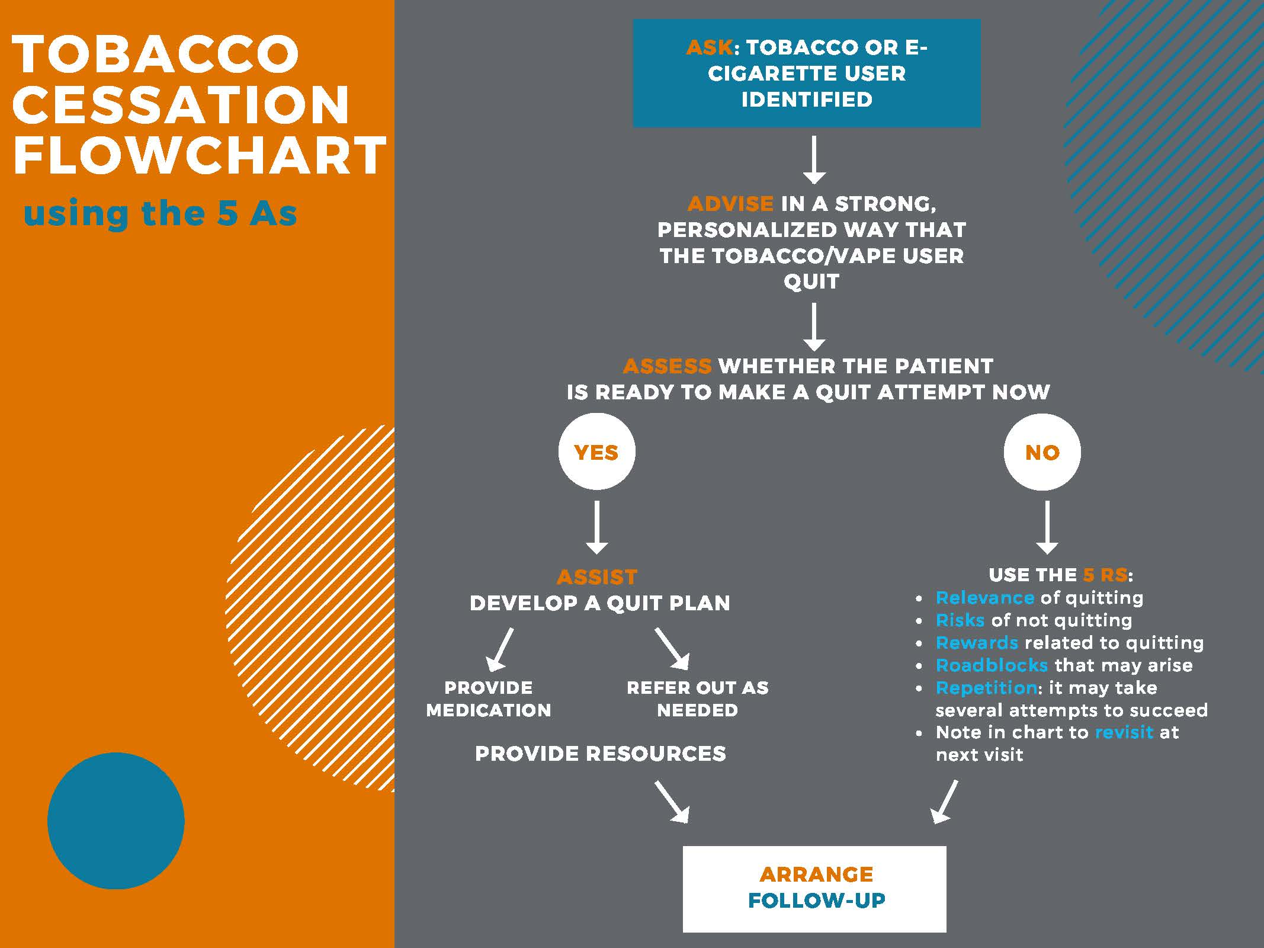

Slide 25
Identify Barriers
Have a team meeting to talk about barriers
Common barriers include:
Need for a better tobacco prompt system/EHR
Lack of time
Lack of training or experience
Staff members who use tobacco/ENDS can be uncomfortable helping patients to quit

Slide 26
Identify Barriers
Many practices don’t have systems that can:
Track patients to determine who needs follow-up or cessation services and remind them to get the services
Prompt all clinicians to Ask and Act when they see patients
Ensure appropriate referrals and follow up occurs
Confirm that patients understand what they need to do

Slide 27
Expectations
Have realistic expectations for patients using tobacco products.
Nicotine dependence should be considered a chronic condition.
The expectation should be that most patients will need help through a series of relapses.

Slide 28
Teachable Moments
New patient visits
Annual physicals
Well-child visits
Well-person visits
Office visits for diseases or symptoms caused by tobacco use
Follow-up visits after hospitalization for tobacco-related illness or the birth of a child
Recent health scare

Slide 29
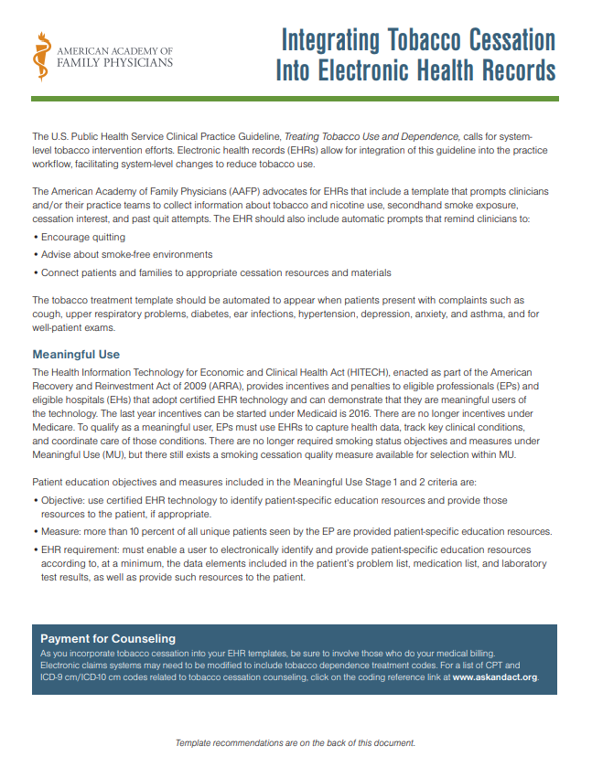
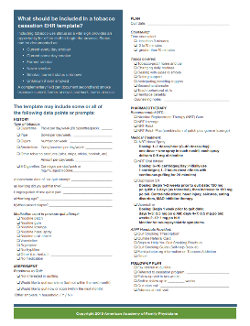

Slide 30
Charting Recommendations
EHR should include a fixed field to document ENDS use
Use inclusive language—“Do you currently use any type of tobacco, including e-cigarette or vaping device?”
Characterize other aspects of use, including:
Frequency
Product design
Product flavoring
Use with other substances

Slide 31
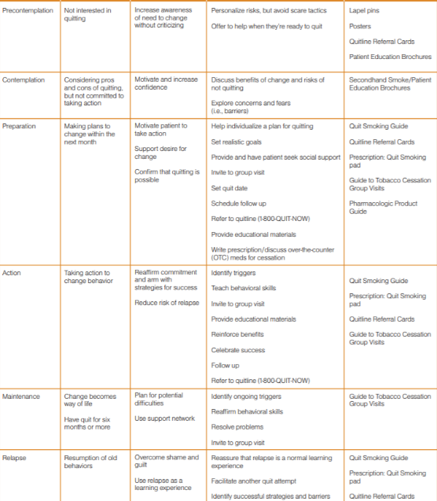

Stages of Change

Slide 32
Brief Interventions and Motivational Interviewing

Slide 33
Brief Interventions
Minimal interventions lasting less than three minutes increases overall tobacco abstinence rates.
Every tobacco user should be offered minimal intervention, whether or not the individual is referred to an intensive intervention.
Source: U.S. Public Health Service. A clinical practice guideline for treating tobacco use and dependence: 2008 update. Accessed March 14, 2021. www.ahrq.gov/prevention/guidelines/tobacco/index.html

Slide 34
Brief Intervention
Does not have to be delivered by physician
Electronic patient databases, tobacco user registries, and real-time clinical care prompts provide opportunities to fit brief interventions into a busy practice.
Source: U.S. Public Health Service. A clinical practice guideline for treating tobacco use and dependence: 2008 update. Accessed March 14, 2021. www.ahrq.gov/prevention/guidelines/tobacco/index.html

Slide 35
Brief Interventions
Even when patients are not willing to make a quit attempt, clinician-delivered brief interventions enhance motivation and increases the likelihood of future quit attempts.
Source: U.S. Public Health Service. A clinical practice guideline for treating tobacco use and dependence: 2008 update. Accessed March 14, 2021. www.ahrq.gov/prevention/guidelines/tobacco/index.html

Slide 36
Motivational Interviewing
Motivational interviewing is effective in increasing future quit attempts, particularly when physicians and other clinicians:
Express empathy
Support self efficacy
Highlight previous successes
Address resistance
Develop discrepancy
Source: U.S. Public Health Service. A clinical practice guideline for treating tobacco use and dependence: 2008 update. Accessed March 14, 2021. www.ahrq.gov/prevention/guidelines/tobacco/index.html

Slide 37
5 R’s of Motivational Interviewing
Relevance
Risks
Rewards
Roadblocks
Repetition
5 R’s Enhance Future Quit Attempts
Source: U.S. Public Health Service. A clinical practice guideline for treating tobacco use and dependence: 2008 update. Accessed March 14, 2021. www.ahrq.gov/prevention/guidelines/tobacco/index.html
Notes:
Relevance: Talk about why quitting is personally relevant (improve health, save money, affects others in the household).
Risks: Help patients identify risks associated with continued tobacco use. If the patient is not ready to quit now or does not want to quit, you may want to ask what the patient has heard about the risks of tobacco use.
Rewards: Discuss the benefits of stopping (food tastes better, feel more energetic, have more money, hair and clothes will not smell like smoke).
Roadblocks: Identify barriers to quitting (triggers and cravings, withdrawal, being around others who smoke, worried about weight gain, may relapse).
Repetition: Discussion quitting smoking more than once. Ambivalence is normal.
Ask open-ended questions. Ask quality questions.
How important do you think it is for you to quit?
What may happen if you quit?
Would you like to hear about some strategies that can help address your concerns when you quit?

Slide 38
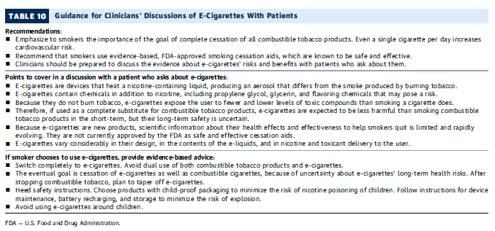
Reprinted with permission from: Barua RS, Rigotti NA, Benowitz NL, et al. 2018 ACC expert consensus decision pathway on tobacco cessation treatment: a report of the American College of Cardiology Task Force on clinical expert consensus documents. J Am Coll Cardiol. 72(25):3332-3365.

Slide 39
When Patients Are Ready to Quit

Slide 40
Patient Ready to Quit
Intensive tobacco dependence treatment is more effective than brief treatment.
Intensive interventions are more comprehensive treatments compared to multiple visits for longer periods of time.
Treatment may be provided by more than one clinician, including a quitline specialist.
Source: U.S. Public Health Service. A clinical practice guideline for treating tobacco use and dependence: 2008 update. Accessed March 14, 2021. www.ahrq.gov/prevention/guidelines/tobacco/index.html
Notes:
40

Slide 41
Develop a Quit Plan
Set a quit date
Have patient tell family and friends and remove tobacco products
Identify social support
Prescribe medication

Slide 42
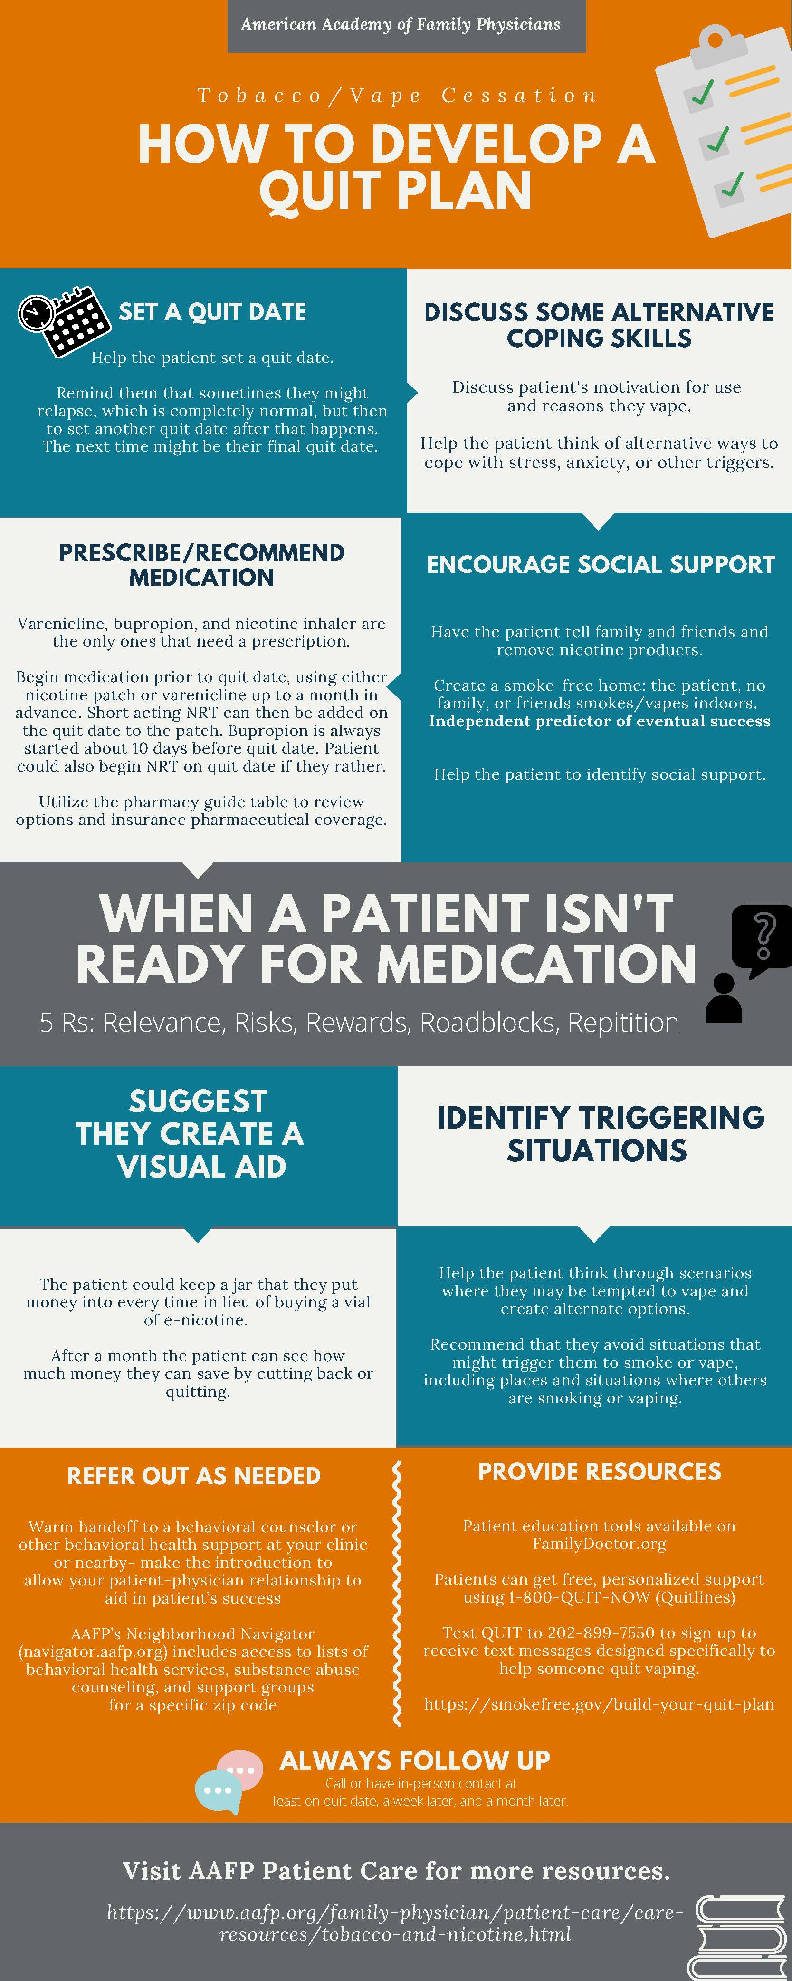

Slide 43
Referrals

Slide 44
Quitlines
It only takes 30 seconds to refer a patient to a toll-free tobacco cessation quitline.
Quitlines are staffed by trained cessation experts who tailor a plan and advice for each caller.
Calling a quitline can increase a tobacco user’s chance of successfully quitting.

Slide 45
Advantages of Quitlines
Accessible in all 50 states
Confidential
Evidence based
Appeals to those who are uncomfortable in a group setting
Tobacco users are more likely to use a quitline than a face-to-face program
No cost to patient
Easy intervention for health care professionals
Notes:
Accessibility: don’t have to wait for classes to form or worry about transportation. Good for people in remote areas.

Slide 46
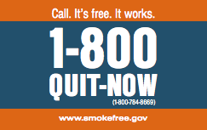
Quitlines
1-800-QUIT-NOW
Callers are routed to state-run quitlines or the National Cancer Institute quitline.
Quitline referral cards are available through the AAFP at www.askandact.org.

Slide 47
Pharmacotherapy

Slide 48
Pharmacotherapy
Who should receive pharmacotherapy?
All tobacco users trying to quit, except where contraindicated or for specific populations where there is insufficient evidence of effectiveness (i.e., pregnant women, smokeless tobacco users, light smokers, and youth/adolescents)
Source: U.S. Public Health Service. A clinical practice guideline for treating tobacco use and dependence: 2008 update. Accessed March 14, 2021. www.ahrq.gov/prevention/guidelines/tobacco/index.html

Slide 49
Factors to Consider When Prescribing
Clinician familiarity with medications
Contraindications
Patient preference
Previous patient experience
Patient characteristics (e.g., history of depression, weight gain concerns, etc.)
Cost and coverage
Source: U.S. Public Health Service. A clinical practice guideline for treating tobacco use and dependence: 2008 update. Accessed March 14, 2021. www.ahrq.gov/prevention/guidelines/tobacco/index.html

Slide 50
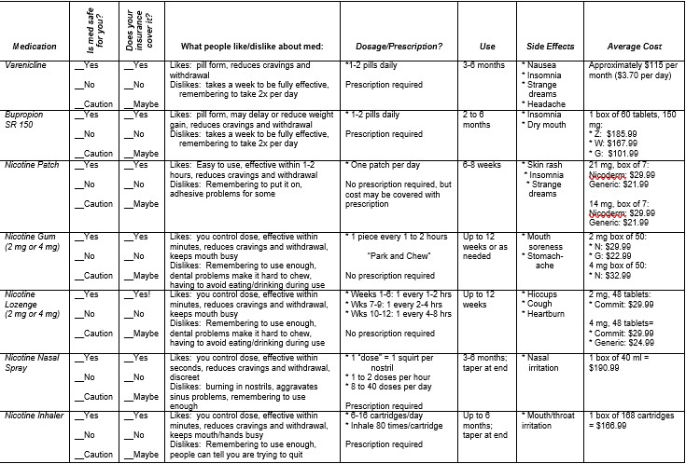
Pharmacotherapy Guidance Form
Adapted with permission: Richter KP, Shireman TI, Ellerbeck EF, et al. Comparative and cost effectiveness of telemedicine versus telephone counseling for smoking cessation. J Med Internet Res. 2015;17(5):e113.
Notes:
This form is available as part of AAFPs Tobacco and Vaping Cessation Guide. It is adapted from the one used in a study done by the University of Kansas Medical Center, which found it incredibly helpful for clinics to have this form filled out by the pharmacist using the patient’s coverage information every time they had a newly identified smoker/vaper. Cost can be a barrier to compliance. After discussing the tobacco/vaping cessation with the patient, the physician could make an informed decision about which treatment to utilize based on which methods would be best for the patient, including those covered by the patient’s insurance.

Slide 51
Medication Options
The U.S. Food and Drug Administration has approved seven cessation options as safe and effective to help smokers quit:
Five types of nicotine replacement therapy (NRT)
Patch*
Gum*
Lozenge*
Inhaler
Nasal spray
*Available without a prescription
Two non-nicotine medications
Bupropion (marketed as Wellbutrin and Zyban)
Varenicline (marketed as Chantix)

Slide 52
Medication Options
Begin medication prior to quit date, using either nicotine patch or varenicline up to a month in advance.
Short-acting NRT can then be added on the quit date to the patch.
Bupropion is always started about 10 days before quit date.
If the patient would rather begin NRT on quit date, that is fine too— there is a better response from patch plus a short-acting NRT.
If the patient is not ready to set a quit date, there is evidence that beginning varenicline anyway will increase spontaneous cessation.

Slide 53
Weight Gain
Bupropion SR and NRTs (especially gum and 4 milligram [mg] lozenge) may delay, but not prevent, weight gain.
The average weight gain from tobacco cessation is less than 10 pounds.
Weight gain on these treatments is more common in women.
Source: U.S. Public Health Service. A clinical practice guideline for treating tobacco use and dependence: 2008 update. Accessed March 14, 2021. www.ahrq.gov/prevention/guidelines/tobacco/index.html

Slide 54
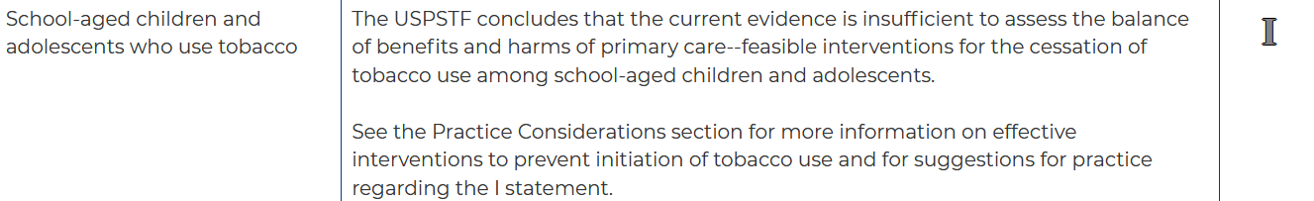
Recommendation for Children and Adolescents who use tobacco
NRT is shown to be safe.
There is very little evidence to support that medications are helpful in this population; not a recommended intervention
Image source: U.S. Preventive Services Task Force. Prevention and cessation of tobacco use in children and adolescents: primary care interventions. Accessed March 14, 2021. www.uspreventiveservicestaskforce.org/uspstf/recommendation/tobacco-and-nicotine-use-prevention-in-children-and-adolescents-primary-care-interventions#:~:text=Recommendation%20Summary&text=The%20USPSTF%20recommends%20that%20primary,school%2Daged%20children%20and%20adolescents
Source: U.S. Public Health Service. A clinical practice guideline for treating tobacco use and dependence: 2008 update. Accessed March 14, 2021. www.ahrq.gov/prevention/guidelines/tobacco/index.html

Slide 55
Behavioral Health Considerations

Slide 56
Patients With Mental Health and Substance Use Disorders
Rates of smoking are 2-4 times higher
Most will need medication to quit
Quitting smoking or nicotine withdrawal may exacerbate comorbid conditions
May need higher doses, longer duration of treatment and combination of medications
Counseling is critical to successful cessation
Sources: U.S. Public Health Service. A clinical practice guideline for treating tobacco use and dependence: 2008 update. Accessed March 14, 2021. www.ahrq.gov/prevention/guidelines/tobacco/index.html
University of Colorado Denver, Department of Psychiatry, Behavioral Health and Wellness Program. Smoking cessation for persons with mental illnesses. Accessed March 14, 2021. https://cbhphilly.org/wp-content/uploads/2019/11/39_Smoking-Cessation-for-Persons-with-Mental-Illnesses.pdf
Notes:
56

Slide 57
Practical Counseling Tips
Teach problem-solving skills
Identify dangerous situations or triggers for people who use tobacco
Suggest coping skills to use and how to avoid temptation
Provide basic information about tobacco use dangers, withdrawal symptoms, and addiction
Source: U.S. Public Health Service. A clinical practice guideline for treating tobacco use and dependence: 2008 update. Accessed March 14, 2021. www.ahrq.gov/prevention/guidelines/tobacco/index.html
Notes:
Some trigger situations where patient may be tempted to smoke includes alcohol use, stress, and being around other smokers.
Change your environment--stay away from places where people are likely to be smoking.
Let others know you are trying to quit and ask them to not smoke around you.
Instead of reaching for a cigarette when tempted, drink a glass of water, chew gum, go for a walk.
Distract yourself from the urge to smoke by talking to someone or working on a task.

Slide 58
Counseling Adolescents
Tobacco cessation counseling is recommended for adolescents
Use motivational interviewing
Respect privacy
Source: U.S. Public Health Service. A clinical practice guideline for treating tobacco use and dependence: 2008 update. Accessed March 14, 2021. www.ahrq.gov/prevention/guidelines/tobacco/index.html
Notes:
58

Slide 59
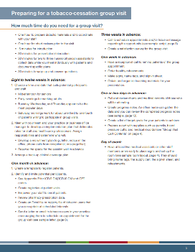
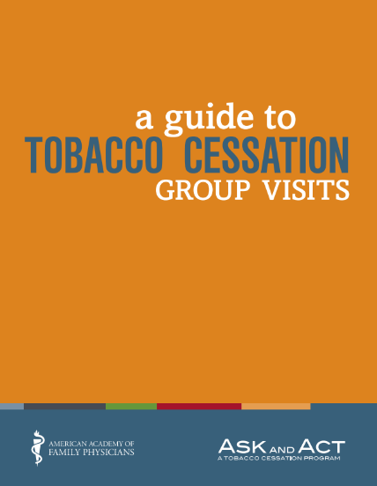

Slide 60
Cultural Considerations
Be aware of traditions or cultural customs (e.g., ceremonial tobacco use).
Help patients see how health benefits outweigh social aspects of smoking.
Patient-centered conversations and motivational interviewing can help.

Slide 61
Health Literacy
Patients may not possess the skills they need to help manage their health
Patients may not understand drug labeling or medical instructions
Help by making patients feel comfortable talking to you
Use plain language
Use visual models
Have patients explain instructions back to you

Slide 62
Follow Up
Follow-up visits are important to monitor progress of quit attempts
Considerations:
When?
Who?
How?

Slide 63
Follow Up
Follow-up calls and/or visits should include:
Benefits of quitting
Potential side effects of medications
Ways that social support is working
Withdrawal effects and ways to deal with them
Positive goals and achievements, such as tobacco-free home or car
Ways you and your care team can help

Slide 64
Return to Use
Return to use occurs when use leads to previous levels of intake, and is very common.
A slip does not bring on a return to previous level of use.
Return to use is part of the change process—not a failure.
Remember, you are helping patients overcome a chronic condition.

Slide 65
Return to Use
When counseling a patient who has returned to use:
Normalize the situation
Focus on the positive(s)
Ask what got in the way—have the patient identify obstacles
Don’t ask “why” questions
Ask how the patient will deal with situations in the future
Acknowledge the difficulty and provide encouragement
Modify the quit plan or make a new one
Shorten intervals between visits, or consider phone calls or e-visits (check-ins)

Slide 66
Standardize the System
Use of EHRS
Tobacco use registries
E-visits
Group visits

Slide 67
Payment for Tobacco Cessation Counseling

Slide 68
AAFP Resources for Payment and Coding
Coding for Tobacco Screening and Cessation
Guide to Tobacco Cessation Group Visits
Tobacco Cessation Telehealth Guide
AAFP Coding Reference Cards: Preventive Services Codes

Slide 69
Resources

Slide 70
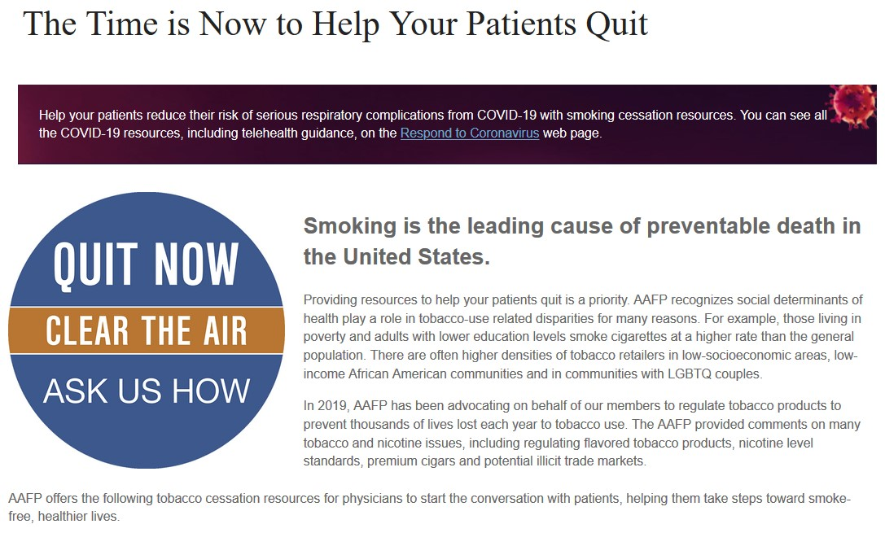
AAFP Tobacco and Vaping Cessation Resource Page
www.aafp.org/patient-care/inform/gaso.html
Notes:
Some trigger situations where patient may be tempted to smoke includes alcohol use, stress, and being around other smokers.
Change your environment--stay away from places where people are likely to be smoking.
Let others know you are trying to quit and ask them to not smoke around you.
Instead of reaching for a cigarette when tempted, drink a glass of water, chew gum, go for a walk.
Distract yourself from the urge to smoke by talking to someone or working on a task.

Slide 71
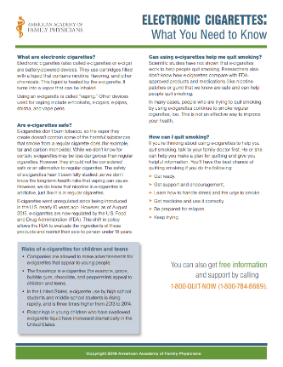
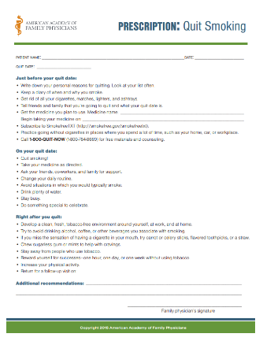
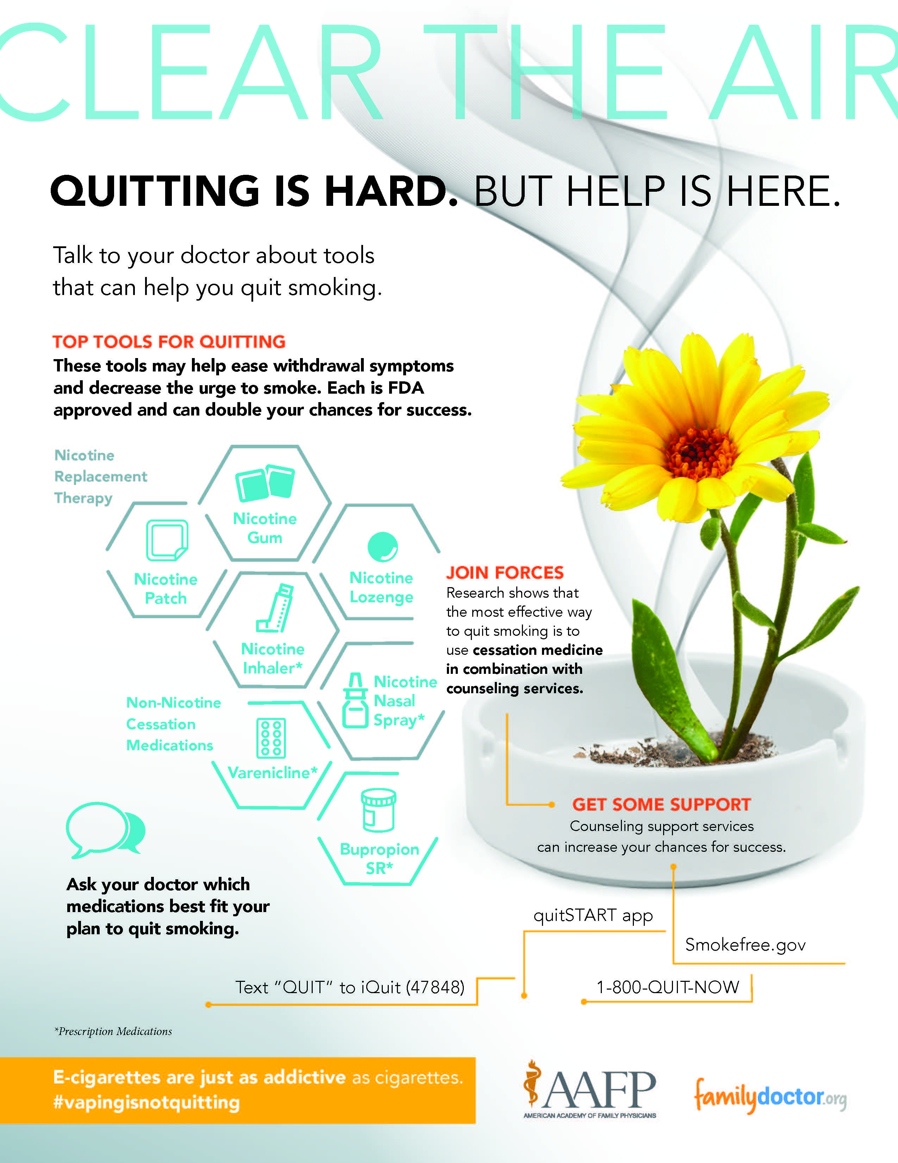
Patient Resources
Electronic Cigarettes: What You Need to Know: English | Spanish
Patient Fact Sheet on JUUL
Quit Smoking Guide: English | Spanish
Top Tools for Quitting Infographic
Prescription Pad: English | Spanish
Tobacco Addiction
Dangers of Vaping
"Do I Want To Quit" Quiz
"Why Do I Smoke" Quiz
Smokeless Tobacco: Tips on How to Stop
Smoking Cessation in Recovering Alcoholics
Nicotine Patch
Smokefree.gov
Clear the Air Infographic

Slide 72
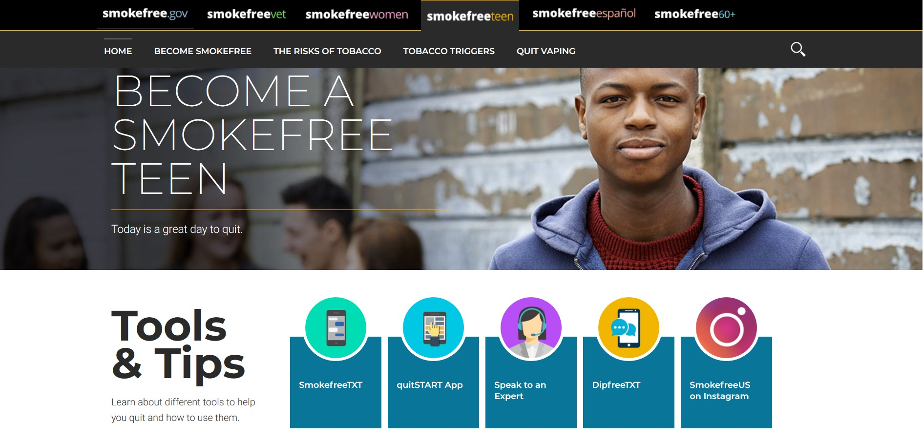
Resources for Teens
www.teen.smokefree.gov

Slide 73
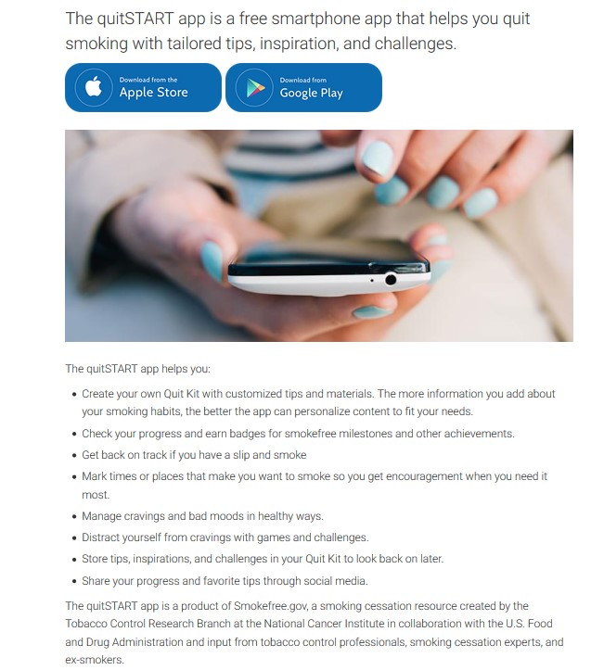
73

Slide 74
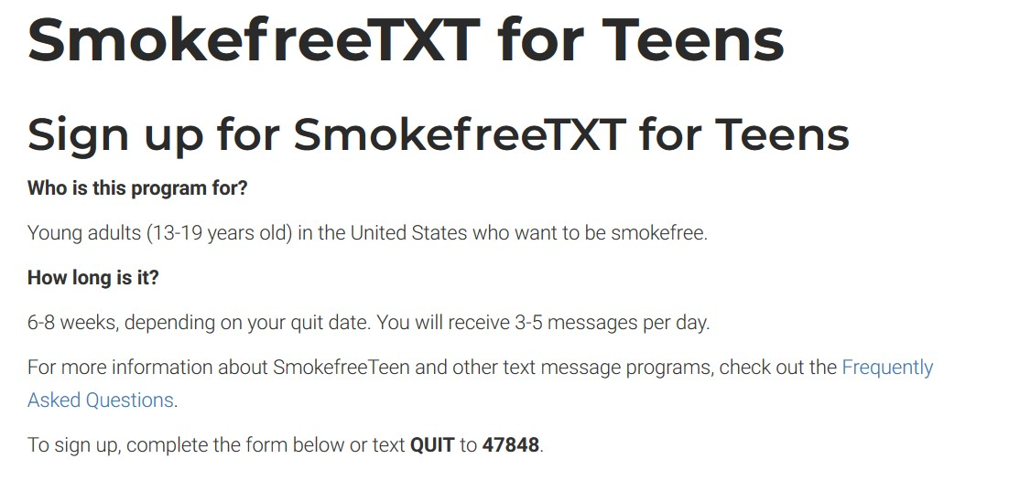

Slide 75
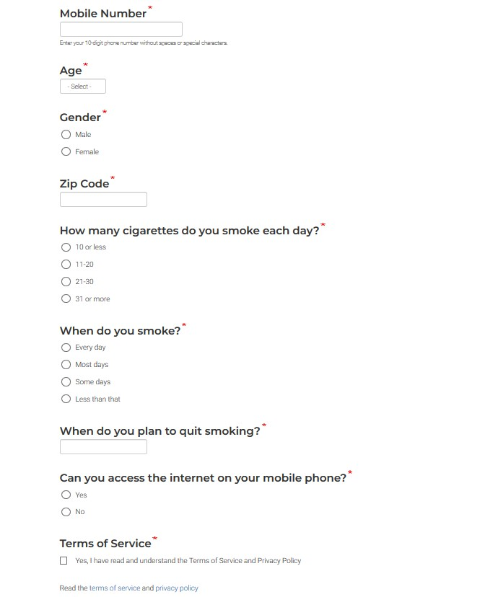
Questions asked when signing up for SmokefreeTXT for Teens
75

Slide 76
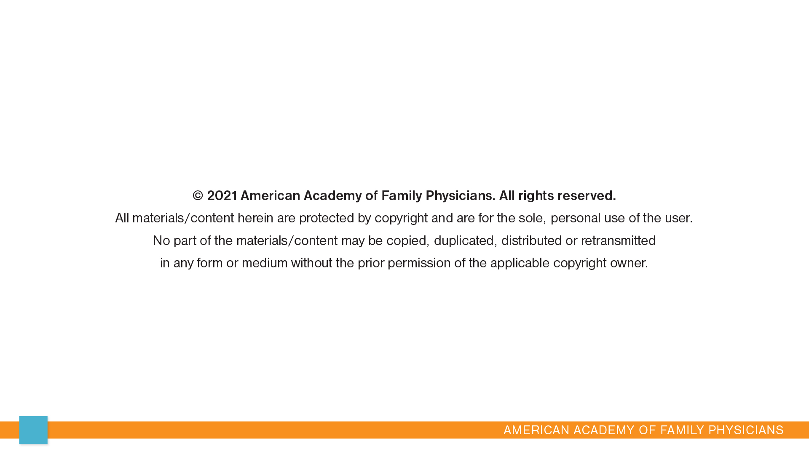
76

Slide 77


