Slide 1
Thinking Med School? America Needs More Family Doctors
Christine Ramos Camacho, MD, MS, DABOM
March 4, 2025
Notes:
Ask them to be thinking about the reasons they wanted to attend this session while we do introductions.
Now we are going to play a game to see how much you know about medicine. Lets see if you can figure out what kind of doctors these are
Thank you for joining to learn more about the specialty of family medicine.
Each year, family medicine is the top specialty choice for many students entering medical school. What many of you might already know about the specialty is that family physicians are that they are the cornerstone of primary care systems throughout the world. What you’ll learn more about here is what this means day to day: we’ll be looking at how family physicians live and work, why the future of the specialty is bright, and what sets family medicine apart from similar primary care fields. What I will show you is that family is a top choice specialty because it offers everything in the form of career and lifestyle that brought you to medical school in the first place.
HOSA Intro:
Thank you for joining us this afternoon! My name is Adam Bradley, Program Strategist for Student Initiatives at the American Academy of Family Physicians. We are excited to talk to you about the educational journey to becoming a physician and the specialty of family medicine. As you consider your future careers, we want to share with you why becoming a family doctor is not only a rewarding path but also a crucial one for our communities. Family doctors play a vital role in providing comprehensive healthcare, building lasting relationships with patients, and addressing a wide range of medical needs.

Slide 2
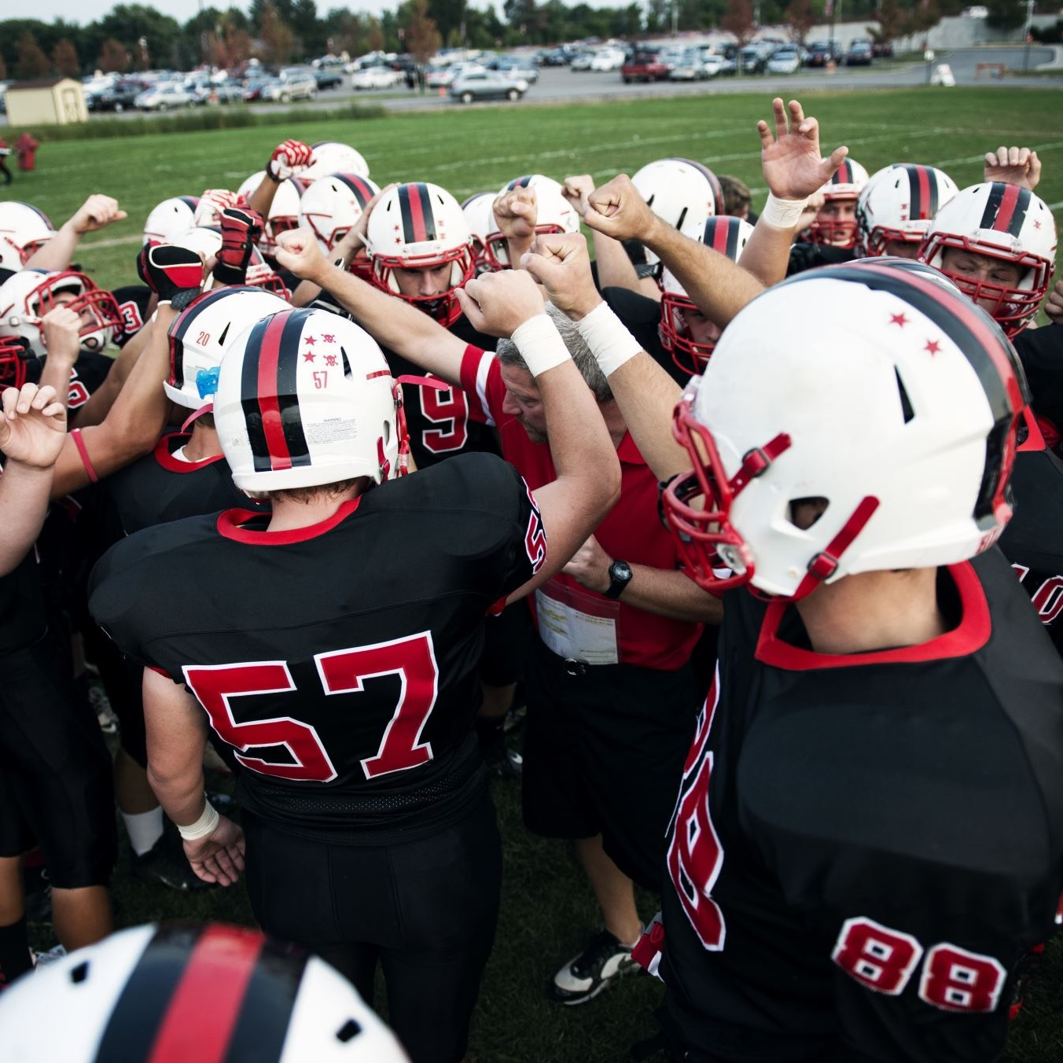
Name The Doctor
Provide medical care during sporting events
Diagnose, treat and manage injuries to your musculoskeletal system
Educate athletes on injury prevention
Offer guidance on return to physical activity post injury
Notes:
Guess what kind of doctor this is
A family doctor who practices sports medicine is a physician trained in family medicine with additional expertise in sports-related injuries and conditions. These doctors focus on the prevention, diagnosis, and treatment of injuries related to physical activity. They work with athletes and active individuals of all ages to help them maintain optimal health and performance. Family doctors in sports medicine can treat a wide range of musculoskeletal issues, such as sprains, strains, fractures, and overuse injuries. They also provide guidance on injury prevention, nutrition, and safe exercise practices.
Unlike orthopedic surgeons, sports medicine physicians typically do not perform surgery but collaborate with surgeons and other healthcare professionals to provide comprehensive care for their patients
(Sports medicine is not a specialty on its own, it’s a type of medicine)

Slide 3
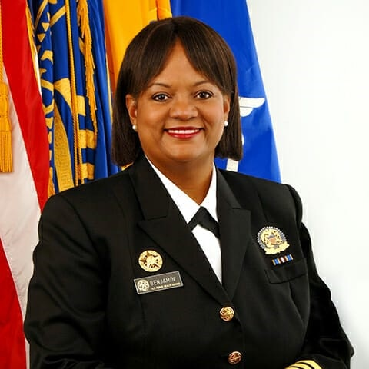
Name The Doctor
Surgeon General
Operational head of the US Public Health Service Commissioned Corps (PHSCC)
Principal advisor to the secretary of health and human services
Educate the American public about health issues
Notes:
Surgeon General, Regina Benjamin
Highest public medical leadership position,
Family doctors are especially qualified for leadership in health care because they are specially trained in various aspects of healthcare, including preventive care, chronic disease management, and patient education. They bring a holistic perspective to public health, emphasizing the importance of comprehensive care and community health initiatives.
These skills translate to being able to see the big picture, leadership

Slide 4

Name The Doctor
Health of populations in the world-wide context
World-wide health improvement
Notes:
Global Health
A family doctor who practices global health is a physician trained in family medicine who focuses on improving health outcomes for populations worldwide. These doctors work to address health disparities, provide care in resource-limited settings, and often engage in public health initiatives. They often collaborate with local health workers, train medical staff, and implement health programs to improve access to care and health education. A family doctor's training allows them to see any patient, in any setting, anywhere in the world

Slide 5
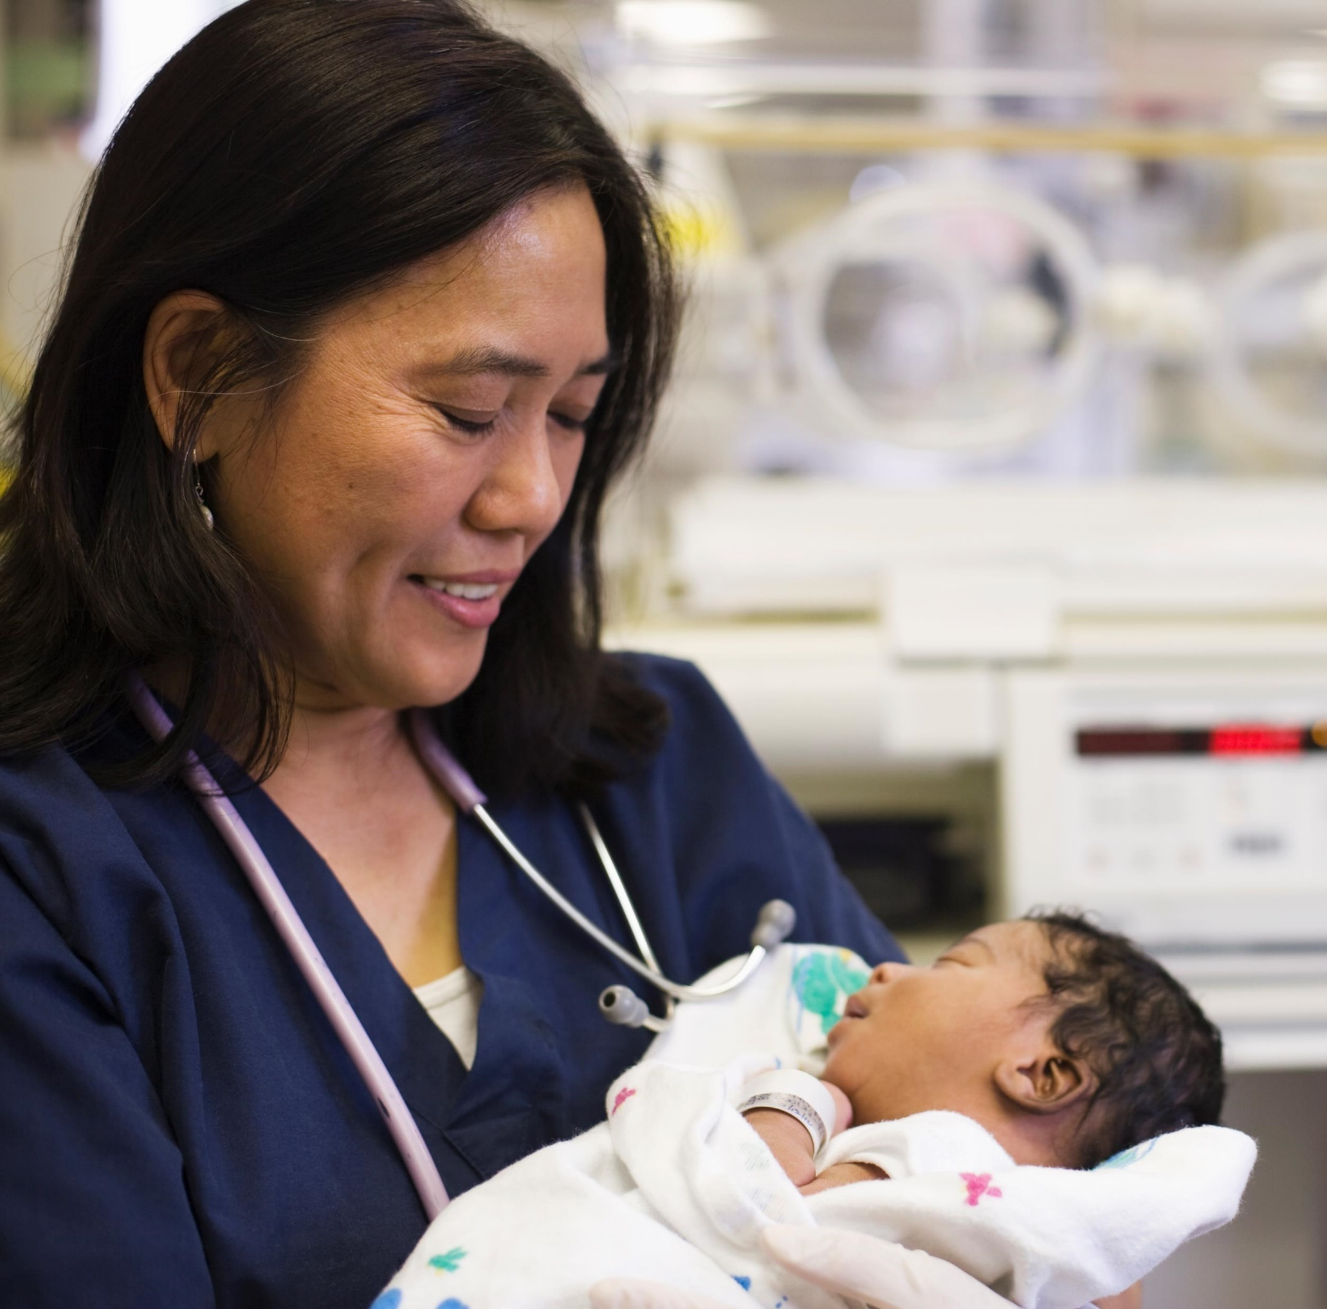
Name The Doctor
Provides care to patients throughout their pregnancy, childbirth, and postpartum period
Family planning
Fertility counseling
Able to provide care to both delivering patient and baby
Notes:
Obstetrics
Deliver babies, family planning, taking care of the baby
A family doctor who practices obstetrics is a physician trained in family medicine who also provides comprehensive care during pregnancy, childbirth, and the postpartum period. These doctors can manage both low- and high-risk pregnancies, perform vaginal deliveries, and sometimes even c-sections if they have additional surgical training.
Family doctors offering obstetric care often provide continuity of care, meaning they can care for the mother and baby before, during, and after pregnancy. This can be especially beneficial in rural or underserved areas where access to specialized obstetric care might be limited

Slide 6
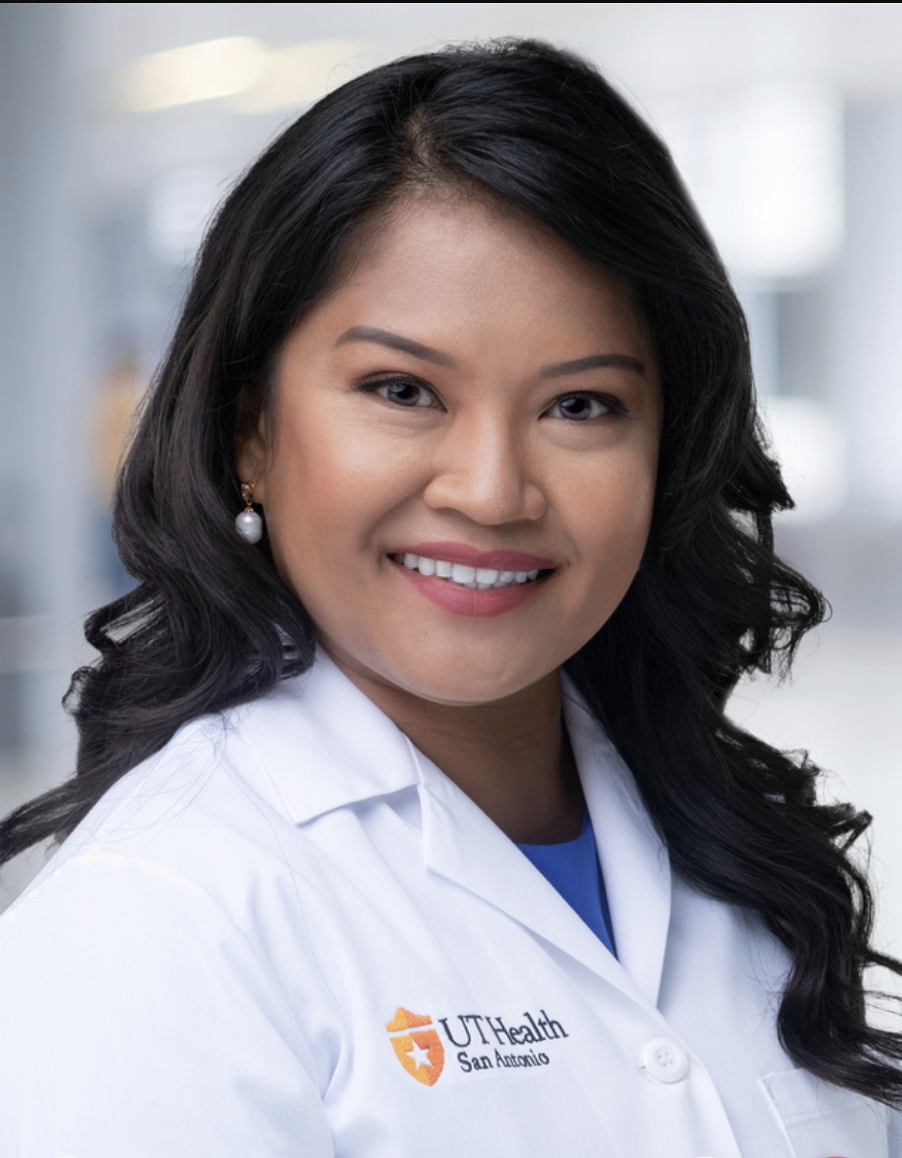
Name The Doctor
UT Health San Antonio
  Assistant Professor/Clinical
  Core faculty for Family Medicine Residency Program
  Clinical instructor at Long School of Medicine
AAFP Leading Physician Well-Being Scholar
AAFP Family Medicine Champions Community Engagement Co-Chair
Clinical focus: Resident and medical student teaching, comprehensive pediatric and adult care, obesity medicine
Notes:
Academics

Slide 7






What is Family Medicine?
A medical specialty
trained to treat most ailments
and provide comprehensive health
care for people of all ages –
from newborns to seniors
Notes:
Recap of game
To put it simply, Family Medicine is a medical specialty trained to treat most ailments and provide comprehensive health care for people of all ages.
That sounds straightforward, but for many people it can be confusing to understand how a family doctor became one, what they are trained to do and why it is the career they would choose all over again if given the chance to start again.
Let’s take some time to dig a little deeper into this question- what is family medicine?

Slide 8






The Physician Journey
FELLOWSHIP
RESIDENCY
1-3+ years, varies by specialty
3-7 years, varies by specialty
MEDICAL SCHOOL
4 years at an allopathic or osteopathic medical school
UNDERGRADUATE
4 years at a college or university program
Notes:
All physicians begin with a obtaining a bachelors degree from an undergraduate college or university. There is no one degree that is required- a physician can have a bachelor of science or art in any field but there are some specific prerequisite courses that are mandatory for application to medical school. Some physicians will get additional training before applying to medical school through post baccalaureate courses or even master’s degrees.
In medical school future doctors will spend 4 years learning about the normal functioning of the human body, diseases and illnesses and how to care for patients in the context of their communities. Everyone who graduates from medical school will be a physician, but to practice medicine, they will need to complete a specialized training program in their field of choice. 4th year medical students apply to residency training programs in the specialty of their choice and if selected will start their specialty training following graduation from medical school.
Some specialists need additional training even beyond their residency, so they complete fellowships. Those subspeciality trainings can be a year or many years depending on the particular field.

Slide 9
The ^Physician Journey
Family Medicine
FELLOWSHIP
RESIDENCY
1-3+ years, varies by specialty
3-7 years, varies by specialty
MEDICAL SCHOOL
4 years at an allopathic or osteopathic medical school
Examples:
Adolescent Medicine
Geriatric Medicine
Hospice & Palliative Care
Pain Medicine
Sleep Medicine
Sports Medicine
Hospital Medicine
Addiction Medicine
Brain Injury Medicine
Clinical Informatics
Emergency Medical Services
Obstetrics: surgical, high risk
UNDERGRADUATE
4 years at a college or university program
Notes:
For the family physician, most will complete a 3-year residency program and then go into practice in a wide variety of settings (we will talk more about that in a bit).
There are some residency programs that offer a 4th year where the resident physicians receive additional training in an area where they have a strong interest in for example some complete tracks on HIV medicine, Obstetrics, women’s health, procedures or a host of other areas.
Family Physicians who want to be subspecialized in a particular area have some options for completing fellowship training in areas such as adolescent medicine, geriatrics, sports medicine or addiction medicine. There are some fellowships that are not run by the board of family medicine but offer family physicians opportunity to gain additional training as well for example the AAFP offers health equity and vaccine science fellowships or academic-minded family physicians often complete faculty development fellowships that train them about developing curriculum and adult learning theories.

Slide 10
The College Journey
College freshman year
Explore medical career options: meet with advisor, visit aspiring docs, explore financial aid, etc.
College Sophomore year
Stay on track for medical school: work with pre-health advisor, attend pre-health meetings, volunteer/work in the field
College Junior year
Strategize with your advisor on a game plan: gap year, post-bac program, letters of recommendation, pre-med and required coursework
Get some experience: participate in enrichment programs, volunteer or intern
SUMMER: finalize and submit AMCAS application, continue with volunteer/work
Register for the MCAT exam: register early, compare schools, begin filling out AMCAS application.
Get more experience and review resources: fee assistance, AMCAS application and MCAT processes, research/internship experience
College senior year
Prepare for medical school interviews: consult with advisor, ask aspiring docs for interview tips
Receive letters of acceptance or rejection: if accepted, decide which school and complete FAFSA, if waitlisted or rejected speak with advisor, consider gap year
College graduation
Get ready for medical school: buy books, find housing, attend orientation.
Notes:
Undergrad, junior/community college is ok too
Follow your passion in undergrad, what do you actually enjoy?
Pre-med is a track but it’s not a major, prerequisite coursework / post-bac programs to prep for medical school
Mission-based academic programs are options as well, and enhance general medical school training by offering additional in-depth training in specific areas of healthcare.
American Medical College Application Service®

Slide 11
The Medical School Journey
Medical School year 1 (M1)
Orientation
Clinical Anatomy, Development and Physical Examination (CADE)
Introduction to Clinical Medicine 1a (ICM 1a)
Molecular Basis of Life, Defense
and Disease (MBLDD)
Introduction to Clinical Medicine 1b (ICM 1b)
Biostatistics and EBM
Vacation or Electives
Medical School year 2 (M2)
Human Systems in Health and Disease 1 (HSHD1)
Introduction to Clinical Medicine 2a (ICM 2a)
Human Systems in Health and Disease 2 (HSHD2)
Introduction to Clinical Medicine 2b (ICM 2b)
Study for Step 1
M3 Orientation,
Clerkships
Medical School year 3 (M3)
Surgery
(8 wks)
Internal Medicine
(8 wks)
Neurology
(4 wks)
OB/GYN
(6 wks)
Psychiatry
(6 wks)
Pediatrics
(6 wks)
Family Medicine
(6 wks)
Medical School year 4 (M4)
Study for Step 2 CK, CS during fall semester
Acting Internship
(4 wks)
ICU
(2 wks)
Palliative
(1 wk)
Graduation
Ambulatory
(4 wks)
Electives
(22-24 total weeks)
Apply to residencies

Slide 12
Jul
AUG
Sep
Oct
Nov
Dec
Jan
Feb
Mar
Apr
May
Jun
M1
Orientation
Clinical Anatomy, Development and Physical Examination
(CADE)
Molecular Basis of Life, Defense
and Disease
(MBLDD)
Biostatistics and EBM
Vacation or Electives
Introduction to Clinical Medicine 1a
(ICM 1a)
Introduction to Clinical Medicine 1b (ICM 1b)
M2
Human Systems in Health and Disease 1 (HSHD1)
Human Systems in Health and Disease 2
(HSHD2)
Study for Step 1
M3 Orientation,
Clerkships
Introduction to Clinical Medicine 2a
(ICM 2a)
Introduction to Clinical Medicine 2b
(ICM 2b)
M3
Surgery
(8 wks)
Internal Medicine
(8 wks)
Neurology
(4 wks)
OB/GYN
(6 wks)
Psychiatry
(6 wks)
Pediatrics
(6 wks)
Family Medicine
(6 wks)
M4
Acting Internship (4 wks)
ICU
(2 wks)
Palliative
(1 wk)
Ambulatory(4 wks)
Electives
(22-24 total weeks)
Electives
(22-24 total weeks)
Graduation
Notes:
Dr. Younger: What was your path to family medicine like? What was the transition like to medical school for you and were there any surprises?
Why would you encourage students to consider family medicine?

Slide 13
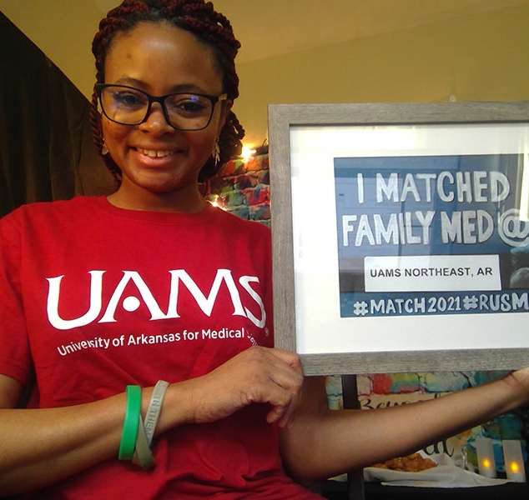
The Family Medicine Residency Experience
Three to four years
Each program offers something unique
Major areas of training
Maternity care
Hospital medicine
Outpatient care
Mental health care
Surgical procedures
Community medicine
End-of-life care
Continuity of Care as a continual focus.
Notes:
Family medicine residencies offer a supportive environment for future primary care physicians. What is a residency in family medicine like? Every program offers something unique, but training is typically three years long. During this time, trainees learn child and maternity care, mental health care, surgical procedures, community medicine, end-of-life care, and more. Students can apply to what are known as solo or collaborative programs, solo programs being those in which the family medicine residency is the only residency at that center, and collaborative being those in a setting where multiple specialties are training.

Slide 14
Family Medicine
Caring for patients regardless of age or health condition, sustaining an enduring and trusting relationship
Understanding community-level factors and social determinants of health
Serving as a patient's first contact for health concerns
Navigating the health care system with patients, including specialist and hospital care coordination and follow-up
Using data and technology to coordinate services and enhance care
Considering the impact of health on a patient’s family
160+
Types of US Doctors
1
Specialty can care for you your whole life
Notes:
In the United States there are over 160 specialties and subspecialties of medicine, but there is only one who is trained to deliver comprehensive care to you for you whole life.
Family physicians treat patients of all ages, all sexes and genders, every organ system.
Family physicians practice in communities of all sizes, going where the people are, geographically distributed more like the U.S. population than any other specialty. That’s because family physicians are needed by everyone, allowing them to find successful practices in many settings.
Family physicians take care of communities and are trained to consider community level impacts and address social determinants of health.
The health care system is complex and coordinated. Having a family physician to help guide you through and make sure you are getting the care you need coordinated is key to health success.

Slide 15

Primary Care Specialties: What’s the Difference?
Sees infants, kids | Sees adults | Comprehensive women’s health + procedures | Options for specialization | Highest number of graduates practicing primary care
Family Medicine
Pediatrics
Internal Medicine
Med-Peds
Notes:
Sometimes people interchange primary care with family medicine. There are a lot of clinicians who offer primary care services including other physicians; however, no one covers the broad scope that a family doctor can deliver.
Some key differences include:
-Age differences of patients
-Philosophical differences
-Cultural differences
Other key points:
Med-Peds: graduates who start out providing care to all ages tend to focus more on adults as they get further out of training (2005, https://www.ncbi.nlm.nih.gov/pubmed/16123468)

Slide 16
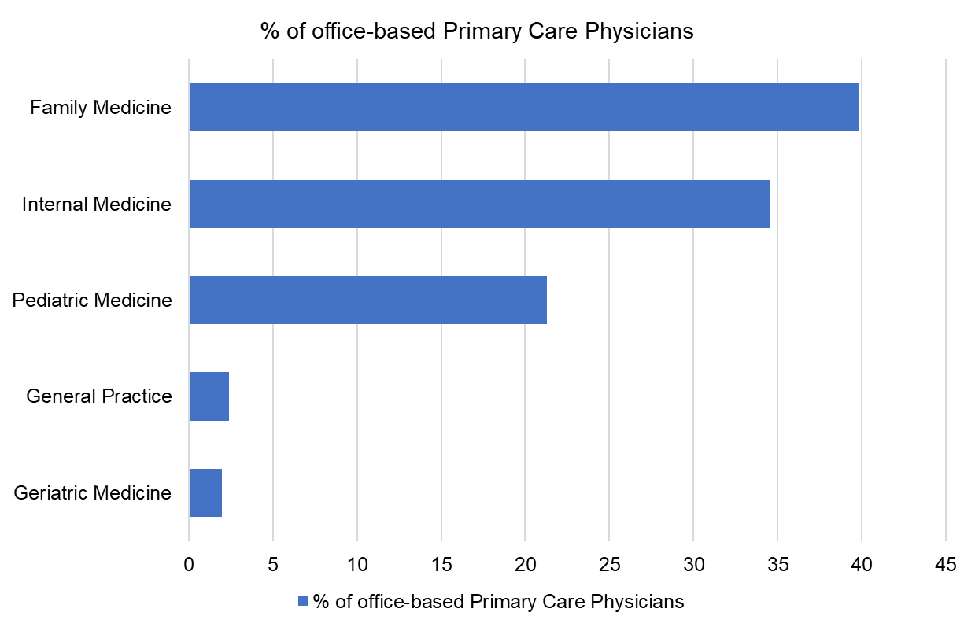
Who Are Primary Care Physicians?
Physician Characteristic
Robert Graham Center. Primary Care in the US: A Chartbook of Facts and Statistics: Table 1. Number of Office-Based, Direct Patient Care Physicians by Specialty, 2019. https://www.graham-center.org/content/dam/rgc/documents/publications-reports/reports/PrimaryCareChartbook2021.pdf. Accessed May 2021.

Slide 17
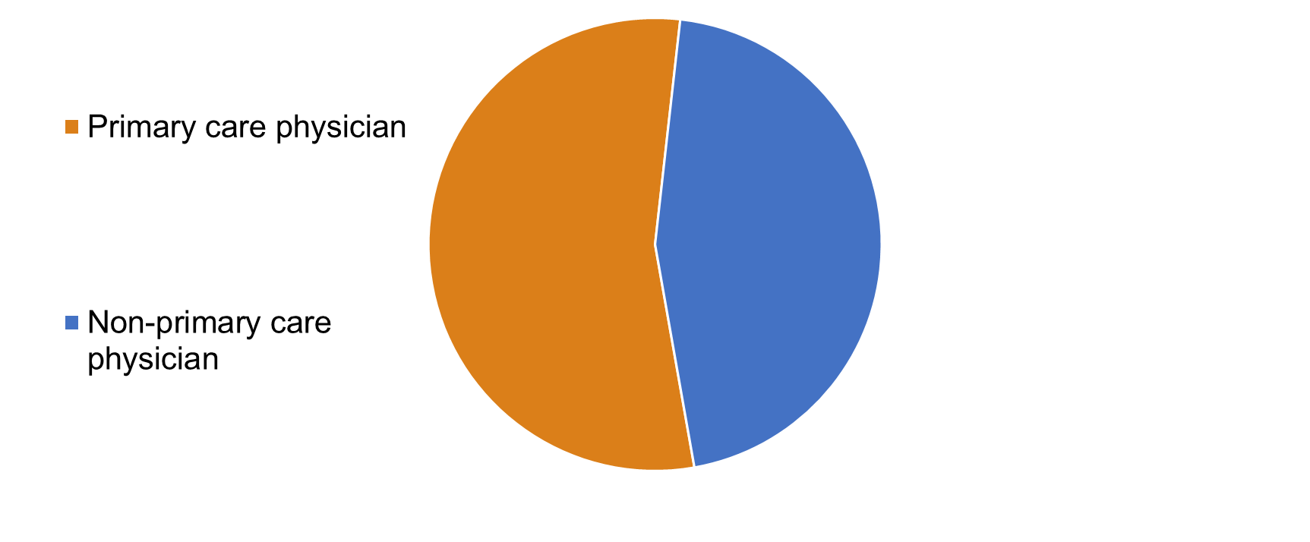
More Than Half of All Office Visits in the U.S. are to a Primary Care Physician
Source: Centers for Disease Control and Prevention. Rui P, Okeyode T. National Ambulatory Medical Care Survey: 2016 National Summary Tables. https://www.cdc.gov/nchs/data/ahcd/namcs_summary/2016_namcs_web_tables.pdf. Accessed May 2021.
Notes:
Primary care doctors see a lot of patients. In fact, half of all doctor office visits are to a primary care physician.
Often we think that these visits are distributed equally among the different primary care specialties, but that isn’t an accurate picture.
In fact when you stop to consider where primary care is being delivered, it quickly becomes clear that family physicians are providing the majority of primary care in the US.
Family physicians practice in communities of all sizes, going where the people are geographically distributed more like the U.S. population than any other specialty. That’s because family physicians are needed by everyone, allowing them to find successful practices in many settings.

Slide 18
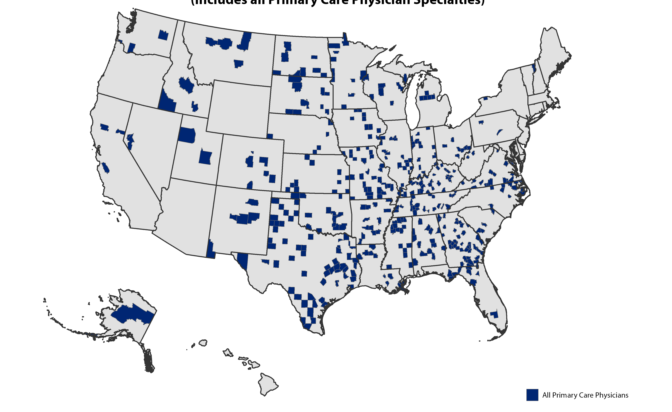
Primary Care, Underserved Areas
The areas in blue represent all the parts of the country where there are >3,000 people to 1 primary care physician
Source: HealthLandscape (2023)
Notes:
One way of seeing the impact of primary care and family medicine is to consider what happens if they went away.
What you are seeing here is a map of the United States creates in 2023 from HealthLandscape with blue highlights over counties which are considered primary care underserved areas. Underserved is defined as place where there are more than 3,000 people per physician. –which is arguably still a lot of patients for one doctor – can you imagine keeping up with 3000 patients?
And primary care physician includes family physicians, primary care pediatricians and internists and those who are considered general practice.
Let’s take a look at what would happen if primary care specialties left.

Slide 19
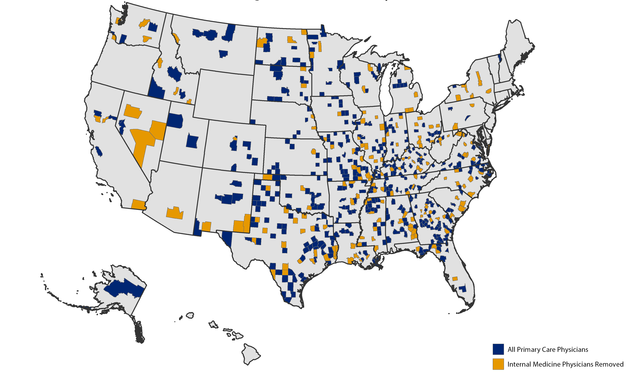
Primary Care Underserved Areas, No Internists
The areas in yellow represent all the new parts of the country where there would be >3,000 people to 1 primary care physician if internists left
Source: HealthLandscape (2023)
Notes:
So if only internal medicine physicians left the primary care work force, we would still have the blue areas that existed, but the yellow areas would now be added to the map of underserved areas.
So there would be more parts of the country without access to primary care.

Slide 20
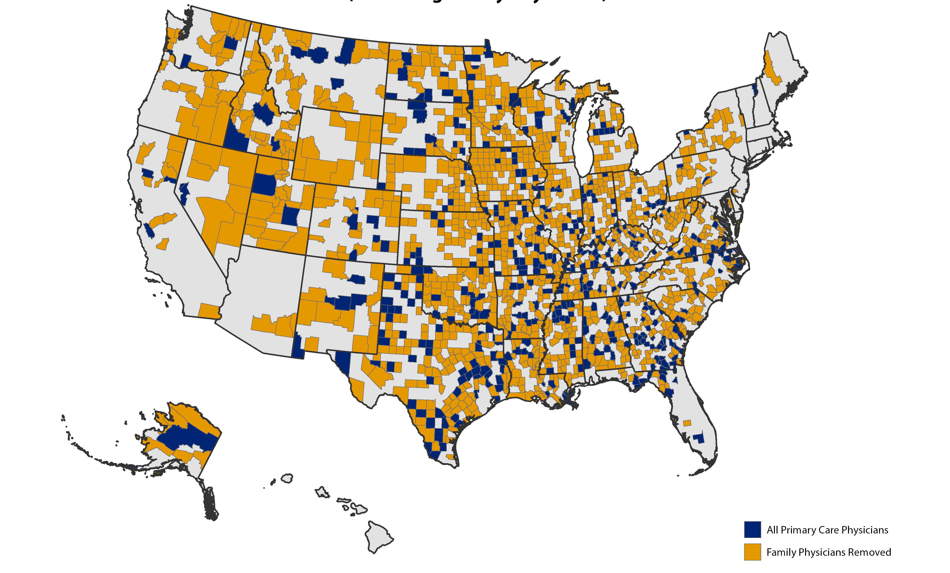
A Country with no Family Medicine...
The areas in yellow represent all the new parts of the country where there would be >3,000 people to 1 primary care physician without Family Medicine
Source: HealthLandscape (2023)
Notes:
Now. If we take family physicians out of the workforce, the entire country’s primary care system is devastated.
Family medicine is not only the largest single specialty, its graduates choose primary care careers in higher numbers than those of other traditional generalist-oriented specialties do.
family physicians, with training that is founded on the philosophy of caring for the whole person and continual emphasis on context, are the ideal specialty to care for America's most vulnerable and underserved communities.

Slide 21
People don’t need more health care, they need more family physicians
Notes:
To understand why family medicine means so much for the future, imagine what it would look like if medical schools started meeting the needs of patients and trained more primary care doctors. We already know that preventive care is the miracle that medicine is looking for. What do we see when the primary care workforce increases? Across the world, from newborns to elderly patients, everyone is healthier (Starfield B, Shi L. Policy relevant determinants of health: an international perspective. Health Policy 2002; 60(3):201-218).
At the state level, patients live longer when there is a healthy supply of family physicians. Although this is an obvious point, more health care doesn’t always lead to such outcomes. The same study to quantify the effect of family physicians on mortality also found that “greater supply of specialty physicians was associated with higher mortality.” Even more interestingly, family physicians were the only primary care specialists who were associated with having an impact on longevity. (https://www.ncbi.nlm.nih.gov/pmc/articles/PMC2690145/)

Slide 22

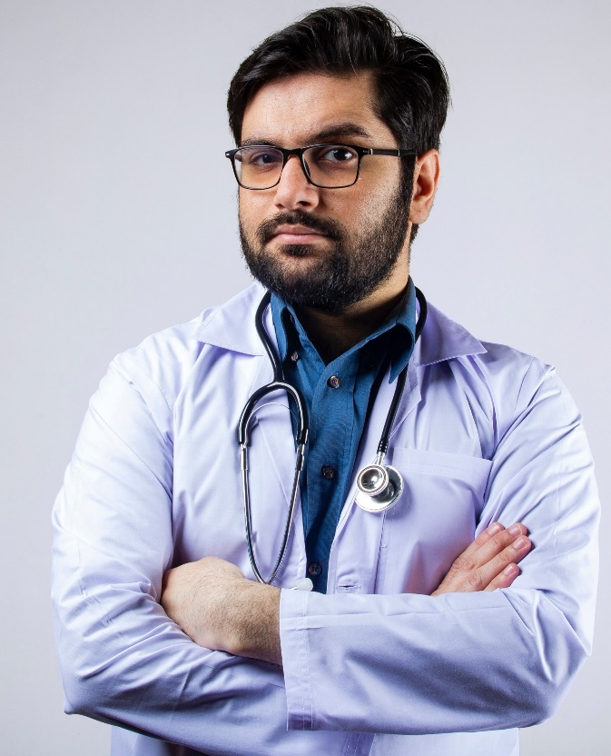
The 4 Cs of Primary Care
Care that is
first-contact,
comprehensive,
continuous, and
coordinated
Notes:
Family physicians are everywhere and taking care of everyone. As we mentioned earlier-family medicine is the only medical specialty that provides care that is first-contact, continuous, coordinated, and comprehensive. Let’s spend some time thinking about what family doctors spend their time doing.

Slide 23

The Four C’s is Not Enough
Context in care – Family Medicine includes understanding health as a result of family
and community
Notes:
From the clinic setting to the research role, every physician trained in family medicine is trained to approach health care through the lens of the whole patient. For this reason, although the commonly cited “four C’s” definition of primary care describe the specialty well, family medicine is recognized for the ways in which it goes beyond these pillars, too. As a specialty, it brings into the primary care mix a fifth C: context. Health care systems are relying more and more on physicians who are skilled at incorporating an understanding of the social determinants of health into daily practice. This greater emphasis on health in the context of the family and the community is just one reason why the family physician’s expertise is increasingly in greater and greater demand.

Slide 24
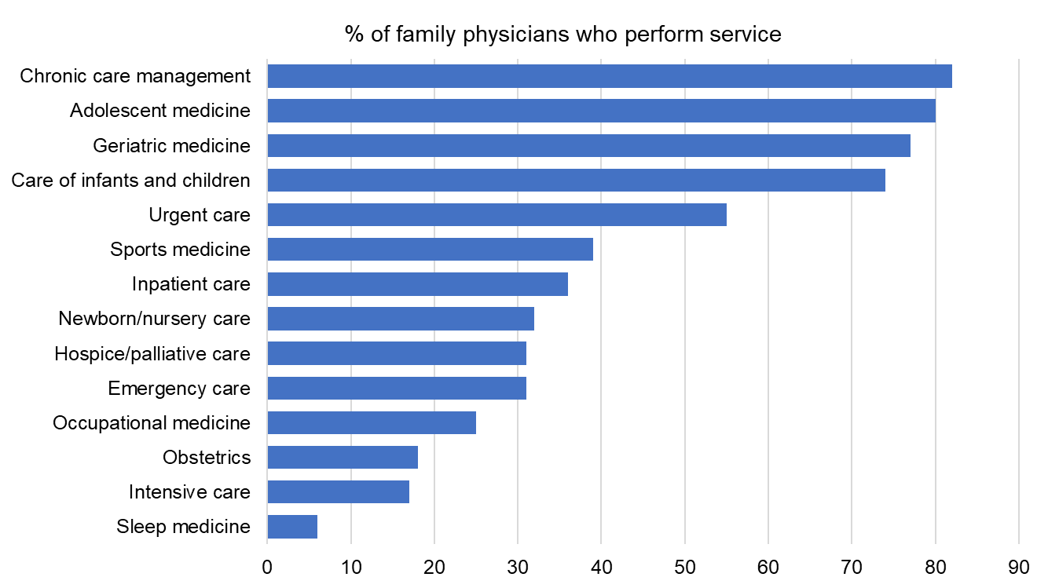
Family Physicians Specialize in Care for All
Area of Clinical Service
Source: AAFP, Family Medicine Facts. American Academy of Family Physicians Demographic Data Collection Survey, December 31, 2018. Accessed May 2021.
Notes:
A survey of family physicians who are members of the AAFP can help us sketch what that comprehensiveness looks like on the ground. First, here are a range of areas in which family physicians report providing services. Family physicians are incredibly good at practicing medicine that benefits all patients regardless of gender, age, or disease.
[If you would like to expand this table or include more slides with family medicine facts, here is a link to the AAFP’s physician survey page: http://www.aafp.org/about/the-aafp/family-medicine-facts.html]

Slide 25
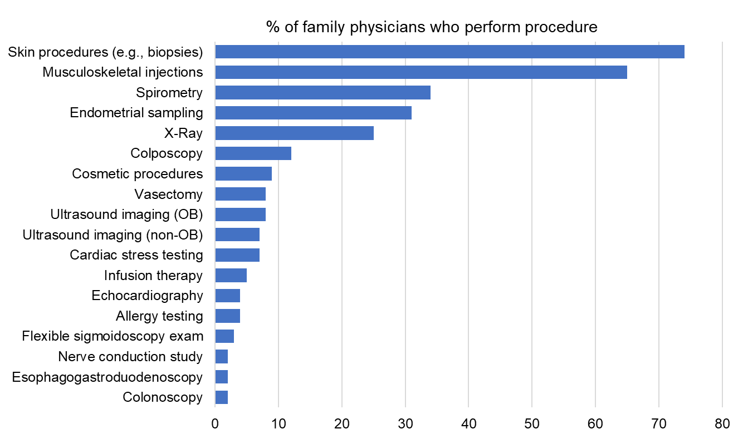
Family Medicine and Procedures
Source: AAFP, Family Medicine Facts. American Academy of Family Physicians Member Census, December 31, 2018. Accessed May 2021.
Notes:
Part of what makes family physicians incredibly good at taking care of all patients is the ability to perform a broad set of procedures. This slide outlines just a few procedures that family physicians report performing. I want to point out that these procedures capture the different areas of scope of practice: from maternity care to sports medicine and urgent care. If you find that you really like the procedures you learn throughout your various rotations, chances are you would really be a fit for family medicine because you’ll get to apply technical skill in so many different areas. Skill with a variety of procedures is key to achieving health care aims such as better population health and improved patient and clinician satisfaction.

Slide 26
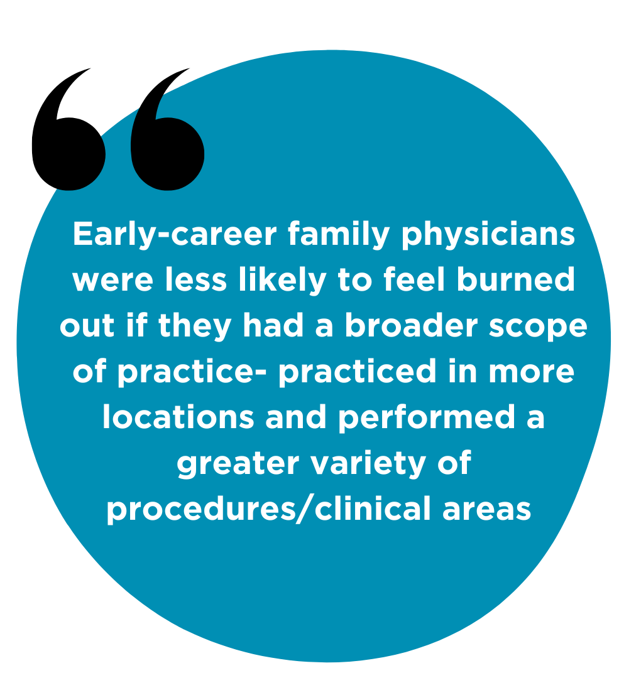

The Value of Delivering Multi-generational Care
Long-Term Relationships
Personal & Professional Satisfaction
Career Flexibility
Contributing to Community Well-being
Lifelong Learning & Growth
Source: Weidner AKH, Phillips RL Jr, Fang B, Peterson LE. Burnout and Scope of Practice in New Family Physicians. Ann Fam Med. 2018 May;16(3):200-205. doi: 10.1370/afm.2221. Erratum in: Ann Fam Med. 2018 Jul;16(4):289. PMID: 29760022; PMCID: PMC5951247.
Notes:
Some may wonder if delivering care across such a wide range of generations and settings makes the life of a family physician impossible to manage. It turns out that isn't true! In fact, family physicians with wider scopes of care actually suffer from less burnout than their colleagues. There are likely a lot of reasons for this.
The first is that caring for the whole family from grandpa to granddaughter and everyone in between is just joyful. You have the opportunity to grow with them through good times and bad and share a long term relationship and bond. While that can be painful at times like the death of a loved one, it is also richly rewarding to be available to take that journey with the family as a trust partner. That ability to contribute to caring for whole families for many family docs leads to caring for whole communities or even towns! Your opportunity to develop and be flexible withyour practice will lead to personal and professional satisfaction as you adapt and learn thoughout your own life journey.

Slide 27
What if I Have an Area of Interest?
20+ Fellowship Options*
Certificates of Added Qualification
Hospitalist medicine
Women’s health
Addiction medicine
Health policy
Community medicine
Preventive medicine
Adolescent medicine
Sports medicine
Emergency medicine
Substance abuse
Obstetrics (including surgery)
Pain medicine
HIV/AIDS care
Rural medicine
Sleep medicine
Behavioral health
Integrative medicine
Clinical informatics
International/global health
Urgent care
Geriatric medicine
Research
Hospice/palliative care
Faculty development
Notes:
Beyond residency, family physicians have a long list of options for fellowships they can pursue. These fellowships provide a route for you to pursue in-depth experience in a particular area of interest. Many family physicians with a fellowship will split their practice time, doing a majority primary care, and another part of their time providing subspecialized care. Another option for carving out a niche is a combined residency program.

Slide 28
What Can I do With a Career in Family Medicine?
Large/Small Cities
Rural and Urban
International/Global
Hospitals
Research
Nursing homes
Community health centers
Urgent care centers
Emergency rooms
Teaching centers/programs
University-based health centers
Telemedicine
Urgent Care
Health care systems
Schools/ Universities
Government
International/global health
Public Health
Leadership
Policy
Office practices
Faculty development
Notes:
Regardless of whether a family physician completes a subspeciality training program, they are well trained to work in a wide range of settings. Family physicians successfully pursue clinical and non-clinical roles, and many will add or change their scope at different parts of their career depending on their current interests and the needs of their community.

Slide 29





Snapshot of a Family Physician
For over ten years, Family Medicine has been the most recruited specialty
Weekly
16%
61 office visits
13 e-visits
8 hospital visits
1 nursing home visit
1 home visit
$274,359
51
Deliver babies
Mean income
average hours
24%
In the first seven years of practice
47%
Hospital Privileges
Source: 2023 AAFP Member Survey​
Notes:
In all, family physicians work about 51 hours per week, spending most of that time in direct patient care. Most family physicians report having about five weeks of vacation during the year. All of these factors are dependent upon the type of care system you choose to practice in.

Slide 30



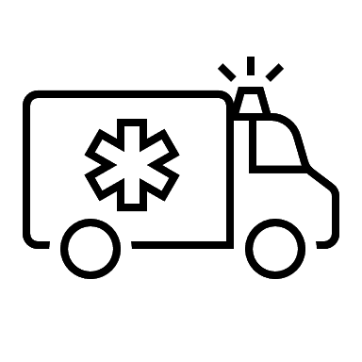
Family Medicine’s Future
Emphasis on primary care
Growing
Salary
Job market
Demand
Population
Aging population
Leadership roles
Innovation
Population & Community Health
  addressing health disparities
  delivering inclusive care
High tech, high touch skillset shaping care delivery
“Chronic care will unseat acute care”
Notes:
What else can you expect from family medicine in the years to come?
Students now can anticipate growing salary as demand increases, more need as urban centers grow and the population of the US grows and ages, greater leadership roles, and innovation in practice models.
As much as the technological side of medicine is emphasized, the “touch” part is, too. The expectation that physicians engage in shared decision making with patients already shows the turn toward the skillset of the primary care physician in the greater health care landscape. Health care reform has continually favored primary care as well and will likely continue to do so in the future.
We understand that for a treatment or preventive measure to be successful, we need to know our patients and where they live, work, and play.
Additionally, because we see more patients than any other specialty, we get a full picture of how the common health needs that emerge are interlinked with the outside world.
Family docs follow patients through their lifecycle and are therefore empowered to take action to ensure meaningful interventions are pursued. Sometimes this means working on extended teams that can put plans in motion, for example, employing a social worker or selecting staff who can advocate for patients to get the community resources they need.
Family physicians are also the regular source of care for special populations. In small communities, a family physician may be the only health care ally a patient feels that he or she has.
We are a country of chronic illness, which means managing diseases over long-term, and emphasizing preventive care

Slide 31
In Summary, Family Physicians…
Provide full-spectrum comprehensive, continuous, coordinated care to patients of all ages, for their whole life
Develop long-term, meaningful relationships with patients, leading to better job satisfaction, and better patient health
Will continue to be in high demand, allowing for better work/life balance, increased salary and growth opportunities
Enjoy the flexibility to pursue areas of interest and to practice in a variety of settings
Are specially trained to address disparities and deliver inclusive, personalized care where it is needed most
Notes:
Are a medical specialty!
Provide care to all patients for all of their lives
Enjoy building meaningful relationships with their patients as they walk with them through life
Are in high demand
Can customize their practice to their interests and the needs of their community
Are specially trained to care for individuals in the context of their life experience, their needs, and their communities.

Slide 32
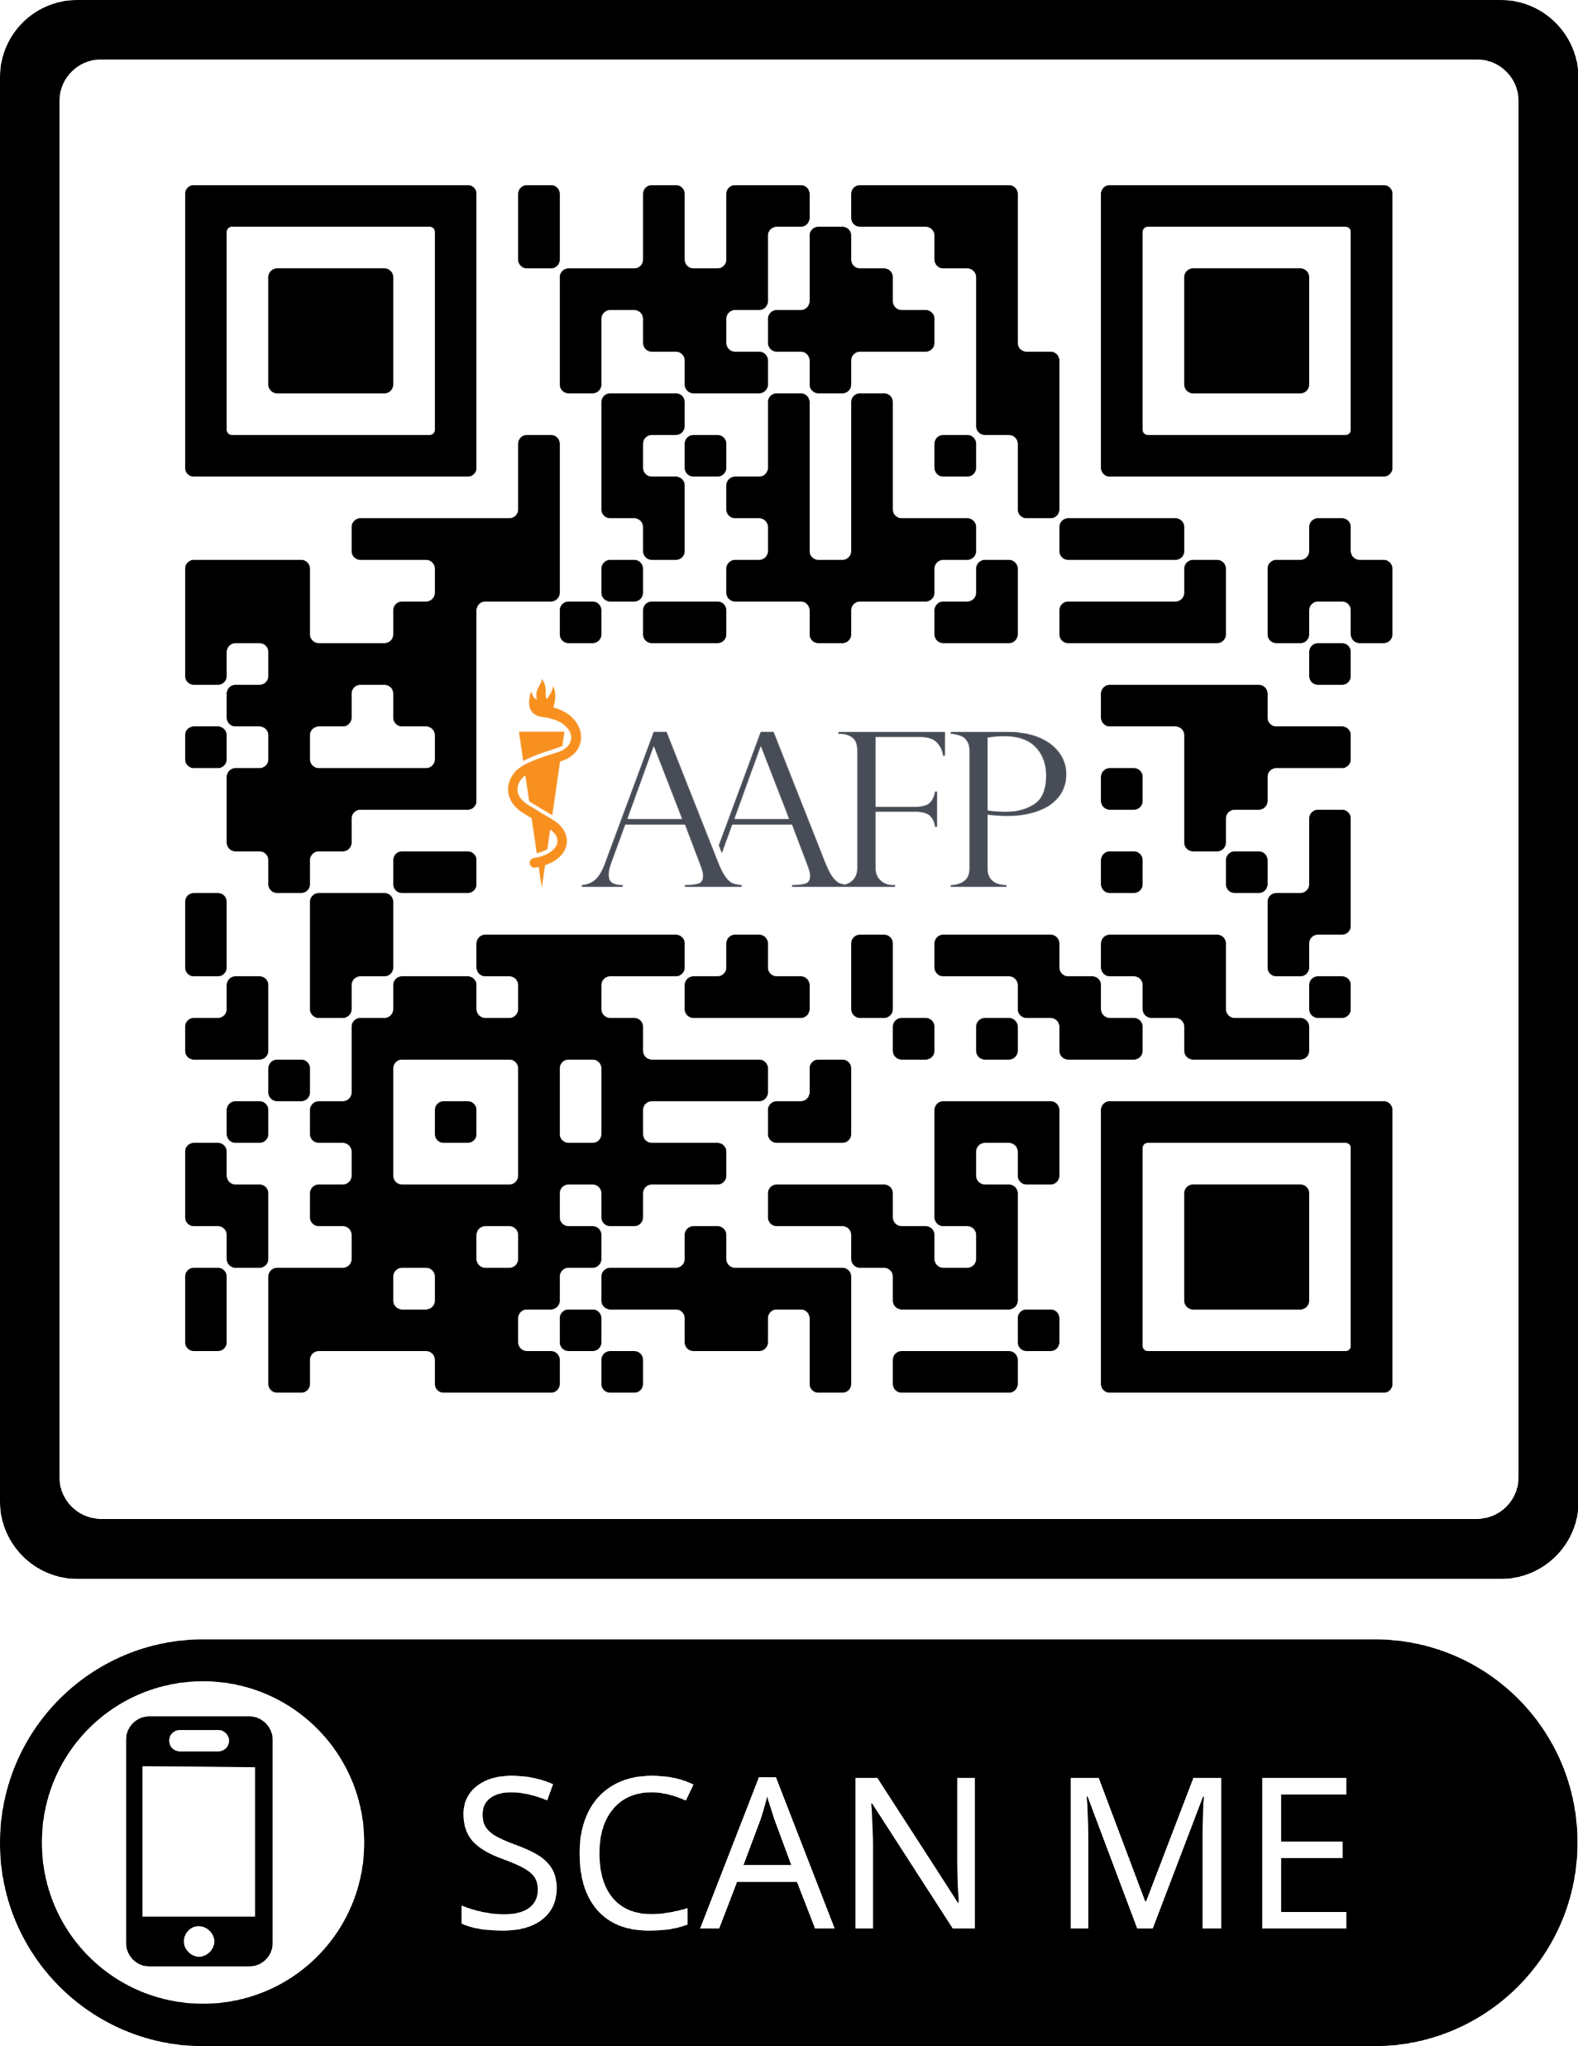


Discover family medicine.
Connect
Learn more about the events, find study resources and connect with a real family physician and/or medical student near you!
Career Test
Competitive Event
HOSA's 50-item multiple choice written exam (plus a tie-breaker essay question!) will test your knowledge in a variety of areas.
Weave together everything you learn about family medicine into a thorough and engaging presentation.
Notes:
How can you learn more?
Take the family medicine career test and compete!

Slide 33

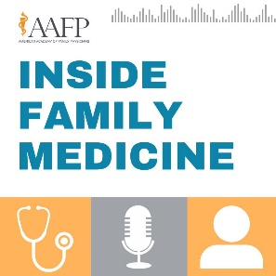




Find Family Medicine
Pre-Medical Students
AAFP Family Medicine Career Test and Family Medicine Physician Competitive Event
hosa.org/guidelines
Podcasts
Social
Stories from real family doctors pursuing their passion:
Inside Family Medicine
@FutureFamilyMed
Listen in on clinical insights:
AFP Podcast
Notes:
We’ve covered the basics of family medicine here today. The best thing you can do if you want to find out if family medicine is where you belong is meet practicing family physicians. Reach out and develop mentorships. In the first two years of medical school, you might not get to see much of this specialty, so branching out and building relationships can help you make sure you don’t miss out on this rich career in medicine. In addition to this outreach, I have on this slide a few other ideas for you.

Slide 35
Thank you!

